Slide 1


STORY · CHOICE
COURSE SLIDES · WSQ
Mastering Articulate Storyline 360 for e-Learning Content Creation
WSQ Course Code TGS-2024042308
TSC Content Strategy · ICT-SNM-4004-1.1
Provider Tertiary Infotech Academy Pte Ltd · UEN: 201200696W
Version v11 · 17 October 2026
Mastering Articulate Storyline 360 for e-Learning Content Creation · TGS-2024042308 · © 2026 Tertiary Infotech Academy Pte Ltd · 1

Slide 2
MANDATORY WSQ ADMIN
Attendance and Feedback
AM attendance
PM attendance
Complete the SSG digital attendance QR shown by the trainer.
Complete the SSG digital attendance QR after the afternoon session.
Assessment attendance
TRAQOM survey
Complete the separate digital attendance event for assessment.
Complete the TRAQOM course-quality survey when instructed; it is separate from attendance.
© 2026 Tertiary Infotech Academy Pte Ltd · Mastering Articulate Storyline 360 for e-Learning Content Creation · TGS-2024042308
2

Slide 3
FACILITATOR TEMPLATE
General Trainer Profile
Industry practice
Training practice
?
Relevant e-learning, Storyline and content-strategy experience.
Adult-learning and facilitation credentials.
TRAINER NAME
Course fit
Contact
Insert approved profile photo and professional designation before delivery.
Examples aligned to learner roles, devices and delivery channels.
Approved professional contact route.
© 2026 Tertiary Infotech Academy Pte Ltd · Mastering Articulate Storyline 360 for e-Learning Content Creation · TGS-2024042308
3

Slide 4
COURSE FACILITATOR
Dr Alfred Ang
Expertise
Facilitation
AA
Digital transformation, courseware and e-learning systems.
Concept explanation, coached Storyline practice and evidence review.
PRINCIPAL TRAINER
Quality
Learning culture
Tertiary Infotech Academy
enquiry@tertiaryinfotech.com
Traceable storyboards, accessible interactions and verified publishing.
Explain and test the reason behind every authoring decision.
© 2026 Tertiary Infotech Academy Pte Ltd · Mastering Articulate Storyline 360 for e-Learning Content Creation · TGS-2024042308
4

Slide 5
OPENING DISCUSSION
Your E-Learning Context
Role
Audience
Channel
What learning or content do you create or manage?
Who must act differently after the experience?
LMS, web, Review 360, video or facilitated delivery?
Friction
Experience
Evidence
Where does current authoring or review lose time?
Which Storyline feature is already familiar?
What artifact will prove improvement?
© 2026 Tertiary Infotech Academy Pte Ltd · Mastering Articulate Storyline 360 for e-Learning Content Creation · TGS-2024042308
5

Slide 6
GROUND RULES
Working Agreements
Participate
Respect
Protect assets
Try the tools and explain choices.
Critique the work, not the person.
Use permitted media and retain rights evidence.
Save versions
Share safely
Verify
Preserve BEGIN/END files and name working copies.
Protect learner data and assessment content.
Test preview and published output before delivery.
© 2026 Tertiary Infotech Academy Pte Ltd · Mastering Articulate Storyline 360 for e-Learning Content Creation · TGS-2024042308
6

Slide 7
LMS-TMS · LEARNER PACKAGE
Download Course Materials
lms-tms.tertiaryinfotech.com
Mastering Articulate Storyline 360
Courseware · v11
PPTX
PDF
LG
LP
14
Trainer deck
Learner slides
Detailed guide
Delivery plan
Storyline activities
Outcome · the complete package is available in one authenticated course record.
© 2026 Tertiary Infotech Academy Pte Ltd · Mastering Articulate Storyline 360 for e-Learning Content Creation · TGS-2024042308
7

Slide 8
COURSE FLOW
Four-Day Learning Journey
1
2
3
4
5
Storyboard
→
Curate
→
Interact
→
Review
→
Distribute
OUTCOME
The course moves from content intent to accessible Storyline construction, reliable interaction and governed delivery.
© 2026 Tertiary Infotech Academy Pte Ltd · Mastering Articulate Storyline 360 for e-Learning Content Creation · TGS-2024042308
8

Slide 9
CONTENT STRATEGY
Skills Framework Alignment
TSC
Course
Duration
Content Strategy · ICT-SNM-4004-1.1
TGS-2024042308
4 days · 32 hours, including 2 hours of assessment
Knowledge
Abilities
Assessment
K1–K6
A1–A7
WA 60 min · PP 60 min
© 2026 Tertiary Infotech Academy Pte Ltd · Mastering Articulate Storyline 360 for e-Learning Content Creation · TGS-2024042308
9

Slide 10
K1–K6
Knowledge Criteria
K1
K2
K3
Principles of digital storytelling
Potential customers' evolving preferences for content types, styles and modes of delivery
Process of developing a digital storyboard
K4
K5
K6
Parameters for delivering content for marketing purposes
Features of marketing content
Modes of content delivery for marketing
© 2026 Tertiary Infotech Academy Pte Ltd · Mastering Articulate Storyline 360 for e-Learning Content Creation · TGS-2024042308
10

Slide 11
A1–A7
Ability Criteria
A1
A2
Conceptualise content ideas to meet marketing objectives
Map out digital storyboards as part of a content strategy
A3
A4
Identify content requirements from customer and potential-customer preferences
Determine the frequency of delivering marketing content to customers
A5
A6
Determine the types and styles of content to deliver to customers
Determine modes and processes for distributing content
A7
Develop guidelines for content-strategy execution
© 2026 Tertiary Infotech Academy Pte Ltd · Mastering Articulate Storyline 360 for e-Learning Content Creation · TGS-2024042308
11

Slide 12
WHAT YOU WILL BE ABLE TO DO
Learning Outcomes
LO1
LO2
Conceptualise and map digital storyboards integrating principles of storytelling in Storyline 360.
Identify and determine diverse e-learning content aligned with audience preferences, industry trends and content features.
LO3
LO4
Determine effective modes and processes for distributing interactive e-learning content.
Develop guidelines and determine content delivery frequency for effective e-learning delivery.
© 2026 Tertiary Infotech Academy Pte Ltd · Mastering Articulate Storyline 360 for e-Learning Content Creation · TGS-2024042308
12

Slide 13
FOUR CONNECTED LEARNING UNITS
Course Outline
Topic 1
Topic 2
Project Architecture and Storyboard
Blank project · scenes · theme · masters · storyboard · naming · variables · navigation · preview
LO1 · A1 · A2 · K1 · K3
Media, Interaction and Accessibility
Media Library · hazards · hotspots · layers · states · triggers · motion · simulation · audio · captions
LO2 · A3 · A5 · K2 · K5
Topic 3
Topic 4
Branching, Questions and Results
Branching · freeform · feedback · question banks · result slide · retry · review · completion
LO3 · A6 · K6
Review, Publishing and Governance
Player · translation · Review 360 · SCORM 1.2/2004 · Tin Can xAPI · LMS/LRS tests · retention
LO4 · A4 · A7 · K4
© 2026 Tertiary Infotech Academy Pte Ltd · Mastering Articulate Storyline 360 for e-Learning Content Creation · TGS-2024042308
13

Slide 14
BEFORE ASSESSMENT
Assessment Briefing
Individual
References
Phones
Complete your own work with no discussion.
Use only materials approved by the assessor.
Place phones and other unapproved materials under the table.
Time
Submission
Outcome
WA 60 min · PP 60 min.
Complete the provided document and upload through LMS-TMS.
Competent or Not Yet Competent, with reassessment and appeal rights.
© 2026 Tertiary Infotech Academy Pte Ltd · Mastering Articulate Storyline 360 for e-Learning Content Creation · TGS-2024042308
14

Slide 15
SUMMATIVE EVIDENCE
Assessment Design
1
2
3
4
5
WA · K1–K6
→
PP · A1–A2
→
PP · A3–A5
→
PP · A6
→
PP · A4 + A7
OUTCOME
Six written questions and four practical tasks; each instrument is 60 minutes and open book.
© 2026 Tertiary Infotech Academy Pte Ltd · Mastering Articulate Storyline 360 for e-Learning Content Creation · TGS-2024042308
15

Slide 16
AUTHORING READINESS
Tools, Materials and Workspace
Hardware
Software
Workspace
A supported Windows laptop, suitable display, mouse and reliable storage.
Current supported Articulate Storyline 360 desktop release.
Local working folder with short paths and separate backup.
Sources
Output brief
Safety
Rights-cleared pictures, audio, video, scripts and brand materials.
Audience, device, channel, tracking, accessibility and update requirements.
Versioned .story files, protected assessment content and verified publishes.
© 2026 Tertiary Infotech Academy Pte Ltd · Mastering Articulate Storyline 360 for e-Learning Content Creation · TGS-2024042308
16

Slide 17
TOOL CONTEXT
Storyline Scope
Industry use
Windows authoring
Interface drift
Interactive e-learning, simulations, quizzes, scenarios and tracked packages.
Storyline desktop authoring requires a supported Windows environment.
Labels may move as releases evolve; authoring principles remain stable.
Decision over clicks
Responsible AI
Trademark
Choose features by purpose, audience, accessibility and delivery.
Review outputs and retain provenance and permission evidence.
Articulate and Storyline are Articulate trademarks; this course is provider-developed.
© 2026 Tertiary Infotech Academy Pte Ltd · Mastering Articulate Storyline 360 for e-Learning Content Creation · TGS-2024042308
17

Slide 18
01
Project Architecture and Storyboard
Blank project · scenes · theme · masters · storyboard · naming · variables · navigation · preview
LO1 · A1 · A2 · K1 · K3
© 2026 Tertiary Infotech Academy Pte Ltd · Mastering Articulate Storyline 360 for e-Learning Content Creation · TGS-2024042308
18

Slide 19
EDITABLE STORYBOARD-PLANNING CHART
Where Authoring Effort Accumulates
Story map
15
READ THE CHART
Screen design
20
Illustrative planning split: interactivity is only one workload. Story architecture, media readiness and review evidence must be planned before production.
Media
20
Interaction
25
Review + QA
20
Editable PowerPoint shape chart
Relative effort
© 2026 Tertiary Infotech Academy Pte Ltd · Mastering Articulate Storyline 360 for e-Learning Content Creation · TGS-2024042308
Course planning model
19

Slide 20
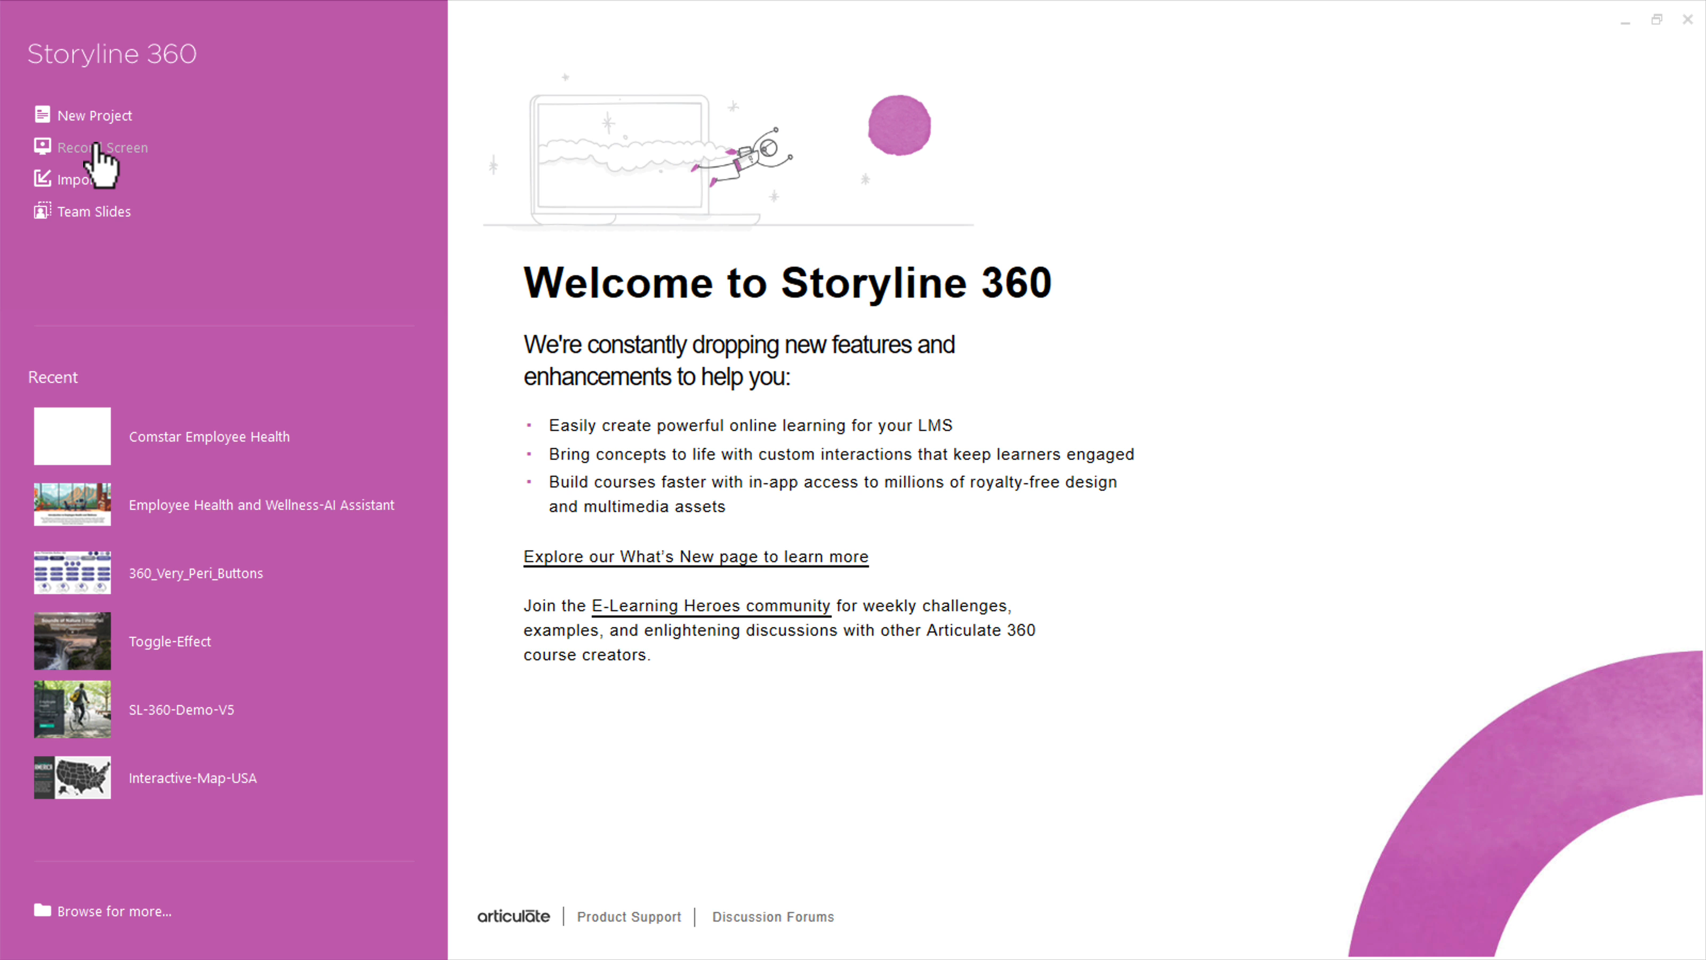
CONCEPT 01 · INTERFACE ORIENTATION
Local project baseline
NAMED ARTIFACT
WSA-001-Local-project-baseline
MECHANISM
File > Save As creates WSA-YourName-v01.story on a local Windows drive
EXPECTED
v01 opens locally and the checksum/modified time identifies the retained…
Authentic Articulate interface reference · verify the named control
© 2026 Tertiary Infotech Academy Pte Ltd · Mastering Articulate Storyline 360 for e-Learning Content Creation · TGS-2024042308
Articulate Storyline 360 official guidance; v11 technical anchor register
20

Slide 21
INTERFACE · NAMED CONFIGURATION
Local project baseline
SET THESE CONTROLS
C1=short local path · C2=version suffix · C3=backup copy
REJECT WHEN
network/removable-drive authoring; overwriting the baseline
VERIFY READBACK
v01 opens locally and the checksum/modified time identifies the retained…
Authentic Articulate interface reference · verify the named control
© 2026 Tertiary Infotech Academy Pte Ltd · Mastering Articulate Storyline 360 for e-Learning Content Creation · TGS-2024042308
Articulate Storyline 360 official guidance; v11 technical anchor register
21

Slide 22
TECHNICAL ANCHOR 001 · WORKED SYNTHETIC TRACE
Local project baseline
FAULTY OUTPUT (EXAMPLE)
network/removable-drive authoring; overwriting the baseline
FIX IN NAMED PANEL
short local path; version suffix; backup copy
EXPECTED AFTER FIX
v01 opens locally and the checksum/modified time identifies the retained…
Authentic Articulate interface reference · verify the named control
© 2026 Tertiary Infotech Academy Pte Ltd · Mastering Articulate Storyline 360 for e-Learning Content Creation · TGS-2024042308
Articulate Storyline 360 official guidance; v11 technical anchor register
22

Slide 23
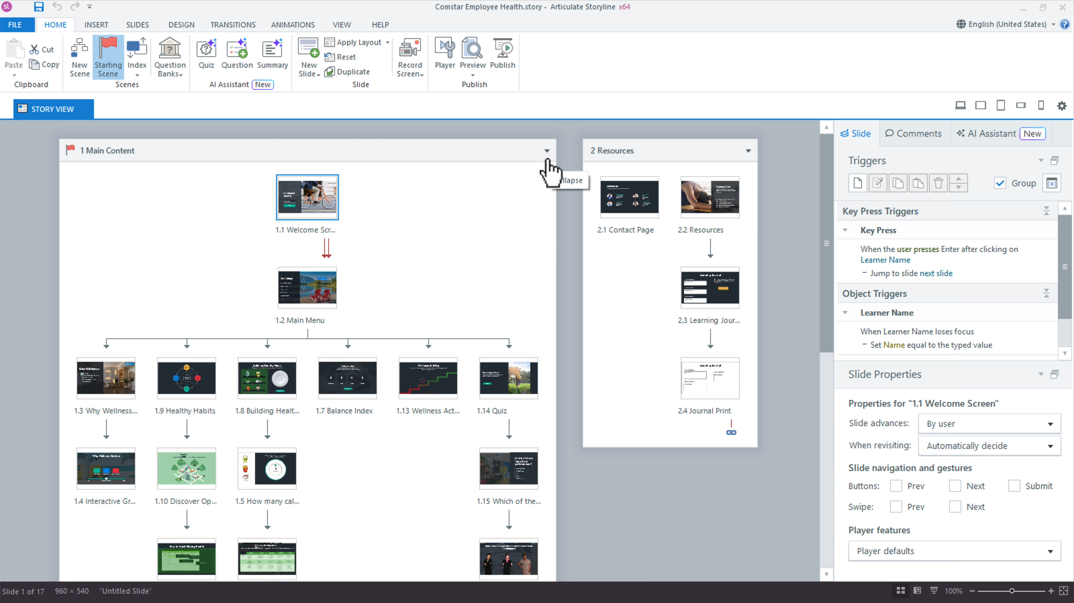
CONCEPT 02 · INTERFACE ORIENTATION
Story View scene architecture
NAMED ARTIFACT
WSA-002-Story-View-scene-architecture
MECHANISM
Story View groups Welcome, Learn, Practise, Quiz and Resources scenes and…
EXPECTED
every route has an intended entry, return and terminal slide
Authentic Articulate interface reference · verify the named control
© 2026 Tertiary Infotech Academy Pte Ltd · Mastering Articulate Storyline 360 for e-Learning Content Creation · TGS-2024042308
Articulate Storyline 360 official guidance; v11 technical anchor register
23

Slide 24
INTERFACE · NAMED CONFIGURATION
Story View scene architecture
SET THESE CONTROLS
C1=scene names · C2=start scene · C3=slide order · C4=jump targets
REJECT WHEN
assuming canvas order controls runtime navigation
VERIFY READBACK
every route has an intended entry, return and terminal slide
Authentic Articulate interface reference · verify the named control
© 2026 Tertiary Infotech Academy Pte Ltd · Mastering Articulate Storyline 360 for e-Learning Content Creation · TGS-2024042308
Articulate Storyline 360 official guidance; v11 technical anchor register
24

Slide 25
TECHNICAL ANCHOR 002 · WORKED SYNTHETIC TRACE
Story View scene architecture
FAULTY OUTPUT (EXAMPLE)
assuming canvas order controls runtime navigation
FIX IN NAMED PANEL
scene names; start scene; slide order; jump targets
EXPECTED AFTER FIX
every route has an intended entry, return and terminal slide · verify in…
Authentic Articulate interface reference · verify the named control
© 2026 Tertiary Infotech Academy Pte Ltd · Mastering Articulate Storyline 360 for e-Learning Content Creation · TGS-2024042308
Articulate Storyline 360 official guidance; v11 technical anchor register
25

Slide 26
CONCEPT 03 · HOW IT WORKS
Slide size and safe area
Named HarbourLink WSH artifact
Input / source state
WSA-003-Slide-size-and-safe-area
WSA checkpoint plus 16:9 size; player chrome; caption area; minimum target size
Runtime mechanism
Expected output
Design > Slide Size fixes the authoring canvas before layouts and media are placed
preview at the intended player size keeps controls and captions visible
Rejected output
Evidence record
changing size after build and clipping controls
WSA-003-Slide-size-and-safe-area: capture the configured control and the runtime readback.
© 2026 Tertiary Infotech Academy Pte Ltd · Mastering Articulate Storyline 360 for e-Learning Content Creation · TGS-2024042308
Articulate Storyline 360 official guidance; v11 technical anchor register
26

Slide 27
EDITABLE CONFIGURATION MODEL
Slide size and safe area
SET THESE CONTROLS
REJECT WHEN
VERIFY READBACK
C1=16:9 size · C2=player chrome · C3=caption area · C4=minimum target size
changing size after build and clipping controls
preview at the intended player size keeps controls and captions visible
→
→
Editable HarbourLink model · preview at the intended player size keeps controls and captions visible
© 2026 Tertiary Infotech Academy Pte Ltd · Mastering Articulate Storyline 360 for e-Learning Content Creation · TGS-2024042308
Articulate Storyline 360 official guidance; v11 technical anchor register
27

Slide 28
TECHNICAL ANCHOR 003 · WORKED SYNTHETIC TRACE
Slide size and safe area
FAULTY OUTPUT (EXAMPLE)
CORRECT THE RECORD
EXPECTED AFTER FIX
changing size after build and clipping controls
16:9 size; player chrome; caption area; minimum target size
preview at the intended player size keeps controls and captions visible · verify in your own Preview
→
→
Editable HarbourLink model · preview at the intended player size keeps controls and captions visible
© 2026 Tertiary Infotech Academy Pte Ltd · Mastering Articulate Storyline 360 for e-Learning Content Creation · TGS-2024042308
Articulate Storyline 360 official guidance; v11 technical anchor register
28

Slide 29
CONCEPT 04 · HOW IT WORKS
Theme fonts and colours
Named HarbourLink WSH artifact
Input / source state
WSA-004-Theme-fonts-and-colours
WSA checkpoint plus heading/body fonts; contrast; semantic colours; theme naming
Runtime mechanism
Expected output
Design > Fonts > Create New Theme Fonts and Design > Colors > Create New Theme Colors define the HarbourLink palette; Design > Themes saves the combined theme
theme values reproduce consistently on three representative slides
Rejected output
Evidence record
manual near-match colours and colour-only meaning
WSA-004-Theme-fonts-and-colours: capture the configured control and the runtime readback.
© 2026 Tertiary Infotech Academy Pte Ltd · Mastering Articulate Storyline 360 for e-Learning Content Creation · TGS-2024042308
Articulate Storyline 360 official guidance; v11 technical anchor register
29

Slide 30
EDITABLE CONFIGURATION MODEL
Theme fonts and colours
SET THESE CONTROLS
REJECT WHEN
VERIFY READBACK
C1=heading/body fonts · C2=contrast · C3=semantic colours · C4=theme naming
manual near-match colours and colour-only meaning
theme values reproduce consistently on three representative slides
→
→
Editable HarbourLink model · theme values reproduce consistently on three representative slides
© 2026 Tertiary Infotech Academy Pte Ltd · Mastering Articulate Storyline 360 for e-Learning Content Creation · TGS-2024042308
Articulate Storyline 360 official guidance; v11 technical anchor register
30

Slide 31
TECHNICAL ANCHOR 004 · WORKED SYNTHETIC TRACE
Theme fonts and colours
FAULTY OUTPUT (EXAMPLE)
CORRECT THE RECORD
EXPECTED AFTER FIX
manual near-match colours and colour-only meaning
heading/body fonts; contrast; semantic colours; theme naming
theme values reproduce consistently on three representative slides · verify in your own Preview
→
→
Editable HarbourLink model · theme values reproduce consistently on three representative slides
© 2026 Tertiary Infotech Academy Pte Ltd · Mastering Articulate Storyline 360 for e-Learning Content Creation · TGS-2024042308
Articulate Storyline 360 official guidance; v11 technical anchor register
31

Slide 32
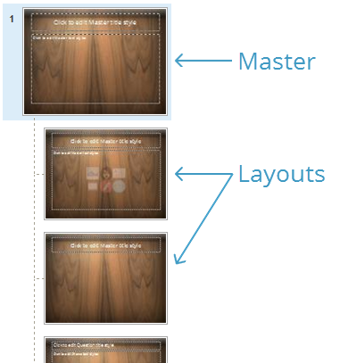
CONCEPT 05 · INTERFACE ORIENTATION
Slide master hierarchy
NAMED ARTIFACT
WSA-005-Slide-master-hierarchy
MECHANISM
View > Slide Master defines title, content, scenario and quiz layouts with…
EXPECTED
new slides inherit geometry without unwanted objects
Authentic Articulate interface reference · verify the named control
© 2026 Tertiary Infotech Academy Pte Ltd · Mastering Articulate Storyline 360 for e-Learning Content Creation · TGS-2024042308
Articulate Storyline 360 official guidance; v11 technical anchor register
32

Slide 33
INTERFACE · NAMED CONFIGURATION
Slide master hierarchy
SET THESE CONTROLS
C1=master · C2=layout · C3=placeholder · C4=background · C5=inheritance
REJECT WHEN
placing course-specific content on the master
VERIFY READBACK
new slides inherit geometry without unwanted objects
Authentic Articulate interface reference · verify the named control
© 2026 Tertiary Infotech Academy Pte Ltd · Mastering Articulate Storyline 360 for e-Learning Content Creation · TGS-2024042308
Articulate Storyline 360 official guidance; v11 technical anchor register
33

Slide 34
TECHNICAL ANCHOR 005 · WORKED SYNTHETIC TRACE
Slide master hierarchy
FAULTY OUTPUT (EXAMPLE)
placing course-specific content on the master
FIX IN NAMED PANEL
master; layout; placeholder; background; inheritance
EXPECTED AFTER FIX
new slides inherit geometry without unwanted objects · verify in your own…
Authentic Articulate interface reference · verify the named control
© 2026 Tertiary Infotech Academy Pte Ltd · Mastering Articulate Storyline 360 for e-Learning Content Creation · TGS-2024042308
Articulate Storyline 360 official guidance; v11 technical anchor register
34

Slide 35
CONCEPT 06 · HOW IT WORKS
Storyboard screen specification
Named HarbourLink WSH artifact
Input / source state
WSA-006-Storyboard-screen-specification
WSA checkpoint plus unique IDs; owner; status; evidence; source
Runtime mechanism
Expected output
The supplied CSV maps screen ID, purpose, narration, asset, interaction, branch and accessibility
each Storyline slide maps to one storyboard row and acceptance check
Rejected output
Evidence record
building before branch and accessibility fields are resolved
WSA-006-Storyboard-screen-specification: capture the configured control and the runtime readback.
© 2026 Tertiary Infotech Academy Pte Ltd · Mastering Articulate Storyline 360 for e-Learning Content Creation · TGS-2024042308
Articulate Storyline 360 official guidance; v11 technical anchor register
35

Slide 36
EDITABLE CONFIGURATION MODEL
Storyboard screen specification
SET THESE CONTROLS
REJECT WHEN
VERIFY READBACK
C1=unique IDs · C2=owner · C3=status · C4=evidence · C5=source
building before branch and accessibility fields are resolved
each Storyline slide maps to one storyboard row and acceptance check
→
→
Editable HarbourLink model · each Storyline slide maps to one storyboard row and acceptance check
© 2026 Tertiary Infotech Academy Pte Ltd · Mastering Articulate Storyline 360 for e-Learning Content Creation · TGS-2024042308
Articulate Storyline 360 official guidance; v11 technical anchor register
36

Slide 37
TECHNICAL ANCHOR 006 · WORKED SYNTHETIC TRACE
Storyboard screen specification
FAULTY OUTPUT (EXAMPLE)
CORRECT THE RECORD
EXPECTED AFTER FIX
building before branch and accessibility fields are resolved
unique IDs; owner; status; evidence; source
each Storyline slide maps to one storyboard row and acceptance check · verify in your own Preview
→
→
Editable HarbourLink model · each Storyline slide maps to one storyboard row and acceptance check
© 2026 Tertiary Infotech Academy Pte Ltd · Mastering Articulate Storyline 360 for e-Learning Content Creation · TGS-2024042308
Articulate Storyline 360 official guidance; v11 technical anchor register
37

Slide 38
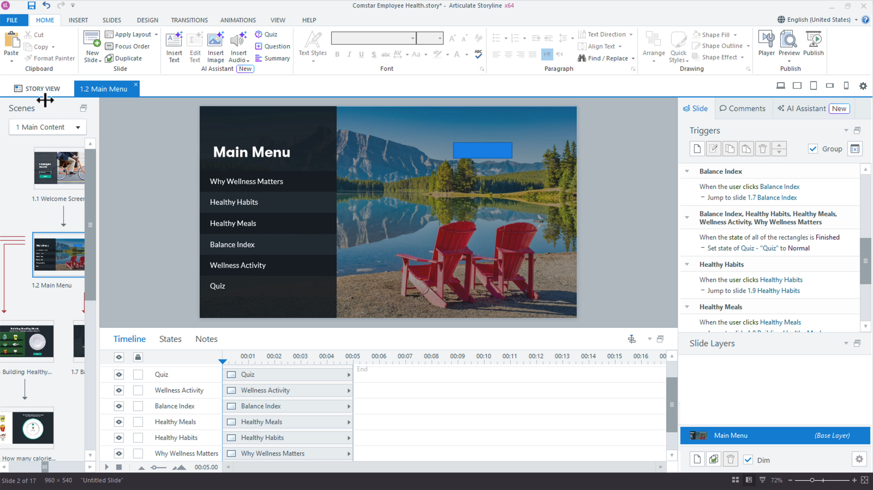
CONCEPT 07 · INTERFACE ORIENTATION
Object naming discipline
NAMED ARTIFACT
WSA-007-Object-naming-discipline
MECHANISM
Timeline object names encode type and purpose such as btn_Hazard01 and…
EXPECTED
trigger and focus panels can be audited without selecting each object
Authentic Articulate interface reference · verify the named control
© 2026 Tertiary Infotech Academy Pte Ltd · Mastering Articulate Storyline 360 for e-Learning Content Creation · TGS-2024042308
Articulate Storyline 360 official guidance; v11 technical anchor register
38

Slide 39
INTERFACE · NAMED CONFIGURATION
Object naming discipline
SET THESE CONTROLS
C1=prefixes · C2=unique names · C3=layer names · C4=variable names
REJECT WHEN
leaving Rectangle 17 or duplicate names
VERIFY READBACK
trigger and focus panels can be audited without selecting each object
Authentic Articulate interface reference · verify the named control
© 2026 Tertiary Infotech Academy Pte Ltd · Mastering Articulate Storyline 360 for e-Learning Content Creation · TGS-2024042308
Articulate Storyline 360 official guidance; v11 technical anchor register
39

Slide 40
TECHNICAL ANCHOR 007 · WORKED SYNTHETIC TRACE
Object naming discipline
FAULTY OUTPUT (EXAMPLE)
leaving Rectangle 17 or duplicate names
FIX IN NAMED PANEL
prefixes; unique names; layer names; variable names
EXPECTED AFTER FIX
trigger and focus panels can be audited without selecting each object ·…
Authentic Articulate interface reference · verify the named control
© 2026 Tertiary Infotech Academy Pte Ltd · Mastering Articulate Storyline 360 for e-Learning Content Creation · TGS-2024042308
Articulate Storyline 360 official guidance; v11 technical anchor register
40

Slide 41
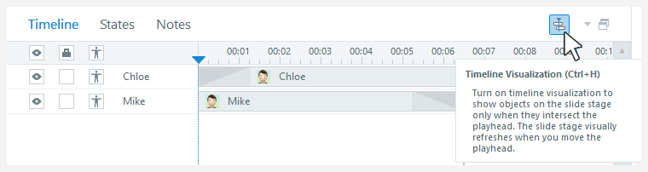
CONCEPT 08 · INTERFACE ORIENTATION
Timeline timing model
NAMED ARTIFACT
WSA-008-Timeline-timing-model
MECHANISM
Timeline start, duration and cue points coordinate narration, captions and…
EXPECTED
preview timing matches the narration script at each cue point
Authentic Articulate interface reference · verify the named control
© 2026 Tertiary Infotech Academy Pte Ltd · Mastering Articulate Storyline 360 for e-Learning Content Creation · TGS-2024042308
Articulate Storyline 360 official guidance; v11 technical anchor register
41

Slide 42
INTERFACE · NAMED CONFIGURATION
Timeline timing model
SET THESE CONTROLS
C1=playhead · C2=cue point · C3=show until end · C4=align to playhead
REJECT WHEN
objects appearing before narration or disappearing on revisit
VERIFY READBACK
preview timing matches the narration script at each cue point
Authentic Articulate interface reference · verify the named control
© 2026 Tertiary Infotech Academy Pte Ltd · Mastering Articulate Storyline 360 for e-Learning Content Creation · TGS-2024042308
Articulate Storyline 360 official guidance; v11 technical anchor register
42

Slide 43
TECHNICAL ANCHOR 008 · WORKED SYNTHETIC TRACE
Timeline timing model
FAULTY OUTPUT (EXAMPLE)
objects appearing before narration or disappearing on revisit
FIX IN NAMED PANEL
playhead; cue point; show until end; align to playhead
EXPECTED AFTER FIX
preview timing matches the narration script at each cue point · verify in…
Authentic Articulate interface reference · verify the named control
© 2026 Tertiary Infotech Academy Pte Ltd · Mastering Articulate Storyline 360 for e-Learning Content Creation · TGS-2024042308
Articulate Storyline 360 official guidance; v11 technical anchor register
43

Slide 44
CONCEPT 09 · HOW IT WORKS
Alignment and guides
Named HarbourLink WSH artifact
Input / source state
WSA-009-Alignment-and-guides
WSA checkpoint plus guides; margins; distribute; aspect ratio
Runtime mechanism
Expected output
View guides plus Align and Distribute create a repeatable grid for text and controls
shared edges and spacing remain consistent at delivery size
Rejected output
Evidence record
pixel drift and stretched images
WSA-009-Alignment-and-guides: capture the configured control and the runtime readback.
© 2026 Tertiary Infotech Academy Pte Ltd · Mastering Articulate Storyline 360 for e-Learning Content Creation · TGS-2024042308
Articulate Storyline 360 official guidance; v11 technical anchor register
44

Slide 45
EDITABLE CONFIGURATION MODEL
Alignment and guides
SET THESE CONTROLS
REJECT WHEN
VERIFY READBACK
C1=guides · C2=margins · C3=distribute · C4=aspect ratio
pixel drift and stretched images
shared edges and spacing remain consistent at delivery size
→
→
Editable HarbourLink model · shared edges and spacing remain consistent at delivery size
© 2026 Tertiary Infotech Academy Pte Ltd · Mastering Articulate Storyline 360 for e-Learning Content Creation · TGS-2024042308
Articulate Storyline 360 official guidance; v11 technical anchor register
45

Slide 46
TECHNICAL ANCHOR 009 · WORKED SYNTHETIC TRACE
Alignment and guides
FAULTY OUTPUT (EXAMPLE)
CORRECT THE RECORD
EXPECTED AFTER FIX
pixel drift and stretched images
guides; margins; distribute; aspect ratio
shared edges and spacing remain consistent at delivery size · verify in your own Preview
→
→
Editable HarbourLink model · shared edges and spacing remain consistent at delivery size
© 2026 Tertiary Infotech Academy Pte Ltd · Mastering Articulate Storyline 360 for e-Learning Content Creation · TGS-2024042308
Articulate Storyline 360 official guidance; v11 technical anchor register
46

Slide 47
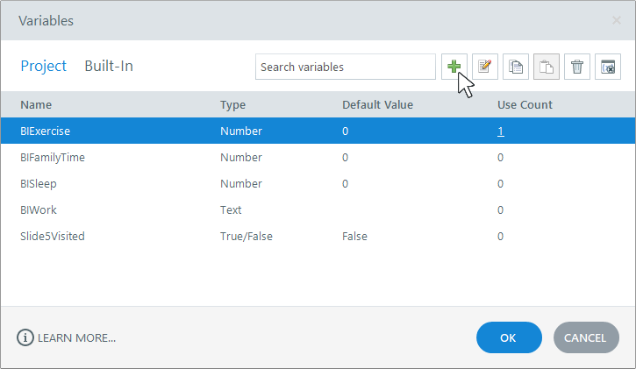
CONCEPT 10 · INTERFACE ORIENTATION
Project variables register
NAMED ARTIFACT
WSA-010-Project-variables-register
MECHANISM
Manage Project Variables defines typed names, defaults, purpose and reset…
EXPECTED
variable reference panel matches the supplied logic register
Authentic Articulate interface reference · verify the named control
© 2026 Tertiary Infotech Academy Pte Ltd · Mastering Articulate Storyline 360 for e-Learning Content Creation · TGS-2024042308
Articulate Storyline 360 official guidance; v11 technical anchor register
47

Slide 48
INTERFACE · NAMED CONFIGURATION
Project variables register
SET THESE CONTROLS
C1=True/False · C2=Number · C3=Text · C4=default · C5=scope
REJECT WHEN
variables with ambiguous names or stale values
VERIFY READBACK
variable reference panel matches the supplied logic register
Authentic Articulate interface reference · verify the named control
© 2026 Tertiary Infotech Academy Pte Ltd · Mastering Articulate Storyline 360 for e-Learning Content Creation · TGS-2024042308
Articulate Storyline 360 official guidance; v11 technical anchor register
48

Slide 49
TECHNICAL ANCHOR 010 · WORKED SYNTHETIC TRACE
Project variables register
FAULTY OUTPUT (EXAMPLE)
variables with ambiguous names or stale values
FIX IN NAMED PANEL
True/False; Number; Text; default; scope
EXPECTED AFTER FIX
variable reference panel matches the supplied logic register · verify in…
Authentic Articulate interface reference · verify the named control
© 2026 Tertiary Infotech Academy Pte Ltd · Mastering Articulate Storyline 360 for e-Learning Content Creation · TGS-2024042308
Articulate Storyline 360 official guidance; v11 technical anchor register
49

Slide 50
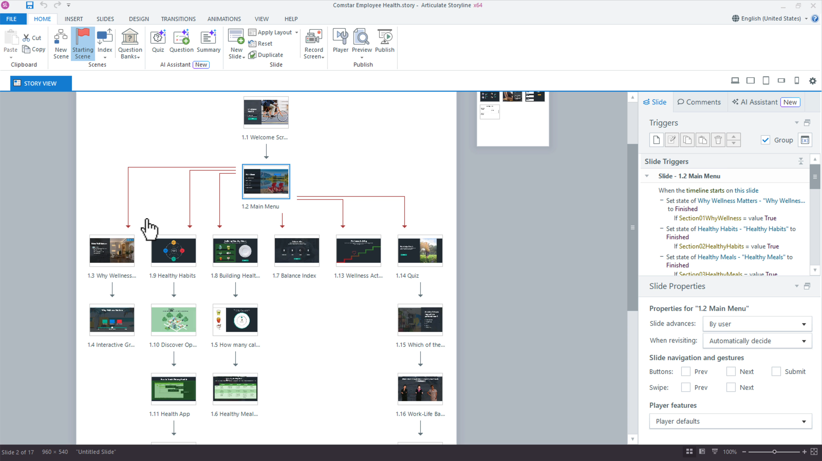
CONCEPT 11 · INTERFACE ORIENTATION
Scene menu navigation
NAMED ARTIFACT
WSA-011-Scene-menu-navigation
MECHANISM
A custom menu uses explicit Jump to slide triggers and visited states
EXPECTED
keyboard and pointer routes reach all four learning topics and return
Authentic Articulate interface reference · verify the named control
© 2026 Tertiary Infotech Academy Pte Ltd · Mastering Articulate Storyline 360 for e-Learning Content Creation · TGS-2024042308
Articulate Storyline 360 official guidance; v11 technical anchor register
50

Slide 51
INTERFACE · NAMED CONFIGURATION
Scene menu navigation
SET THESE CONTROLS
C1=button state · C2=destination · C3=focus order · C4=return path
REJECT WHEN
relying on slide order or trapping the learner
VERIFY READBACK
keyboard and pointer routes reach all four learning topics and return
Authentic Articulate interface reference · verify the named control
© 2026 Tertiary Infotech Academy Pte Ltd · Mastering Articulate Storyline 360 for e-Learning Content Creation · TGS-2024042308
Articulate Storyline 360 official guidance; v11 technical anchor register
51

Slide 52
TECHNICAL ANCHOR 011 · WORKED SYNTHETIC TRACE
Scene menu navigation
FAULTY OUTPUT (EXAMPLE)
relying on slide order or trapping the learner
FIX IN NAMED PANEL
button state; destination; focus order; return path
EXPECTED AFTER FIX
keyboard and pointer routes reach all four learning topics and return ·…
Authentic Articulate interface reference · verify the named control
© 2026 Tertiary Infotech Academy Pte Ltd · Mastering Articulate Storyline 360 for e-Learning Content Creation · TGS-2024042308
Articulate Storyline 360 official guidance; v11 technical anchor register
52

Slide 53
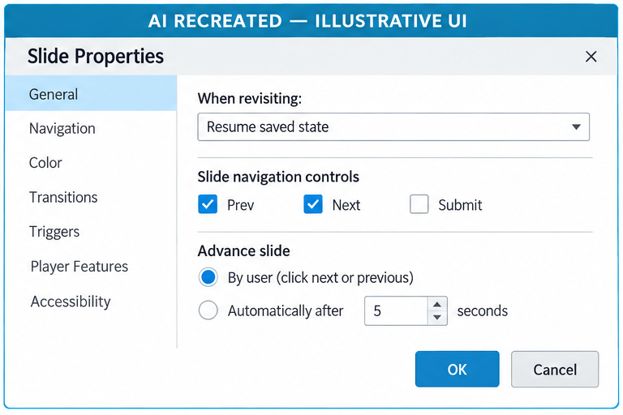
CONCEPT 12 · INTERFACE ORIENTATION
Revisit behaviour
NAMED ARTIFACT
WSA-012-Revisit-behaviour
MECHANISM
Slide Properties selects Automatically decide, Resume saved state or Reset…
EXPECTED
back, next and relaunch tests produce the specified state
AI RECREATED — ILLUSTRATIVE UI · verify the named control
© 2026 Tertiary Infotech Academy Pte Ltd · Mastering Articulate Storyline 360 for e-Learning Content Creation · TGS-2024042308
Articulate Storyline 360 official guidance; v11 technical anchor register
53

Slide 54
INTERFACE · NAMED CONFIGURATION
Revisit behaviour
SET THESE CONTROLS
C1=revisit mode · C2=timeline · C3=layer state · C4=variable persistence
REJECT WHEN
global revisit choice applied without testing
VERIFY READBACK
back, next and relaunch tests produce the specified state
AI RECREATED — ILLUSTRATIVE UI · verify the named control
© 2026 Tertiary Infotech Academy Pte Ltd · Mastering Articulate Storyline 360 for e-Learning Content Creation · TGS-2024042308
Articulate Storyline 360 official guidance; v11 technical anchor register
54

Slide 55
TECHNICAL ANCHOR 012 · WORKED SYNTHETIC TRACE
Revisit behaviour
FAULTY OUTPUT (EXAMPLE)
global revisit choice applied without testing
FIX IN NAMED PANEL
revisit mode; timeline; layer state; variable persistence
EXPECTED AFTER FIX
back, next and relaunch tests produce the specified state · verify in your…
AI RECREATED — ILLUSTRATIVE UI · verify the named control
© 2026 Tertiary Infotech Academy Pte Ltd · Mastering Articulate Storyline 360 for e-Learning Content Creation · TGS-2024042308
Articulate Storyline 360 official guidance; v11 technical anchor register
55

Slide 56
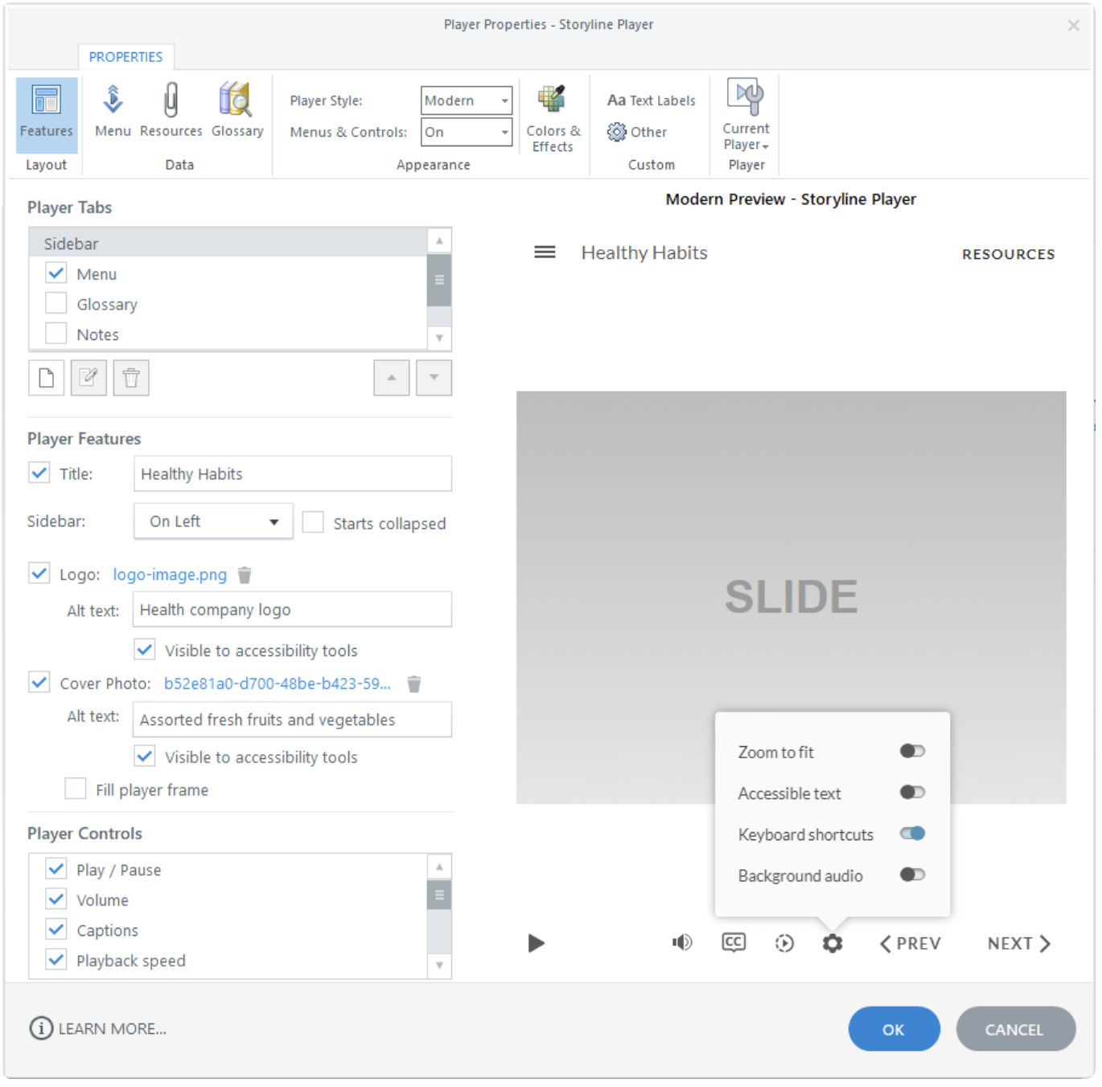
CONCEPT 13 · INTERFACE ORIENTATION
Player feature baseline
NAMED ARTIFACT
WSA-013-Player-feature-baseline
MECHANISM
Player Properties exposes only required controls and a predictable course…
EXPECTED
player and slide controls do not conflict in keyboard testing
Authentic Articulate interface reference · verify the named control
© 2026 Tertiary Infotech Academy Pte Ltd · Mastering Articulate Storyline 360 for e-Learning Content Creation · TGS-2024042308
Articulate Storyline 360 official guidance; v11 technical anchor register
56

Slide 57
INTERFACE · NAMED CONFIGURATION
Player feature baseline
SET THESE CONTROLS
C1=menu · C2=seekbar · C3=volume · C4=captions · C5=glossary · C6=resources
REJECT WHEN
duplicated navigation and inaccessible custom chrome
VERIFY READBACK
player and slide controls do not conflict in keyboard testing
Authentic Articulate interface reference · verify the named control
© 2026 Tertiary Infotech Academy Pte Ltd · Mastering Articulate Storyline 360 for e-Learning Content Creation · TGS-2024042308
Articulate Storyline 360 official guidance; v11 technical anchor register
57

Slide 58
TECHNICAL ANCHOR 013 · WORKED SYNTHETIC TRACE
Player feature baseline
FAULTY OUTPUT (EXAMPLE)
duplicated navigation and inaccessible custom chrome
FIX IN NAMED PANEL
menu; seekbar; volume; captions; glossary; resources
EXPECTED AFTER FIX
player and slide controls do not conflict in keyboard testing · verify in…
Authentic Articulate interface reference · verify the named control
© 2026 Tertiary Infotech Academy Pte Ltd · Mastering Articulate Storyline 360 for e-Learning Content Creation · TGS-2024042308
Articulate Storyline 360 official guidance; v11 technical anchor register
58

Slide 59
CONCEPT 14 · HOW IT WORKS
Preview test levels
Named HarbourLink WSH artifact
Input / source state
WSA-014-Preview-test-levels
WSA checkpoint plus slide logic; cross-slide routing; project variables; player
Runtime mechanism
Expected output
Preview This Slide, This Scene and Entire Project reveal different classes of defects
scene and project test logs cover entry, exit, revisit and resume
Rejected output
Evidence record
signing off from single-slide preview
WSA-014-Preview-test-levels: capture the configured control and the runtime readback.
© 2026 Tertiary Infotech Academy Pte Ltd · Mastering Articulate Storyline 360 for e-Learning Content Creation · TGS-2024042308
Articulate Storyline 360 official guidance; v11 technical anchor register
59

Slide 60
EDITABLE CONFIGURATION MODEL
Preview test levels
SET THESE CONTROLS
REJECT WHEN
VERIFY READBACK
C1=slide logic · C2=cross-slide routing · C3=project variables · C4=player
signing off from single-slide preview
scene and project test logs cover entry, exit, revisit and resume
→
→
Editable HarbourLink model · scene and project test logs cover entry, exit, revisit and resume
© 2026 Tertiary Infotech Academy Pte Ltd · Mastering Articulate Storyline 360 for e-Learning Content Creation · TGS-2024042308
Articulate Storyline 360 official guidance; v11 technical anchor register
60

Slide 61
TECHNICAL ANCHOR 014 · WORKED SYNTHETIC TRACE
Preview test levels
FAULTY OUTPUT (EXAMPLE)
CORRECT THE RECORD
EXPECTED AFTER FIX
signing off from single-slide preview
slide logic; cross-slide routing; project variables; player
scene and project test logs cover entry, exit, revisit and resume · verify in your own Preview
→
→
Editable HarbourLink model · scene and project test logs cover entry, exit, revisit and resume
© 2026 Tertiary Infotech Academy Pte Ltd · Mastering Articulate Storyline 360 for e-Learning Content Creation · TGS-2024042308
Articulate Storyline 360 official guidance; v11 technical anchor register
61

Slide 62
CONCEPT 15 · HOW IT WORKS
Recovery and version handoff
Named HarbourLink WSH artifact
Input / source state
WSA-015-Recovery-and-version-handoff
WSA checkpoint plus source version; owner; publish ID; backup; archive
Runtime mechanism
Expected output
Save As versions plus a release register separate editable source from published output
handoff opens the exact source used to create the tested package
Rejected output
Evidence record
renaming only the published ZIP or losing the .story source
WSA-015-Recovery-and-version-handoff: capture the configured control and the runtime readback.
© 2026 Tertiary Infotech Academy Pte Ltd · Mastering Articulate Storyline 360 for e-Learning Content Creation · TGS-2024042308
Articulate Storyline 360 official guidance; v11 technical anchor register
62

Slide 63
EDITABLE CONFIGURATION MODEL
Recovery and version handoff
SET THESE CONTROLS
REJECT WHEN
VERIFY READBACK
C1=source version · C2=owner · C3=publish ID · C4=backup · C5=archive
renaming only the published ZIP or losing the .story source
handoff opens the exact source used to create the tested package
→
→
Editable HarbourLink model · handoff opens the exact source used to create the tested package
© 2026 Tertiary Infotech Academy Pte Ltd · Mastering Articulate Storyline 360 for e-Learning Content Creation · TGS-2024042308
Articulate Storyline 360 official guidance; v11 technical anchor register
63

Slide 64
TECHNICAL ANCHOR 015 · WORKED SYNTHETIC TRACE
Recovery and version handoff
FAULTY OUTPUT (EXAMPLE)
CORRECT THE RECORD
EXPECTED AFTER FIX
renaming only the published ZIP or losing the .story source
source version; owner; publish ID; backup; archive
handoff opens the exact source used to create the tested package · verify in your own Preview
→
→
Editable HarbourLink model · handoff opens the exact source used to create the tested package
© 2026 Tertiary Infotech Academy Pte Ltd · Mastering Articulate Storyline 360 for e-Learning Content Creation · TGS-2024042308
Articulate Storyline 360 official guidance; v11 technical anchor register
64

Slide 65
CONCEPT 16 · HOW IT WORKS
HarbourLink annual WSH narrative beat map
Named HarbourLink WSH artifact
Input / source state
WSA-016-HarbourLink-annual-WSH-narrative-beat-map
WSA checkpoint plus protagonist; workplace goal; hazard tension; learner choice; consequence; resolution
Runtime mechanism
Expected output
A worked beat map links normal work, visible disruption, decision, consequence and safer resolution across screen IDs WSA-001 to WSA-401
each beat maps to a slide, learner action and observable safety outcome
Rejected output
Evidence record
adding a decorative story that does not change the learner decision
WSA-016-HarbourLink-annual-WSH-narrative-beat-map: capture the configured control and the runtime readback.
© 2026 Tertiary Infotech Academy Pte Ltd · Mastering Articulate Storyline 360 for e-Learning Content Creation · TGS-2024042308
Articulate Storyline 360 official guidance; v11 technical anchor register
65

Slide 66
EDITABLE CONFIGURATION MODEL
HarbourLink annual WSH narrative beat map
SET THESE CONTROLS
REJECT WHEN
VERIFY READBACK
C1=protagonist · C2=workplace goal · C3=hazard tension · C4=learner choice · C5=consequence · C6=resolution
adding a decorative story that does not change the learner decision
each beat maps to a slide, learner action and observable safety outcome
→
→
Editable HarbourLink model · each beat maps to a slide, learner action and observable safety outcome
© 2026 Tertiary Infotech Academy Pte Ltd · Mastering Articulate Storyline 360 for e-Learning Content Creation · TGS-2024042308
Articulate Storyline 360 official guidance; v11 technical anchor register
66

Slide 67
TECHNICAL ANCHOR 016 · WORKED SYNTHETIC TRACE
HarbourLink annual WSH narrative beat map
FAULTY OUTPUT (EXAMPLE)
CORRECT THE RECORD
EXPECTED AFTER FIX
adding a decorative story that does not change the learner decision
protagonist; workplace goal; hazard tension; learner choice; consequence; resolution
each beat maps to a slide, learner action and observable safety outcome · verify in your own Preview
→
→
Editable HarbourLink model · each beat maps to a slide, learner action and observable safety outcome
© 2026 Tertiary Infotech Academy Pte Ltd · Mastering Articulate Storyline 360 for e-Learning Content Creation · TGS-2024042308
Articulate Storyline 360 official guidance; v11 technical anchor register
67

Slide 68
CONCEPT 17 · HOW IT WORKS
Marketing objective to learning promise
Named HarbourLink WSH artifact
Input / source state
WSA-017-Marketing-objective-to-learning-promise
WSA checkpoint plus business objective; audience action; course promise; metric; data owner
Runtime mechanism
Expected output
A traceability row converts the provider objective 'increase induction completion and safe-reporting uptake' into a learner promise and measurable action
objective, promise, interaction and metric read as one causal chain
Rejected output
Evidence record
claiming engagement without a defined behaviour or measure
WSA-017-Marketing-objective-to-learning-promise: capture the configured control and the runtime readback.
© 2026 Tertiary Infotech Academy Pte Ltd · Mastering Articulate Storyline 360 for e-Learning Content Creation · TGS-2024042308
Articulate Storyline 360 official guidance; v11 technical anchor register
68

Slide 69
EDITABLE CONFIGURATION MODEL
Marketing objective to learning promise
SET THESE CONTROLS
REJECT WHEN
VERIFY READBACK
C1=business objective · C2=audience action · C3=course promise · C4=metric · C5=data owner
claiming engagement without a defined behaviour or measure
objective, promise, interaction and metric read as one causal chain
→
→
Editable HarbourLink model · objective, promise, interaction and metric read as one causal chain
© 2026 Tertiary Infotech Academy Pte Ltd · Mastering Articulate Storyline 360 for e-Learning Content Creation · TGS-2024042308
Articulate Storyline 360 official guidance; v11 technical anchor register
69

Slide 70
TECHNICAL ANCHOR 017 · WORKED SYNTHETIC TRACE
Marketing objective to learning promise
FAULTY OUTPUT (EXAMPLE)
CORRECT THE RECORD
EXPECTED AFTER FIX
claiming engagement without a defined behaviour or measure
business objective; audience action; course promise; metric; data owner
objective, promise, interaction and metric read as one causal chain · verify in your own Preview
→
→
Editable HarbourLink model · objective, promise, interaction and metric read as one causal chain
© 2026 Tertiary Infotech Academy Pte Ltd · Mastering Articulate Storyline 360 for e-Learning Content Creation · TGS-2024042308
Articulate Storyline 360 official guidance; v11 technical anchor register
70

Slide 71
CONCEPT 18 · HOW IT WORKS
Digital storyboard production cycle
Named HarbourLink WSH artifact
Input / source state
WSA-018-Digital-storyboard-production-cycle
WSA checkpoint plus screen ID; owner; asset; branch; access; version; approval
Runtime mechanism
Expected output
The HarbourLink annual WSH storyboard moves through brief, screen map, narration/media, interaction/branch, accessibility, prototype review and signed revision
one reviewed CSV row contains every required production field and disposition
Rejected output
Evidence record
treating the storyboard as on-screen copy only
WSA-018-Digital-storyboard-production-cycle: capture the configured control and the runtime readback.
© 2026 Tertiary Infotech Academy Pte Ltd · Mastering Articulate Storyline 360 for e-Learning Content Creation · TGS-2024042308
Articulate Storyline 360 official guidance; v11 technical anchor register
71

Slide 72
EDITABLE CONFIGURATION MODEL
Digital storyboard production cycle
SET THESE CONTROLS
REJECT WHEN
VERIFY READBACK
C1=screen ID · C2=owner · C3=asset · C4=branch · C5=access · C6=version · C7=approval
treating the storyboard as on-screen copy only
one reviewed CSV row contains every required production field and disposition
→
→
Editable HarbourLink model · one reviewed CSV row contains every required production field and disposition
© 2026 Tertiary Infotech Academy Pte Ltd · Mastering Articulate Storyline 360 for e-Learning Content Creation · TGS-2024042308
Articulate Storyline 360 official guidance; v11 technical anchor register
72

Slide 73
TECHNICAL ANCHOR 018 · WORKED SYNTHETIC TRACE
Digital storyboard production cycle
FAULTY OUTPUT (EXAMPLE)
CORRECT THE RECORD
EXPECTED AFTER FIX
treating the storyboard as on-screen copy only
screen ID; owner; asset; branch; access; version; approval
one reviewed CSV row contains every required production field and disposition · verify in your own Preview
→
→
Editable HarbourLink model · one reviewed CSV row contains every required production field and disposition
© 2026 Tertiary Infotech Academy Pte Ltd · Mastering Articulate Storyline 360 for e-Learning Content Creation · TGS-2024042308
Articulate Storyline 360 official guidance; v11 technical anchor register
73

Slide 74
CONCEPT 19 · HOW IT WORKS
PowerPoint slide import
Named HarbourLink WSH artifact
Input / source state
WSA-019-PowerPoint-slide-import
WSA checkpoint plus source file; selected slides; destination scene; imported masters; media links
Runtime mechanism
Expected output
Home > New Slide > Import imports selected source slides into a named scene, followed by master, font and trigger inspection
import log lists selected slides and the review confirms masters, focus order and navigation
Rejected output
Evidence record
assuming imported slide order, theme or accessibility is production-ready
WSA-019-PowerPoint-slide-import: capture the configured control and the runtime readback.
© 2026 Tertiary Infotech Academy Pte Ltd · Mastering Articulate Storyline 360 for e-Learning Content Creation · TGS-2024042308
Articulate Storyline 360 official guidance; v11 technical anchor register
74

Slide 75
EDITABLE CONFIGURATION MODEL
PowerPoint slide import
SET THESE CONTROLS
REJECT WHEN
VERIFY READBACK
C1=source file · C2=selected slides · C3=destination scene · C4=imported masters · C5=media links
assuming imported slide order, theme or accessibility is production-ready
import log lists selected slides and the review confirms masters, focus order and navigation
→
→
Editable HarbourLink model · import log lists selected slides and the review confirms masters, focus order and navigation
© 2026 Tertiary Infotech Academy Pte Ltd · Mastering Articulate Storyline 360 for e-Learning Content Creation · TGS-2024042308
Articulate Storyline 360 official guidance; v11 technical anchor register
75

Slide 76
TECHNICAL ANCHOR 019 · WORKED SYNTHETIC TRACE
PowerPoint slide import
FAULTY OUTPUT (EXAMPLE)
CORRECT THE RECORD
EXPECTED AFTER FIX
assuming imported slide order, theme or accessibility is production-ready
source file; selected slides; destination scene; imported masters; media links
import log lists selected slides and the review confirms masters, focus order and navigation · verify in your own Preview
→
→
Editable HarbourLink model · import log lists selected slides and the review confirms masters, focus order and navigation
© 2026 Tertiary Infotech Academy Pte Ltd · Mastering Articulate Storyline 360 for e-Learning Content Creation · TGS-2024042308
Articulate Storyline 360 official guidance; v11 technical anchor register
76

Slide 77
HANDS-ON APPLICATION · TOPIC 1
Activity 01 · Start the Safety Module and Storyboard
Create the local source baseline, five-scene architecture and traceable storyboard.
1
2
3
4
5
Analyse
Choose
Apply
Inspect
Evidence
EVIDENCE
Retain the named .story checkpoint, the completed self-check table and one screenshot for each task showing the final state or setting that proves the acceptance criteria.
Full click-by-click procedure · Learner Guide / Activity 01
© 2026 Tertiary Infotech Academy Pte Ltd · Mastering Articulate Storyline 360 for e-Learning Content Creation · TGS-2024042308
77

Slide 78
AUTHENTIC ARTICULATE UI
Activity 01 · Interface Reference
Locate
Use this authentic interface capture to find the named…
Set
In Story View, create and name scenes `01 Welcome`, `02…
Verify
Five named scenes and storyboard IDs match.
Evidence
Capture one final-state screenshot for the task; this…
© 2026 Tertiary Infotech Academy Pte Ltd · Mastering Articulate Storyline 360 for e-Learning Content Creation · TGS-2024042308
Articulate official product guidance
78

Slide 79
EDITABLE TECHNICAL MODEL
Activity 01 · Artifact Model
Artifact
Purpose
HarbourLink-WSH-Checkpoint-01-YourName.story
Create the local source baseline, five-scene architecture and traceable storyboard.
Scenario input
Required output
HarbourLink annual WSH refresher; picture-first content, narration, captions, keyboard access and five-question 80% practice quiz.
Five named scenes and storyboard IDs match.
Control point
Readback
Variables use the specified type and default.
Retain the named .story checkpoint, the completed self-check table and one screenshot for each task showing the final state or setting that proves the acceptance criteria.
© 2026 Tertiary Infotech Academy Pte Ltd · Mastering Articulate Storyline 360 for e-Learning Content Creation · TGS-2024042308
79

Slide 80
EDITABLE TECHNICAL MODEL
Activity 01 · Runtime State Trace
Initial state
Input
Open with declared defaults and no prior test residue.
Use the named WSA asset, learner decision or publish setting.
Control
Stored state
Five named scenes and storyboard IDs match.
Variables use the specified type and default.
Runtime output
Boundary
Source and checkpoint are versioned locally.
Whole-project preview has no dead end.
© 2026 Tertiary Infotech Academy Pte Ltd · Mastering Articulate Storyline 360 for e-Learning Content Creation · TGS-2024042308
80

Slide 81
EDITABLE TECHNICAL MODEL
Activity 01 · Worked Failure Case
Expected
Incomplete
Five named scenes and storyboard IDs match.
Fail when: Variables use the specified type and default. is not demonstrated.
Repeat
Access
Repeat/revisit must preserve: Source and checkpoint are versioned locally.
Whole-project preview has no dead end.
Recovery
Log
Correct the named setting in the next checkpoint, then rerun the same case.
Record expected, actual, pass/fail and corrected version.
© 2026 Tertiary Infotech Academy Pte Ltd · Mastering Articulate Storyline 360 for e-Learning Content Creation · TGS-2024042308
81

Slide 82
EDITABLE TECHNICAL MODEL
Activity 01 · Evidence Record
Source
Evidence rule
HarbourLink-WSH-Checkpoint-01-YourName.story
One decisive learner screenshot per task.
Setting evidence
Runtime evidence
Five named scenes and storyboard IDs match.
Variables use the specified type and default.
Regression evidence
Retention
Whole-project preview has no dead end.
Retain the named .story checkpoint, the completed self-check table and one screenshot for each task showing the final state or setting that proves the acceptance criteria.
© 2026 Tertiary Infotech Academy Pte Ltd · Mastering Articulate Storyline 360 for e-Learning Content Creation · TGS-2024042308
82

Slide 83
AUTHENTIC ARTICULATE UI
Activity 01 · Verify the Panel
Named setting
Import `source/storyboard.csv` into your working notes and…
Expected output
Five named scenes and storyboard IDs match.
Boundary
Whole-project preview has no dead end.
Own evidence
Show the learner-created checkpoint and final setting, not…
© 2026 Tertiary Infotech Academy Pte Ltd · Mastering Articulate Storyline 360 for e-Learning Content Creation · TGS-2024042308
Articulate official product guidance
83

Slide 84
EXPECTED VERSUS ACTUAL
Activity 01 · Test Matrix
Case 1
Case 2
Five named scenes and storyboard IDs match.
Variables use the specified type and default.
Case 3
Case 4
Source and checkpoint are versioned locally.
Whole-project preview has no dead end.
Revisit
Record
Navigate away and back; compare actual state with the specified revisit rule.
Log expected, actual, pass/fail, defect owner and corrected checkpoint filename.
© 2026 Tertiary Infotech Academy Pte Ltd · Mastering Articulate Storyline 360 for e-Learning Content Creation · TGS-2024042308
84

Slide 85
HANDS-ON APPLICATION · TOPIC 1
Activity 02 · Build Theme, Masters and Menu
Create reusable visual layouts and accessible scene navigation.
1
2
3
4
5
Analyse
Choose
Apply
Inspect
Evidence
EVIDENCE
Retain the named .story checkpoint, the completed self-check table and one screenshot for each task showing the final state or setting that proves the acceptance criteria.
Full click-by-click procedure · Learner Guide / Activity 02
© 2026 Tertiary Infotech Academy Pte Ltd · Mastering Articulate Storyline 360 for e-Learning Content Creation · TGS-2024042308
85

Slide 86
AUTHENTIC ARTICULATE UI
Activity 02 · Interface Reference
Locate
Use this authentic interface capture to find the named…
Set
Choose Design > Fonts > Create New Theme Fonts and Design…
Verify
Four reusable layouts inherit correctly.
Evidence
Capture one final-state screenshot for the task; this…
© 2026 Tertiary Infotech Academy Pte Ltd · Mastering Articulate Storyline 360 for e-Learning Content Creation · TGS-2024042308
Articulate official product guidance
86

Slide 87
EDITABLE TECHNICAL MODEL
Activity 02 · Artifact Model
Artifact
Purpose
HarbourLink-WSH-Checkpoint-02-YourName.story
Create reusable visual layouts and accessible scene navigation.
Scenario input
Required output
HarbourLink annual WSH refresher; picture-first content, narration, captions, keyboard access and five-question 80% practice quiz.
Four reusable layouts inherit correctly.
Control point
Readback
Theme values match the style guide.
Retain the named .story checkpoint, the completed self-check table and one screenshot for each task showing the final state or setting that proves the acceptance criteria.
© 2026 Tertiary Infotech Academy Pte Ltd · Mastering Articulate Storyline 360 for e-Learning Content Creation · TGS-2024042308
87

Slide 88
EDITABLE TECHNICAL MODEL
Activity 02 · Runtime State Trace
Initial state
Input
Open with declared defaults and no prior test residue.
Use the named WSA asset, learner decision or publish setting.
Control
Stored state
Four reusable layouts inherit correctly.
Theme values match the style guide.
Runtime output
Boundary
Menu routes and returns correctly.
Keyboard focus and state changes are visible.
© 2026 Tertiary Infotech Academy Pte Ltd · Mastering Articulate Storyline 360 for e-Learning Content Creation · TGS-2024042308
88

Slide 89
EDITABLE TECHNICAL MODEL
Activity 02 · Worked Failure Case
Expected
Incomplete
Four reusable layouts inherit correctly.
Fail when: Theme values match the style guide. is not demonstrated.
Repeat
Access
Repeat/revisit must preserve: Menu routes and returns correctly.
Keyboard focus and state changes are visible.
Recovery
Log
Correct the named setting in the next checkpoint, then rerun the same case.
Record expected, actual, pass/fail and corrected version.
© 2026 Tertiary Infotech Academy Pte Ltd · Mastering Articulate Storyline 360 for e-Learning Content Creation · TGS-2024042308
89

Slide 90
EDITABLE TECHNICAL MODEL
Activity 02 · Evidence Record
Source
Evidence rule
HarbourLink-WSH-Checkpoint-02-YourName.story
One decisive learner screenshot per task.
Setting evidence
Runtime evidence
Four reusable layouts inherit correctly.
Theme values match the style guide.
Regression evidence
Retention
Keyboard focus and state changes are visible.
Retain the named .story checkpoint, the completed self-check table and one screenshot for each task showing the final state or setting that proves the acceptance criteria.
© 2026 Tertiary Infotech Academy Pte Ltd · Mastering Articulate Storyline 360 for e-Learning Content Creation · TGS-2024042308
90

Slide 91
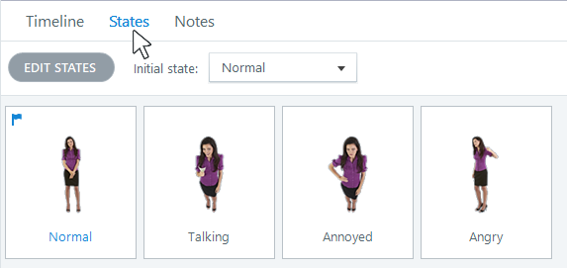
AUTHENTIC ARTICULATE UI
Activity 02 · Verify the Panel
Named setting
Open View > Slide Master and build title, content,…
Expected output
Four reusable layouts inherit correctly.
Boundary
Keyboard focus and state changes are visible.
Own evidence
Show the learner-created checkpoint and final setting, not…
© 2026 Tertiary Infotech Academy Pte Ltd · Mastering Articulate Storyline 360 for e-Learning Content Creation · TGS-2024042308
Articulate official product guidance
91

Slide 92
EXPECTED VERSUS ACTUAL
Activity 02 · Test Matrix
Case 1
Case 2
Four reusable layouts inherit correctly.
Theme values match the style guide.
Case 3
Case 4
Menu routes and returns correctly.
Keyboard focus and state changes are visible.
Revisit
Record
Navigate away and back; compare actual state with the specified revisit rule.
Log expected, actual, pass/fail, defect owner and corrected checkpoint filename.
© 2026 Tertiary Infotech Academy Pte Ltd · Mastering Articulate Storyline 360 for e-Learning Content Creation · TGS-2024042308
92

Slide 93
WSA ACCEPTANCE MODEL
Topic 1 Checkpoint
Source
Scenes
Variables
HarbourLink-WSH-Checkpoint-02-YourName.story
Welcome · Learn · Practise · Quiz · Resources
HazardsFound=0; Hazard01Found–07=False
Menu test
Revisit
Evidence
Four destinations and explicit return paths
Reset/resume choice recorded per slide
Story View, variable list and keyboard menu screenshot
© 2026 Tertiary Infotech Academy Pte Ltd · Mastering Articulate Storyline 360 for e-Learning Content Creation · TGS-2024042308
93

Slide 94
02
Media, Interaction and Accessibility
Media Library · hazards · hotspots · layers · states · triggers · motion · simulation · audio · captions
LO2 · A3 · A5 · K2 · K5
© 2026 Tertiary Infotech Academy Pte Ltd · Mastering Articulate Storyline 360 for e-Learning Content Creation · TGS-2024042308
94

Slide 95
EDITABLE CONTENT-PLANNING CHART
Accessible Media Mix
Text + visuals
25
READ THE CHART
Narrated demo
20
A mixed design serves different learning needs. Every audio/video element still needs captions, an accessible path and a reason to exist.
Interactive scenario
25
Quiz + feedback
15
Reference support
15
Editable PowerPoint shape chart
Illustrative share
© 2026 Tertiary Infotech Academy Pte Ltd · Mastering Articulate Storyline 360 for e-Learning Content Creation · TGS-2024042308
Course design model
95

Slide 96
CONCEPT 20 · HOW IT WORKS
Picture insertion and crop
Named HarbourLink WSH artifact
Input / source state
WSA-020-Picture-insertion-and-crop
WSA checkpoint plus crop focal point; compression; alt text; source
Runtime mechanism
Expected output
Insert > Picture plus Picture Format > Crop fits safety photography without distortion
image remains sharp and the hazard stays visible at player size
Rejected output
Evidence record
stretching media or hiding critical hazard detail
WSA-020-Picture-insertion-and-crop: capture the configured control and the runtime readback.
© 2026 Tertiary Infotech Academy Pte Ltd · Mastering Articulate Storyline 360 for e-Learning Content Creation · TGS-2024042308
Articulate Storyline 360 official guidance; v11 technical anchor register
96

Slide 97
EDITABLE CONFIGURATION MODEL
Picture insertion and crop
SET THESE CONTROLS
REJECT WHEN
VERIFY READBACK
C1=crop focal point · C2=compression · C3=alt text · C4=source
stretching media or hiding critical hazard detail
image remains sharp and the hazard stays visible at player size
→
→
Editable HarbourLink model · image remains sharp and the hazard stays visible at player size
© 2026 Tertiary Infotech Academy Pte Ltd · Mastering Articulate Storyline 360 for e-Learning Content Creation · TGS-2024042308
Articulate Storyline 360 official guidance; v11 technical anchor register
97

Slide 98
TECHNICAL ANCHOR 020 · WORKED SYNTHETIC TRACE
Picture insertion and crop
FAULTY OUTPUT (EXAMPLE)
CORRECT THE RECORD
EXPECTED AFTER FIX
stretching media or hiding critical hazard detail
crop focal point; compression; alt text; source
image remains sharp and the hazard stays visible at player size · verify in your own Preview
→
→
Editable HarbourLink model · image remains sharp and the hazard stays visible at player size
© 2026 Tertiary Infotech Academy Pte Ltd · Mastering Articulate Storyline 360 for e-Learning Content Creation · TGS-2024042308
Articulate Storyline 360 official guidance; v11 technical anchor register
98

Slide 99
CONCEPT 21 · HOW IT WORKS
Illustration and icon system
Named HarbourLink WSH artifact
Input / source state
WSA-021-Illustration-and-icon-system
WSA checkpoint plus style; size; theme colour; decorative flag
Runtime mechanism
Expected output
Insert > Icons/Illustrations creates consistent editable safety cues
icons reinforce labels and remain understandable without colour
Rejected output
Evidence record
mixing styles or announcing decorative icons
WSA-021-Illustration-and-icon-system: capture the configured control and the runtime readback.
© 2026 Tertiary Infotech Academy Pte Ltd · Mastering Articulate Storyline 360 for e-Learning Content Creation · TGS-2024042308
Articulate Storyline 360 official guidance; v11 technical anchor register
99

Slide 100
EDITABLE CONFIGURATION MODEL
Illustration and icon system
SET THESE CONTROLS
REJECT WHEN
VERIFY READBACK
C1=style · C2=size · C3=theme colour · C4=decorative flag
mixing styles or announcing decorative icons
icons reinforce labels and remain understandable without colour
→
→
Editable HarbourLink model · icons reinforce labels and remain understandable without colour
© 2026 Tertiary Infotech Academy Pte Ltd · Mastering Articulate Storyline 360 for e-Learning Content Creation · TGS-2024042308
Articulate Storyline 360 official guidance; v11 technical anchor register
100

Slide 101
TECHNICAL ANCHOR 021 · WORKED SYNTHETIC TRACE
Illustration and icon system
FAULTY OUTPUT (EXAMPLE)
CORRECT THE RECORD
EXPECTED AFTER FIX
mixing styles or announcing decorative icons
style; size; theme colour; decorative flag
icons reinforce labels and remain understandable without colour · verify in your own Preview
→
→
Editable HarbourLink model · icons reinforce labels and remain understandable without colour
© 2026 Tertiary Infotech Academy Pte Ltd · Mastering Articulate Storyline 360 for e-Learning Content Creation · TGS-2024042308
Articulate Storyline 360 official guidance; v11 technical anchor register
101

Slide 102
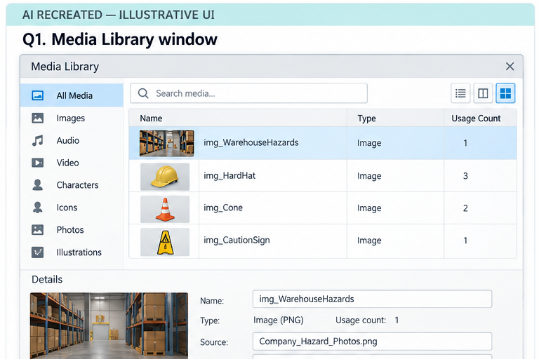
CONCEPT 22 · INTERFACE ORIENTATION
Media Library replacement
NAMED ARTIFACT
WSA-022-Media-Library-replacement
MECHANISM
View > Media Library replaces a source asset and exposes where it is used
EXPECTED
replacement updates intended uses and preserves crops after review
AI RECREATED — ILLUSTRATIVE UI · verify the named control
© 2026 Tertiary Infotech Academy Pte Ltd · Mastering Articulate Storyline 360 for e-Learning Content Creation · TGS-2024042308
Articulate Storyline 360 official guidance; v11 technical anchor register
102

Slide 103
INTERFACE · NAMED CONFIGURATION
Media Library replacement
SET THESE CONTROLS
C1=asset name · C2=usage count · C3=replace · C4=source record
REJECT WHEN
changing one instance while duplicates drift
VERIFY READBACK
replacement updates intended uses and preserves crops after review
AI RECREATED — ILLUSTRATIVE UI · verify the named control
© 2026 Tertiary Infotech Academy Pte Ltd · Mastering Articulate Storyline 360 for e-Learning Content Creation · TGS-2024042308
Articulate Storyline 360 official guidance; v11 technical anchor register
103

Slide 104
TECHNICAL ANCHOR 022 · WORKED SYNTHETIC TRACE
Media Library replacement
FAULTY OUTPUT (EXAMPLE)
changing one instance while duplicates drift
FIX IN NAMED PANEL
asset name; usage count; replace; source record
EXPECTED AFTER FIX
replacement updates intended uses and preserves crops after review ·…
AI RECREATED — ILLUSTRATIVE UI · verify the named control
© 2026 Tertiary Infotech Academy Pte Ltd · Mastering Articulate Storyline 360 for e-Learning Content Creation · TGS-2024042308
Articulate Storyline 360 official guidance; v11 technical anchor register
104

Slide 105
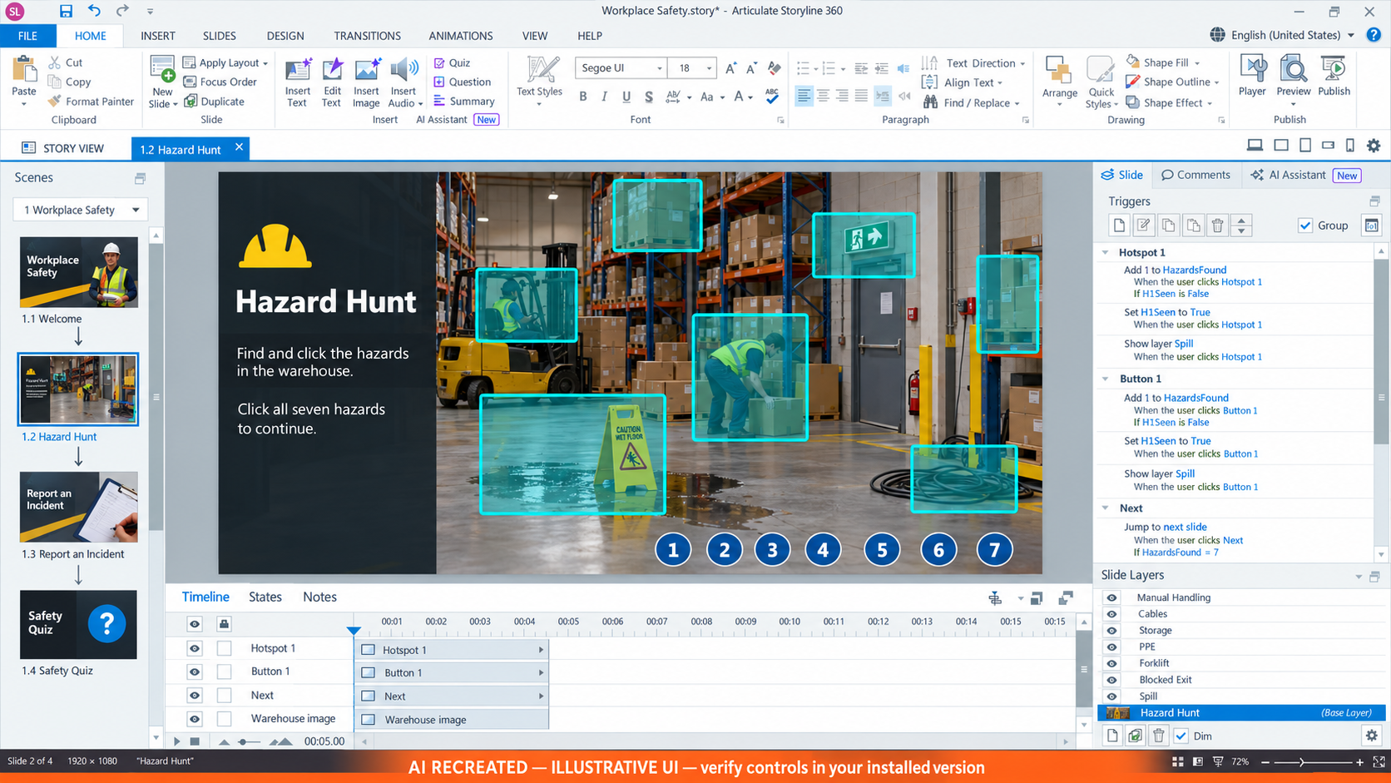
CONCEPT 23 · INTERFACE ORIENTATION
Hazard hotspot geometry
NAMED ARTIFACT
WSA-023-Hazard-hotspot-geometry
MECHANISM
Hotspots sit over seven visible hazards with non-overlapping target regions
EXPECTED
all hazards can be activated by pointer and equivalent keyboard controls
AI RECREATED — ILLUSTRATIVE UI · verify the named control
© 2026 Tertiary Infotech Academy Pte Ltd · Mastering Articulate Storyline 360 for e-Learning Content Creation · TGS-2024042308
Articulate Storyline 360 official guidance; v11 technical anchor register
105

Slide 106
INTERFACE · NAMED CONFIGURATION
Hazard hotspot geometry
SET THESE CONTROLS
C1=target bounds · C2=label · C3=focus alternative · C4=z-order
REJECT WHEN
tiny invisible targets or overlapping hotspots
VERIFY READBACK
all hazards can be activated by pointer and equivalent keyboard controls
AI RECREATED — ILLUSTRATIVE UI · verify the named control
© 2026 Tertiary Infotech Academy Pte Ltd · Mastering Articulate Storyline 360 for e-Learning Content Creation · TGS-2024042308
Articulate Storyline 360 official guidance; v11 technical anchor register
106

Slide 107
TECHNICAL ANCHOR 023 · WORKED SYNTHETIC TRACE
Hazard hotspot geometry
FAULTY OUTPUT (EXAMPLE)
tiny invisible targets or overlapping hotspots
FIX IN NAMED PANEL
target bounds; label; focus alternative; z-order
EXPECTED AFTER FIX
all hazards can be activated by pointer and equivalent keyboard controls ·…
AI RECREATED — ILLUSTRATIVE UI · verify the named control
© 2026 Tertiary Infotech Academy Pte Ltd · Mastering Articulate Storyline 360 for e-Learning Content Creation · TGS-2024042308
Articulate Storyline 360 official guidance; v11 technical anchor register
107

Slide 108
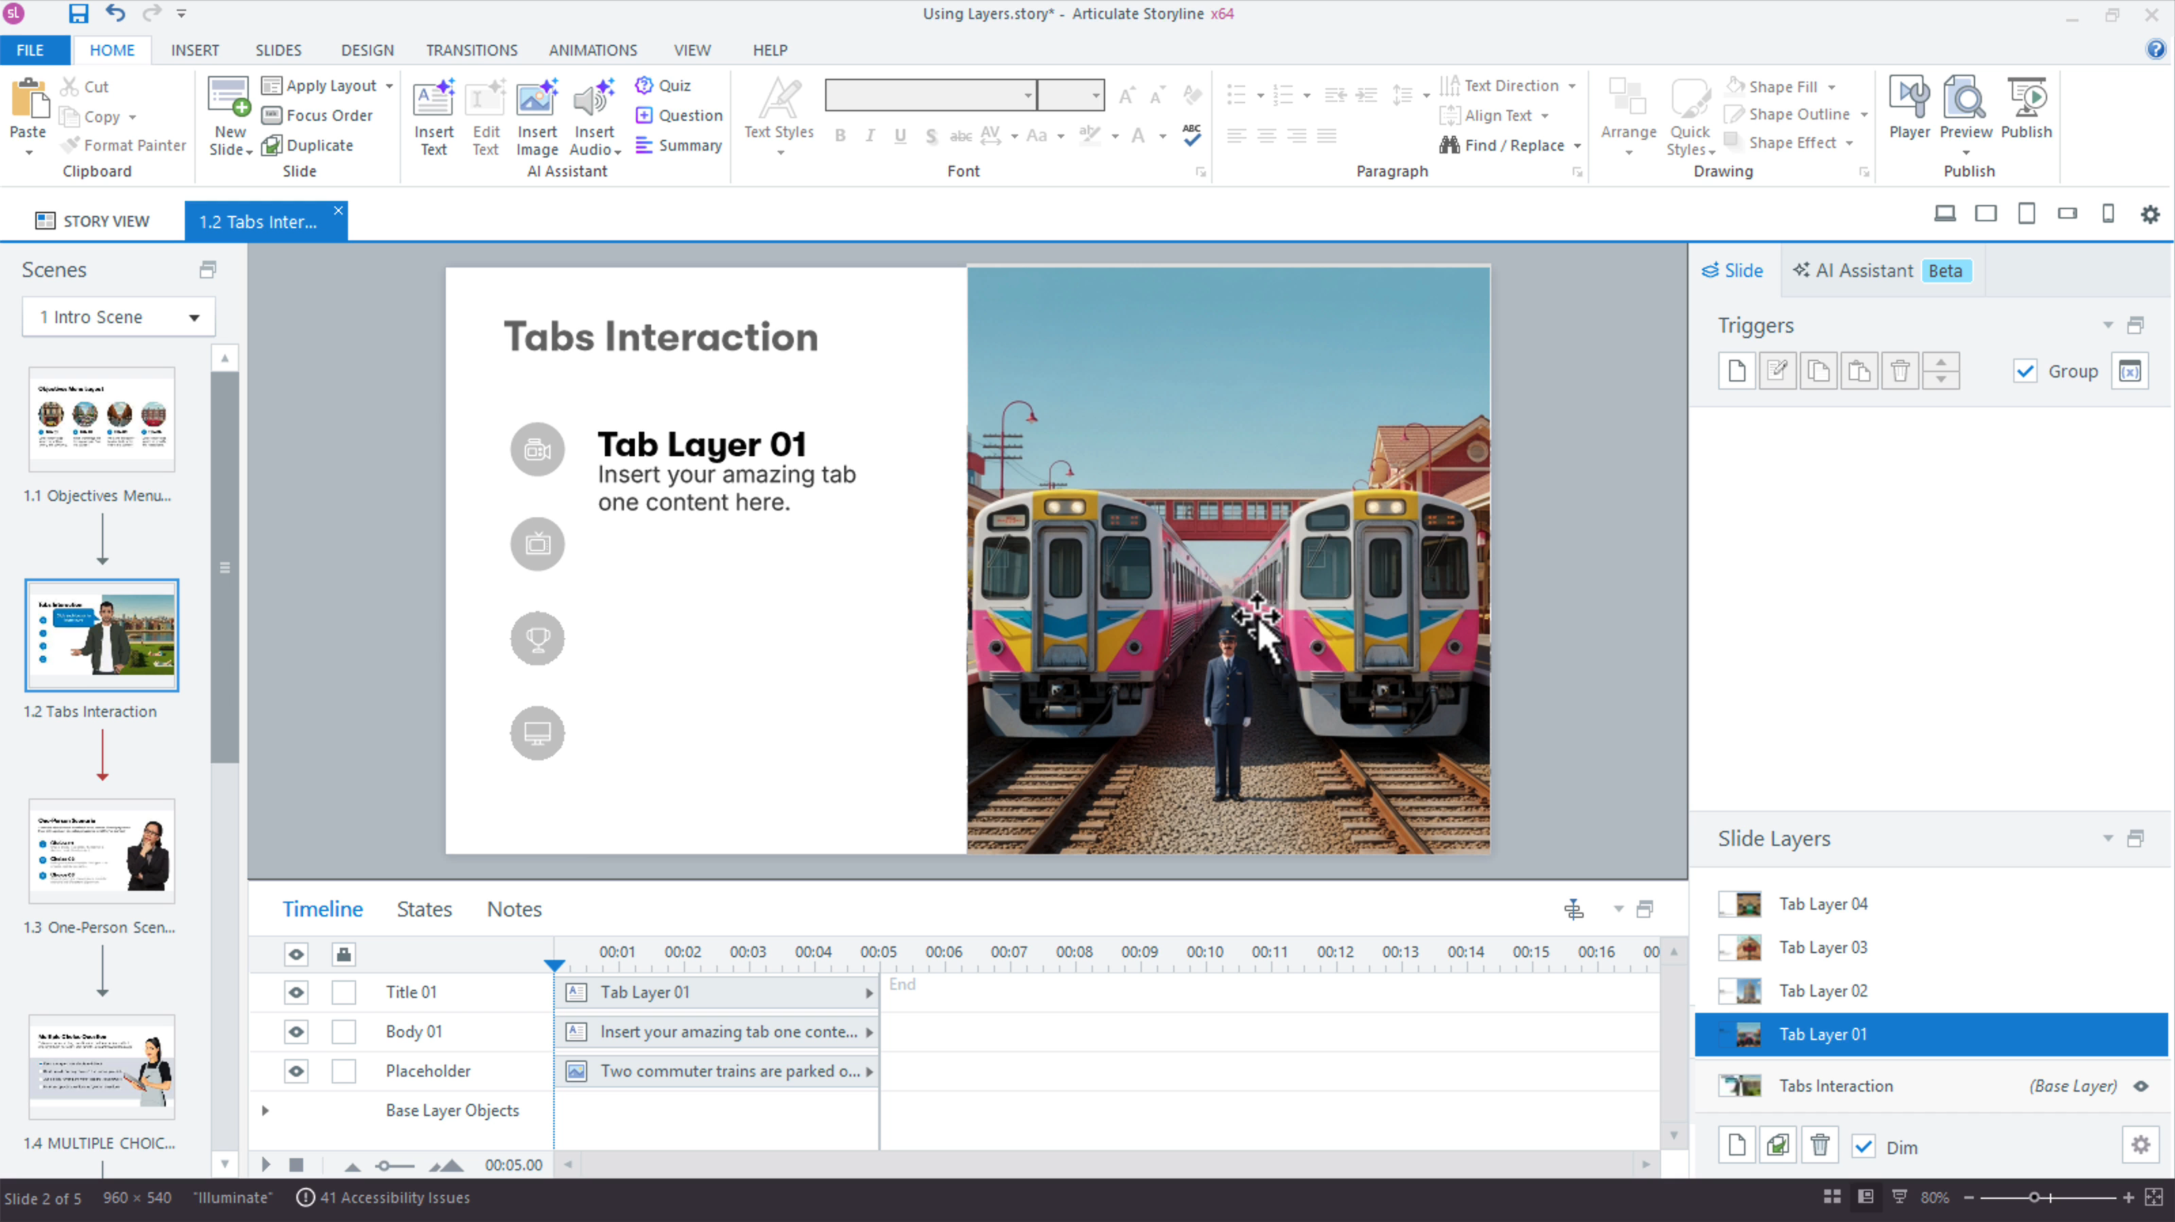
CONCEPT 24 · INTERFACE ORIENTATION
Hotspot information layers
NAMED ARTIFACT
WSA-024-Hotspot-information-layers
MECHANISM
Each hazard opens one named layer with risk, control and close action
EXPECTED
open/close cycles return focus to the invoking hazard control
Authentic Articulate interface reference · verify the named control
© 2026 Tertiary Infotech Academy Pte Ltd · Mastering Articulate Storyline 360 for e-Learning Content Creation · TGS-2024042308
Articulate Storyline 360 official guidance; v11 technical anchor register
108

Slide 109
INTERFACE · NAMED CONFIGURATION
Hotspot information layers
SET THESE CONTROLS
C1=show layer · C2=hide layer · C3=focus · C4=pause base timeline
REJECT WHEN
click-through behind the layer or stranded focus
VERIFY READBACK
open/close cycles return focus to the invoking hazard control
Authentic Articulate interface reference · verify the named control
© 2026 Tertiary Infotech Academy Pte Ltd · Mastering Articulate Storyline 360 for e-Learning Content Creation · TGS-2024042308
Articulate Storyline 360 official guidance; v11 technical anchor register
109

Slide 110
TECHNICAL ANCHOR 024 · WORKED SYNTHETIC TRACE
Hotspot information layers
FAULTY OUTPUT (EXAMPLE)
click-through behind the layer or stranded focus
FIX IN NAMED PANEL
show layer; hide layer; focus; pause base timeline
EXPECTED AFTER FIX
open/close cycles return focus to the invoking hazard control · verify in…
Authentic Articulate interface reference · verify the named control
© 2026 Tertiary Infotech Academy Pte Ltd · Mastering Articulate Storyline 360 for e-Learning Content Creation · TGS-2024042308
Articulate Storyline 360 official guidance; v11 technical anchor register
110

Slide 111
CONCEPT 25 · INTERFACE ORIENTATION
Keyboard hotspot alternative
NAMED ARTIFACT
WSA-025-Keyboard-hotspot-alternative
MECHANISM
Visible numbered buttons mirror hotspot triggers for keyboard and…
EXPECTED
keyboard activation shows the same hazard layer and visited state
AI RECREATED — ILLUSTRATIVE UI · verify the named control
© 2026 Tertiary Infotech Academy Pte Ltd · Mastering Articulate Storyline 360 for e-Learning Content Creation · TGS-2024042308
Articulate Storyline 360 official guidance; v11 technical anchor register
111

Slide 112
INTERFACE · NAMED CONFIGURATION
Keyboard hotspot alternative
SET THESE CONTROLS
C1=button label · C2=trigger parity · C3=focus order · C4=visible focus
REJECT WHEN
mouse-only discovery
VERIFY READBACK
keyboard activation shows the same hazard layer and visited state
AI RECREATED — ILLUSTRATIVE UI · verify the named control
© 2026 Tertiary Infotech Academy Pte Ltd · Mastering Articulate Storyline 360 for e-Learning Content Creation · TGS-2024042308
Articulate Storyline 360 official guidance; v11 technical anchor register
112

Slide 113
TECHNICAL ANCHOR 025 · WORKED SYNTHETIC TRACE
Keyboard hotspot alternative
FAULTY OUTPUT (EXAMPLE)
mouse-only discovery
FIX IN NAMED PANEL
button label; trigger parity; focus order; visible focus
EXPECTED AFTER FIX
keyboard activation shows the same hazard layer and visited state · verify…
AI RECREATED — ILLUSTRATIVE UI · verify the named control
© 2026 Tertiary Infotech Academy Pte Ltd · Mastering Articulate Storyline 360 for e-Learning Content Creation · TGS-2024042308
Articulate Storyline 360 official guidance; v11 technical anchor register
113

Slide 114
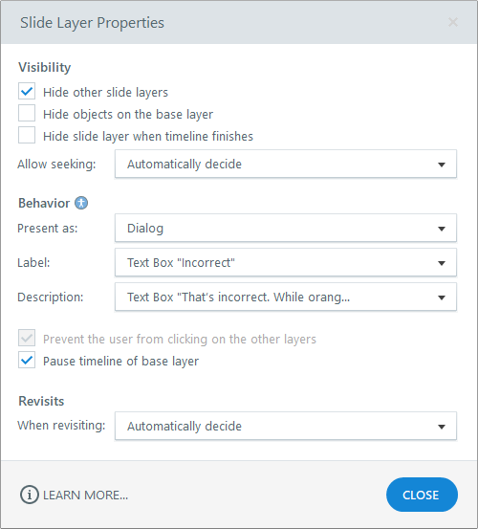
CONCEPT 26 · INTERFACE ORIENTATION
Layer properties
NAMED ARTIFACT
WSA-026-Layer-properties
MECHANISM
Layer Properties controls hide other layers, prevent base clicks, pause…
EXPECTED
only one layer is operable and close restores the base slide
Authentic Articulate interface reference · verify the named control
© 2026 Tertiary Infotech Academy Pte Ltd · Mastering Articulate Storyline 360 for e-Learning Content Creation · TGS-2024042308
Articulate Storyline 360 official guidance; v11 technical anchor register
114

Slide 115
INTERFACE · NAMED CONFIGURATION
Layer properties
SET THESE CONTROLS
C1=modal behaviour · C2=base visibility · C3=reset/resume
REJECT WHEN
two hazard layers visible or base controls active behind modal
VERIFY READBACK
only one layer is operable and close restores the base slide
Authentic Articulate interface reference · verify the named control
© 2026 Tertiary Infotech Academy Pte Ltd · Mastering Articulate Storyline 360 for e-Learning Content Creation · TGS-2024042308
Articulate Storyline 360 official guidance; v11 technical anchor register
115

Slide 116
TECHNICAL ANCHOR 026 · WORKED SYNTHETIC TRACE
Layer properties
FAULTY OUTPUT (EXAMPLE)
two hazard layers visible or base controls active behind modal
FIX IN NAMED PANEL
modal behaviour; base visibility; reset/resume
EXPECTED AFTER FIX
only one layer is operable and close restores the base slide · verify in…
Authentic Articulate interface reference · verify the named control
© 2026 Tertiary Infotech Academy Pte Ltd · Mastering Articulate Storyline 360 for e-Learning Content Creation · TGS-2024042308
Articulate Storyline 360 official guidance; v11 technical anchor register
116

Slide 117
CONCEPT 27 · INTERFACE ORIENTATION
Built-in object states
NAMED ARTIFACT
WSA-027-Built-in-object-states
MECHANISM
Normal, Hover, Down, Visited and Disabled states communicate interaction…
EXPECTED
state change is perceivable in pointer and keyboard paths
Authentic Articulate interface reference · verify the named control
© 2026 Tertiary Infotech Academy Pte Ltd · Mastering Articulate Storyline 360 for e-Learning Content Creation · TGS-2024042308
Articulate Storyline 360 official guidance; v11 technical anchor register
117

Slide 118
INTERFACE · NAMED CONFIGURATION
Built-in object states
SET THESE CONTROLS
C1=state name · C2=contrast · C3=icon/text cue · C4=initial state
REJECT WHEN
colour-only visited state or disabled focus target
VERIFY READBACK
state change is perceivable in pointer and keyboard paths
Authentic Articulate interface reference · verify the named control
© 2026 Tertiary Infotech Academy Pte Ltd · Mastering Articulate Storyline 360 for e-Learning Content Creation · TGS-2024042308
Articulate Storyline 360 official guidance; v11 technical anchor register
118

Slide 119
TECHNICAL ANCHOR 027 · WORKED SYNTHETIC TRACE
Built-in object states
FAULTY OUTPUT (EXAMPLE)
colour-only visited state or disabled focus target
FIX IN NAMED PANEL
state name; contrast; icon/text cue; initial state
EXPECTED AFTER FIX
state change is perceivable in pointer and keyboard paths · verify in your…
Authentic Articulate interface reference · verify the named control
© 2026 Tertiary Infotech Academy Pte Ltd · Mastering Articulate Storyline 360 for e-Learning Content Creation · TGS-2024042308
Articulate Storyline 360 official guidance; v11 technical anchor register
119

Slide 120
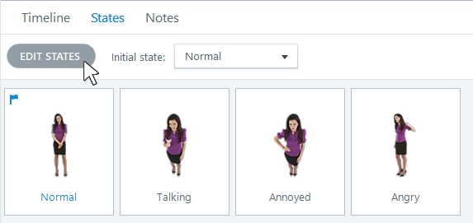
CONCEPT 28 · INTERFACE ORIENTATION
Custom hazard states
NAMED ARTIFACT
WSA-028-Custom-hazard-states
MECHANISM
Custom Safe and Selected states show mitigated equipment after a learner…
EXPECTED
one object changes predictably without shifting geometry
Authentic Articulate interface reference · verify the named control
© 2026 Tertiary Infotech Academy Pte Ltd · Mastering Articulate Storyline 360 for e-Learning Content Creation · TGS-2024042308
Articulate Storyline 360 official guidance; v11 technical anchor register
120

Slide 121
INTERFACE · NAMED CONFIGURATION
Custom hazard states
SET THESE CONTROLS
C1=custom state · C2=trigger condition · C3=persistent variable
REJECT WHEN
duplicating whole objects for visual changes
VERIFY READBACK
one object changes predictably without shifting geometry
Authentic Articulate interface reference · verify the named control
© 2026 Tertiary Infotech Academy Pte Ltd · Mastering Articulate Storyline 360 for e-Learning Content Creation · TGS-2024042308
Articulate Storyline 360 official guidance; v11 technical anchor register
121

Slide 122
TECHNICAL ANCHOR 028 · WORKED SYNTHETIC TRACE
Custom hazard states
FAULTY OUTPUT (EXAMPLE)
duplicating whole objects for visual changes
FIX IN NAMED PANEL
custom state; trigger condition; persistent variable
EXPECTED AFTER FIX
one object changes predictably without shifting geometry · verify in your…
Authentic Articulate interface reference · verify the named control
© 2026 Tertiary Infotech Academy Pte Ltd · Mastering Articulate Storyline 360 for e-Learning Content Creation · TGS-2024042308
Articulate Storyline 360 official guidance; v11 technical anchor register
122

Slide 123
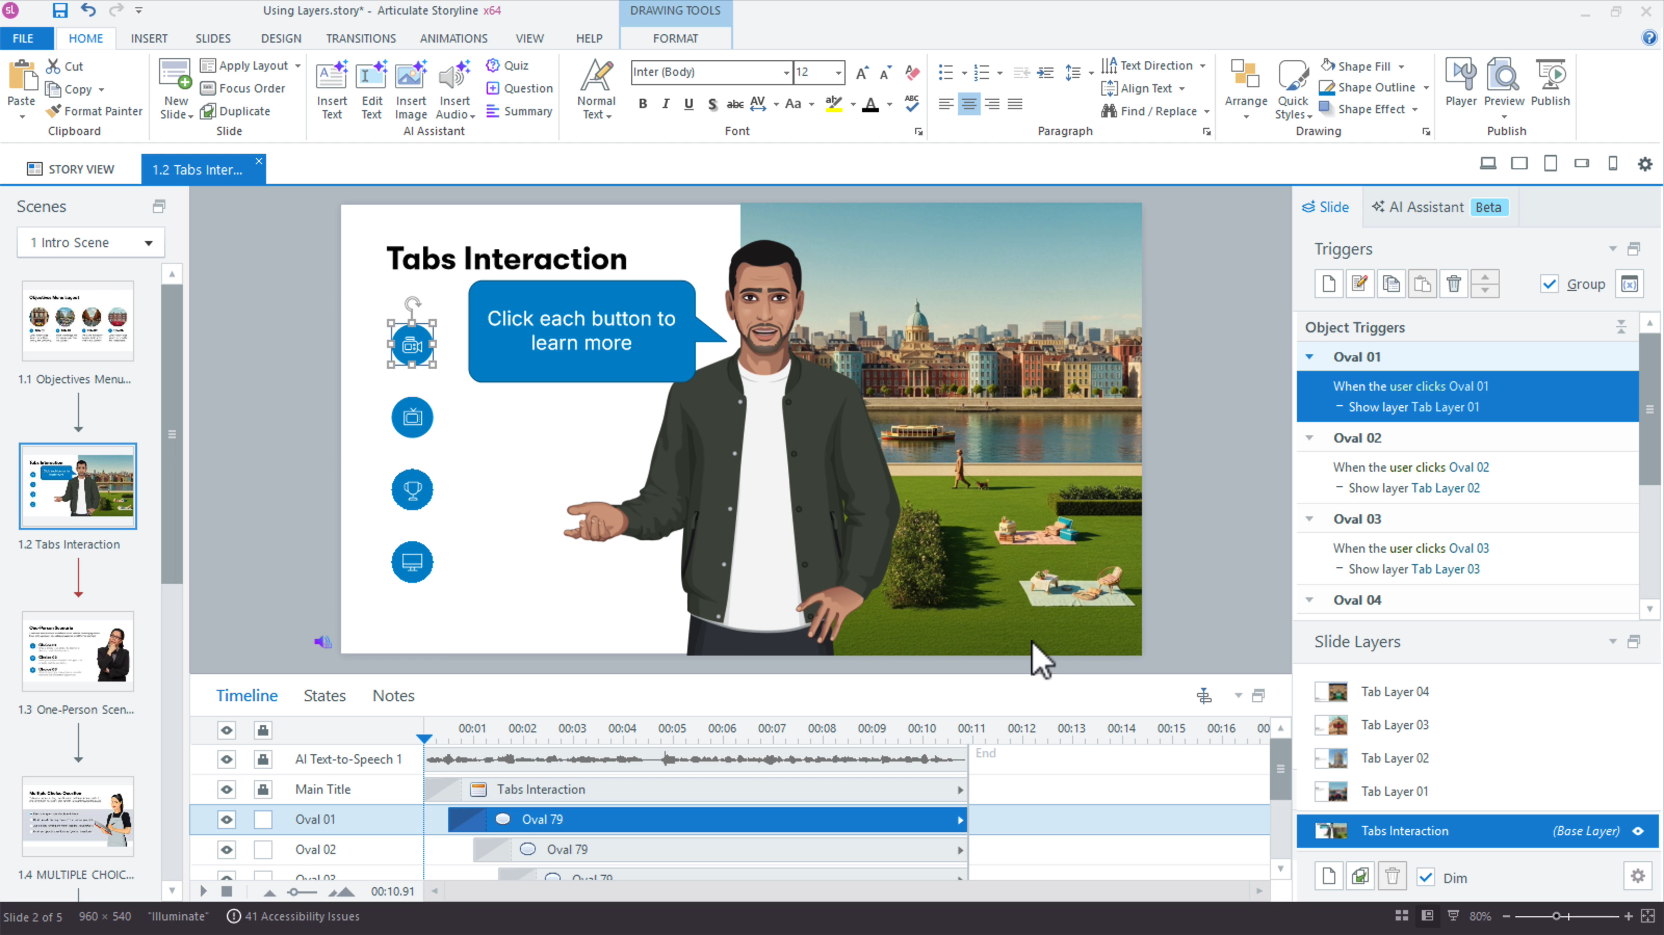
CONCEPT 29 · INTERFACE ORIENTATION
Trigger execution order
NAMED ARTIFACT
WSA-029-Trigger-execution-order
MECHANISM
The Triggers panel orders adjust-variable, change-state and show-layer…
EXPECTED
trigger trace shows the variable updated before feedback/navigation
Authentic Articulate interface reference · verify the named control
© 2026 Tertiary Infotech Academy Pte Ltd · Mastering Articulate Storyline 360 for e-Learning Content Creation · TGS-2024042308
Articulate Storyline 360 official guidance; v11 technical anchor register
123

Slide 124
INTERFACE · NAMED CONFIGURATION
Trigger execution order
SET THESE CONTROLS
C1=event · C2=object · C3=condition · C4=top-to-bottom order
REJECT WHEN
navigation fires before evidence is stored
VERIFY READBACK
trigger trace shows the variable updated before feedback/navigation
Authentic Articulate interface reference · verify the named control
© 2026 Tertiary Infotech Academy Pte Ltd · Mastering Articulate Storyline 360 for e-Learning Content Creation · TGS-2024042308
Articulate Storyline 360 official guidance; v11 technical anchor register
124

Slide 125
TECHNICAL ANCHOR 029 · WORKED SYNTHETIC TRACE
Trigger execution order
FAULTY OUTPUT (EXAMPLE)
navigation fires before evidence is stored
FIX IN NAMED PANEL
event; object; condition; top-to-bottom order
EXPECTED AFTER FIX
trigger trace shows the variable updated before feedback/navigation ·…
Authentic Articulate interface reference · verify the named control
© 2026 Tertiary Infotech Academy Pte Ltd · Mastering Articulate Storyline 360 for e-Learning Content Creation · TGS-2024042308
Articulate Storyline 360 official guidance; v11 technical anchor register
125

Slide 126
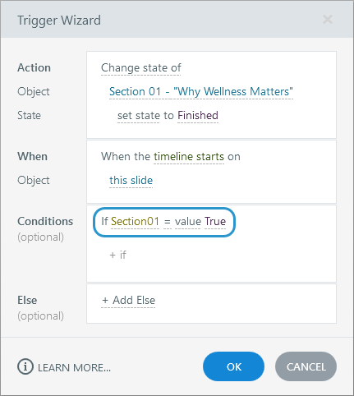
CONCEPT 30 · INTERFACE ORIENTATION
Conditional trigger gate
NAMED ARTIFACT
WSA-030-Conditional-trigger-gate
MECHANISM
Next jumps only when HazardsFound equals 7; otherwise a prompt layer opens
EXPECTED
six hazards block progression; seven allow it
Authentic Articulate interface reference · verify the named control
© 2026 Tertiary Infotech Academy Pte Ltd · Mastering Articulate Storyline 360 for e-Learning Content Creation · TGS-2024042308
Articulate Storyline 360 official guidance; v11 technical anchor register
126

Slide 127
INTERFACE · NAMED CONFIGURATION
Conditional trigger gate
SET THESE CONTROLS
C1=condition · C2=comparison · C3=else feedback · C4=count display
REJECT WHEN
hidden dead-end or gate based on clicks rather than distinct hazards
VERIFY READBACK
six hazards block progression; seven allow it
Authentic Articulate interface reference · verify the named control
© 2026 Tertiary Infotech Academy Pte Ltd · Mastering Articulate Storyline 360 for e-Learning Content Creation · TGS-2024042308
Articulate Storyline 360 official guidance; v11 technical anchor register
127

Slide 128
TECHNICAL ANCHOR 030 · WORKED SYNTHETIC TRACE
Conditional trigger gate
FAULTY OUTPUT (EXAMPLE)
hidden dead-end or gate based on clicks rather than distinct hazards
FIX IN NAMED PANEL
condition; comparison; else feedback; count display
EXPECTED AFTER FIX
six hazards block progression; seven allow it · verify in your own Preview
Authentic Articulate interface reference · verify the named control
© 2026 Tertiary Infotech Academy Pte Ltd · Mastering Articulate Storyline 360 for e-Learning Content Creation · TGS-2024042308
Articulate Storyline 360 official guidance; v11 technical anchor register
128

Slide 129
CONCEPT 31 · INTERFACE ORIENTATION
True/False completion flags
NAMED ARTIFACT
WSA-031-True-False-completion-flags
MECHANISM
Hazard01Found through Hazard07Found prevent repeated clicks inflating the…
EXPECTED
repeated activation leaves HazardsFound unchanged
Authentic Articulate interface reference · verify the named control
© 2026 Tertiary Infotech Academy Pte Ltd · Mastering Articulate Storyline 360 for e-Learning Content Creation · TGS-2024042308
Articulate Storyline 360 official guidance; v11 technical anchor register
129

Slide 130
INTERFACE · NAMED CONFIGURATION
True/False completion flags
SET THESE CONTROLS
C1=default False · C2=condition False · C3=set True
REJECT WHEN
incrementing every time a hotspot is clicked
VERIFY READBACK
repeated activation leaves HazardsFound unchanged
Authentic Articulate interface reference · verify the named control
© 2026 Tertiary Infotech Academy Pte Ltd · Mastering Articulate Storyline 360 for e-Learning Content Creation · TGS-2024042308
Articulate Storyline 360 official guidance; v11 technical anchor register
130

Slide 131
TECHNICAL ANCHOR 031 · WORKED SYNTHETIC TRACE
True/False completion flags
FAULTY OUTPUT (EXAMPLE)
incrementing every time a hotspot is clicked
FIX IN NAMED PANEL
default False; condition False; set True
EXPECTED AFTER FIX
repeated activation leaves HazardsFound unchanged · verify in your own Preview
Authentic Articulate interface reference · verify the named control
© 2026 Tertiary Infotech Academy Pte Ltd · Mastering Articulate Storyline 360 for e-Learning Content Creation · TGS-2024042308
Articulate Storyline 360 official guidance; v11 technical anchor register
131

Slide 132
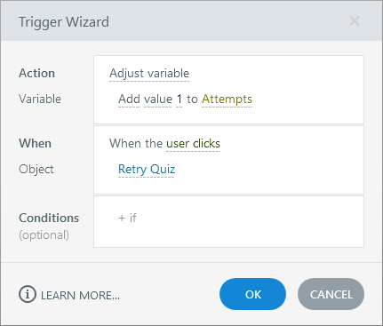
CONCEPT 32 · INTERFACE ORIENTATION
Number variable counter
NAMED ARTIFACT
WSA-032-Number-variable-counter
MECHANISM
HazardsFound increments once per newly identified hazard and drives…
EXPECTED
counter sequence is 0–7 and survives specified revisit
Authentic Articulate interface reference · verify the named control
© 2026 Tertiary Infotech Academy Pte Ltd · Mastering Articulate Storyline 360 for e-Learning Content Creation · TGS-2024042308
Articulate Storyline 360 official guidance; v11 technical anchor register
132

Slide 133
INTERFACE · NAMED CONFIGURATION
Number variable counter
SET THESE CONTROLS
C1=add 1 · C2=variable reference · C3=upper bound · C4=reset
REJECT WHEN
counter exceeding seven or resetting on revisit
VERIFY READBACK
counter sequence is 0–7 and survives specified revisit
Authentic Articulate interface reference · verify the named control
© 2026 Tertiary Infotech Academy Pte Ltd · Mastering Articulate Storyline 360 for e-Learning Content Creation · TGS-2024042308
Articulate Storyline 360 official guidance; v11 technical anchor register
133

Slide 134
TECHNICAL ANCHOR 032 · WORKED SYNTHETIC TRACE
Number variable counter
FAULTY OUTPUT (EXAMPLE)
counter exceeding seven or resetting on revisit
FIX IN NAMED PANEL
add 1; variable reference; upper bound; reset
EXPECTED AFTER FIX
counter sequence is 0–7 and survives specified revisit · verify in your…
Authentic Articulate interface reference · verify the named control
© 2026 Tertiary Infotech Academy Pte Ltd · Mastering Articulate Storyline 360 for e-Learning Content Creation · TGS-2024042308
Articulate Storyline 360 official guidance; v11 technical anchor register
134

Slide 135
CONCEPT 33 · HOW IT WORKS
Variable references
Named HarbourLink WSH artifact
Input / source state
WSA-033-Variable-references
WSA checkpoint plus reference syntax; accessible label; update event
Runtime mechanism
Expected output
Text %HazardsFound% of 7 found gives visible progress tied to runtime state
display matches the variable after every unique selection
Rejected output
Evidence record
hard-coded progress text drifting from logic
WSA-033-Variable-references: capture the configured control and the runtime readback.
© 2026 Tertiary Infotech Academy Pte Ltd · Mastering Articulate Storyline 360 for e-Learning Content Creation · TGS-2024042308
Articulate Storyline 360 official guidance; v11 technical anchor register
135

Slide 136
EDITABLE CONFIGURATION MODEL
Variable references
SET THESE CONTROLS
REJECT WHEN
VERIFY READBACK
C1=reference syntax · C2=accessible label · C3=update event
hard-coded progress text drifting from logic
display matches the variable after every unique selection
→
→
Editable HarbourLink model · display matches the variable after every unique selection
© 2026 Tertiary Infotech Academy Pte Ltd · Mastering Articulate Storyline 360 for e-Learning Content Creation · TGS-2024042308
Articulate Storyline 360 official guidance; v11 technical anchor register
136

Slide 137
TECHNICAL ANCHOR 033 · WORKED SYNTHETIC TRACE
Variable references
FAULTY OUTPUT (EXAMPLE)
CORRECT THE RECORD
EXPECTED AFTER FIX
hard-coded progress text drifting from logic
reference syntax; accessible label; update event
display matches the variable after every unique selection · verify in your own Preview
→
→
Editable HarbourLink model · display matches the variable after every unique selection
© 2026 Tertiary Infotech Academy Pte Ltd · Mastering Articulate Storyline 360 for e-Learning Content Creation · TGS-2024042308
Articulate Storyline 360 official guidance; v11 technical anchor register
137

Slide 138
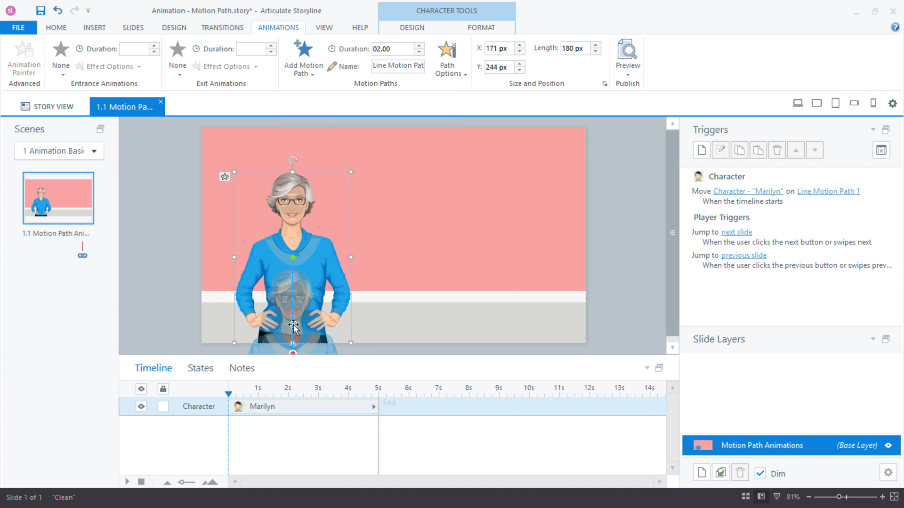
CONCEPT 34 · INTERFACE ORIENTATION
Motion path forklift
NAMED ARTIFACT
WSA-034-Motion-path-forklift
MECHANISM
A named motion path demonstrates a moving-forklift hazard and supports…
EXPECTED
motion starts on learner action, remains visible and can be paused
Authentic Articulate interface reference · verify the named control
© 2026 Tertiary Infotech Academy Pte Ltd · Mastering Articulate Storyline 360 for e-Learning Content Creation · TGS-2024042308
Articulate Storyline 360 official guidance; v11 technical anchor register
138

Slide 139
INTERFACE · NAMED CONFIGURATION
Motion path forklift
SET THESE CONTROLS
C1=path name · C2=duration · C3=relative start · C4=reverse · C5=trigger
REJECT WHEN
uncontrolled autoplay motion or path ending off-canvas
VERIFY READBACK
motion starts on learner action, remains visible and can be paused
Authentic Articulate interface reference · verify the named control
© 2026 Tertiary Infotech Academy Pte Ltd · Mastering Articulate Storyline 360 for e-Learning Content Creation · TGS-2024042308
Articulate Storyline 360 official guidance; v11 technical anchor register
139

Slide 140
TECHNICAL ANCHOR 034 · WORKED SYNTHETIC TRACE
Motion path forklift
FAULTY OUTPUT (EXAMPLE)
uncontrolled autoplay motion or path ending off-canvas
FIX IN NAMED PANEL
path name; duration; relative start; reverse; trigger
EXPECTED AFTER FIX
motion starts on learner action, remains visible and can be paused ·…
Authentic Articulate interface reference · verify the named control
© 2026 Tertiary Infotech Academy Pte Ltd · Mastering Articulate Storyline 360 for e-Learning Content Creation · TGS-2024042308
Articulate Storyline 360 official guidance; v11 technical anchor register
140

Slide 141
CONCEPT 35 · HOW IT WORKS
Animation accessibility
Named HarbourLink WSH artifact
Input / source state
WSA-035-Animation-accessibility
WSA checkpoint plus play/pause; duration; alternative; no flashing
Runtime mechanism
Expected output
Motion is brief, purposeful and paired with static explanation and learner control
meaning is available when animation is paused or skipped
Rejected output
Evidence record
decorative motion causing distraction or vestibular discomfort
WSA-035-Animation-accessibility: capture the configured control and the runtime readback.
© 2026 Tertiary Infotech Academy Pte Ltd · Mastering Articulate Storyline 360 for e-Learning Content Creation · TGS-2024042308
Articulate Storyline 360 official guidance; v11 technical anchor register
141

Slide 142
EDITABLE CONFIGURATION MODEL
Animation accessibility
SET THESE CONTROLS
REJECT WHEN
VERIFY READBACK
C1=play/pause · C2=duration · C3=alternative · C4=no flashing
decorative motion causing distraction or vestibular discomfort
meaning is available when animation is paused or skipped
→
→
Editable HarbourLink model · meaning is available when animation is paused or skipped
© 2026 Tertiary Infotech Academy Pte Ltd · Mastering Articulate Storyline 360 for e-Learning Content Creation · TGS-2024042308
Articulate Storyline 360 official guidance; v11 technical anchor register
142

Slide 143
TECHNICAL ANCHOR 035 · WORKED SYNTHETIC TRACE
Animation accessibility
FAULTY OUTPUT (EXAMPLE)
CORRECT THE RECORD
EXPECTED AFTER FIX
decorative motion causing distraction or vestibular discomfort
play/pause; duration; alternative; no flashing
meaning is available when animation is paused or skipped · verify in your own Preview
→
→
Editable HarbourLink model · meaning is available when animation is paused or skipped
© 2026 Tertiary Infotech Academy Pte Ltd · Mastering Articulate Storyline 360 for e-Learning Content Creation · TGS-2024042308
Articulate Storyline 360 official guidance; v11 technical anchor register
143

Slide 144
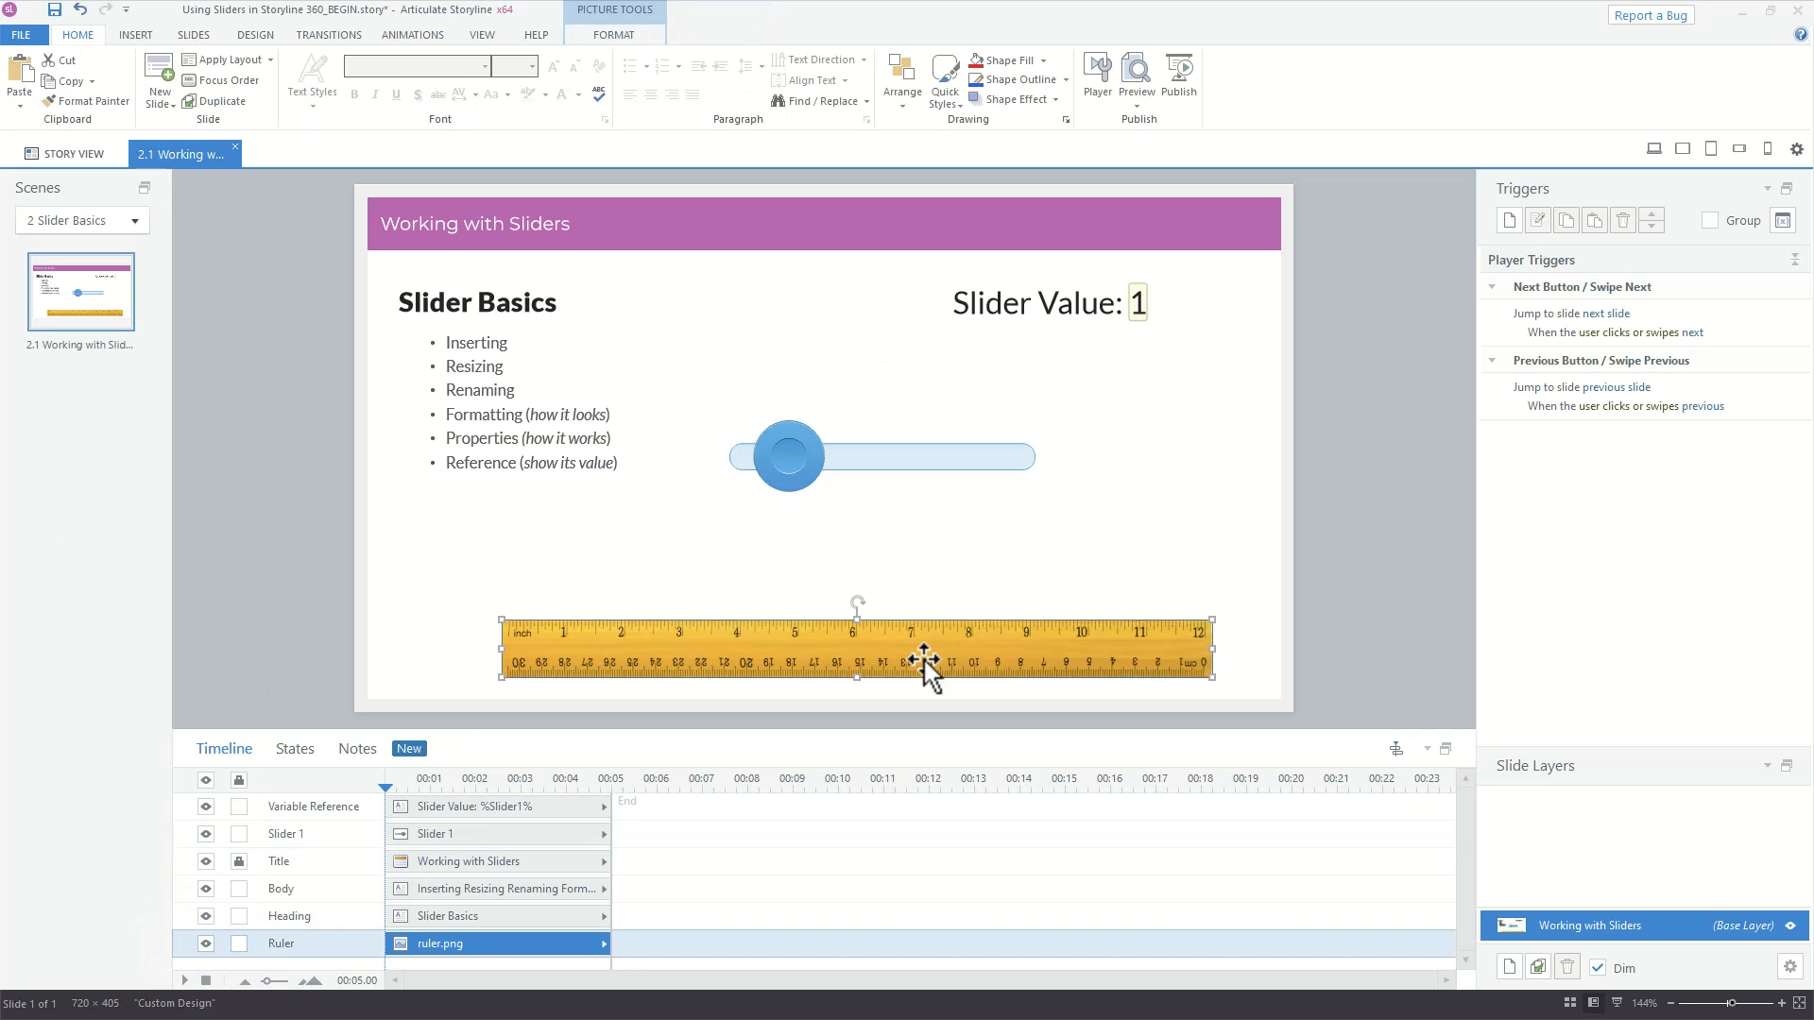
CONCEPT 36 · INTERFACE ORIENTATION
Slider risk control
NAMED ARTIFACT
WSA-036-Slider-risk-control
MECHANISM
A 1–5 slider writes RiskLevel and updates a textual risk classification
EXPECTED
arrow keys change the value and every value has a text equivalent
Authentic Articulate interface reference · verify the named control
© 2026 Tertiary Infotech Academy Pte Ltd · Mastering Articulate Storyline 360 for e-Learning Content Creation · TGS-2024042308
Articulate Storyline 360 official guidance; v11 technical anchor register
144

Slide 145
INTERFACE · NAMED CONFIGURATION
Slider risk control
SET THESE CONTROLS
C1=start · C2=end · C3=step · C4=variable · C5=state mapping
REJECT WHEN
unlabelled values or pointer-only input
VERIFY READBACK
arrow keys change the value and every value has a text equivalent
Authentic Articulate interface reference · verify the named control
© 2026 Tertiary Infotech Academy Pte Ltd · Mastering Articulate Storyline 360 for e-Learning Content Creation · TGS-2024042308
Articulate Storyline 360 official guidance; v11 technical anchor register
145

Slide 146
TECHNICAL ANCHOR 036 · WORKED SYNTHETIC TRACE
Slider risk control
FAULTY OUTPUT (EXAMPLE)
unlabelled values or pointer-only input
FIX IN NAMED PANEL
start; end; step; variable; state mapping
EXPECTED AFTER FIX
arrow keys change the value and every value has a text equivalent · verify…
Authentic Articulate interface reference · verify the named control
© 2026 Tertiary Infotech Academy Pte Ltd · Mastering Articulate Storyline 360 for e-Learning Content Creation · TGS-2024042308
Articulate Storyline 360 official guidance; v11 technical anchor register
146

Slide 147
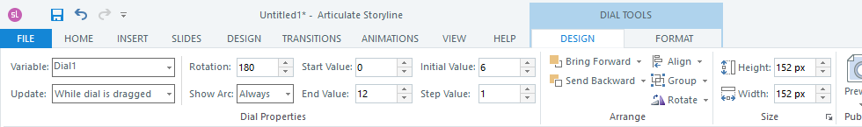
CONCEPT 37 · INTERFACE ORIENTATION
Dial inspection control
NAMED ARTIFACT
WSA-037-Dial-inspection-control
MECHANISM
A dial rotates through inspection zones and reveals the matching checklist…
EXPECTED
each detent selects exactly one named inspection zone
Authentic Articulate interface reference · verify the named control
© 2026 Tertiary Infotech Academy Pte Ltd · Mastering Articulate Storyline 360 for e-Learning Content Creation · TGS-2024042308
Articulate Storyline 360 official guidance; v11 technical anchor register
147

Slide 148
INTERFACE · NAMED CONFIGURATION
Dial inspection control
SET THESE CONTROLS
C1=steps · C2=start · C3=end · C4=variable · C5=trigger
REJECT WHEN
continuous values with unreachable layers
VERIFY READBACK
each detent selects exactly one named inspection zone
Authentic Articulate interface reference · verify the named control
© 2026 Tertiary Infotech Academy Pte Ltd · Mastering Articulate Storyline 360 for e-Learning Content Creation · TGS-2024042308
Articulate Storyline 360 official guidance; v11 technical anchor register
148

Slide 149
TECHNICAL ANCHOR 037 · WORKED SYNTHETIC TRACE
Dial inspection control
FAULTY OUTPUT (EXAMPLE)
continuous values with unreachable layers
FIX IN NAMED PANEL
steps; start; end; variable; trigger
EXPECTED AFTER FIX
each detent selects exactly one named inspection zone · verify in your own…
Authentic Articulate interface reference · verify the named control
© 2026 Tertiary Infotech Academy Pte Ltd · Mastering Articulate Storyline 360 for e-Learning Content Creation · TGS-2024042308
Articulate Storyline 360 official guidance; v11 technical anchor register
149

Slide 150
CONCEPT 38 · HOW IT WORKS
Web object incident form
Named HarbourLink WSH artifact
Input / source state
WSA-038-Web-object-incident-form
WSA checkpoint plus index.html root; focus exit; fallback link; offline test
Runtime mechanism
Expected output
Insert > Web Object embeds the supplied local incident-report simulation folder
published output loads locally and keyboard users can enter and leave it
Rejected output
Evidence record
selecting a single HTML file or depending on external tracking
WSA-038-Web-object-incident-form: capture the configured control and the runtime readback.
© 2026 Tertiary Infotech Academy Pte Ltd · Mastering Articulate Storyline 360 for e-Learning Content Creation · TGS-2024042308
Articulate Storyline 360 official guidance; v11 technical anchor register
150

Slide 151
EDITABLE CONFIGURATION MODEL
Web object incident form
SET THESE CONTROLS
REJECT WHEN
VERIFY READBACK
C1=index.html root · C2=focus exit · C3=fallback link · C4=offline test
selecting a single HTML file or depending on external tracking
published output loads locally and keyboard users can enter and leave it
→
→
Editable HarbourLink model · published output loads locally and keyboard users can enter and leave it
© 2026 Tertiary Infotech Academy Pte Ltd · Mastering Articulate Storyline 360 for e-Learning Content Creation · TGS-2024042308
Articulate Storyline 360 official guidance; v11 technical anchor register
151

Slide 152
TECHNICAL ANCHOR 038 · WORKED SYNTHETIC TRACE
Web object incident form
FAULTY OUTPUT (EXAMPLE)
CORRECT THE RECORD
EXPECTED AFTER FIX
selecting a single HTML file or depending on external tracking
index.html root; focus exit; fallback link; offline test
published output loads locally and keyboard users can enter and leave it · verify in your own Preview
→
→
Editable HarbourLink model · published output loads locally and keyboard users can enter and leave it
© 2026 Tertiary Infotech Academy Pte Ltd · Mastering Articulate Storyline 360 for e-Learning Content Creation · TGS-2024042308
Articulate Storyline 360 official guidance; v11 technical anchor register
152

Slide 153
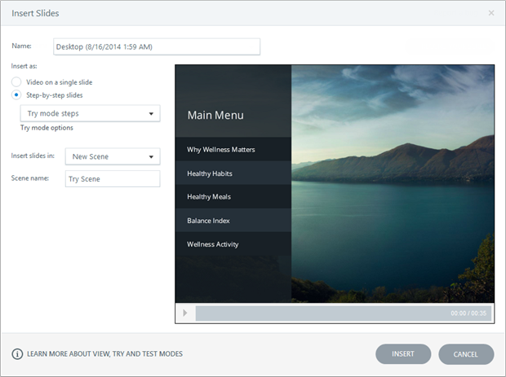
CONCEPT 39 · INTERFACE ORIENTATION
Screen recording preparation
NAMED ARTIFACT
WSA-039-Screen-recording-preparation
MECHANISM
Slides > Record Screen captures a clean bounded application workflow with…
EXPECTED
test capture is readable and follows the scripted incident-report path
Authentic Articulate interface reference · verify the named control
© 2026 Tertiary Infotech Academy Pte Ltd · Mastering Articulate Storyline 360 for e-Learning Content Creation · TGS-2024042308
Articulate Storyline 360 official guidance; v11 technical anchor register
153

Slide 154
INTERFACE · NAMED CONFIGURATION
Screen recording preparation
SET THESE CONTROLS
C1=recording region · C2=resolution · C3=notifications · C4=rehearsal
REJECT WHEN
tiny UI, exposed data or unplanned cursor search
VERIFY READBACK
test capture is readable and follows the scripted incident-report path
Authentic Articulate interface reference · verify the named control
© 2026 Tertiary Infotech Academy Pte Ltd · Mastering Articulate Storyline 360 for e-Learning Content Creation · TGS-2024042308
Articulate Storyline 360 official guidance; v11 technical anchor register
154

Slide 155
TECHNICAL ANCHOR 039 · WORKED SYNTHETIC TRACE
Screen recording preparation
FAULTY OUTPUT (EXAMPLE)
tiny UI, exposed data or unplanned cursor search
FIX IN NAMED PANEL
recording region; resolution; notifications; rehearsal
EXPECTED AFTER FIX
test capture is readable and follows the scripted incident-report path ·…
Authentic Articulate interface reference · verify the named control
© 2026 Tertiary Infotech Academy Pte Ltd · Mastering Articulate Storyline 360 for e-Learning Content Creation · TGS-2024042308
Articulate Storyline 360 official guidance; v11 technical anchor register
155

Slide 156
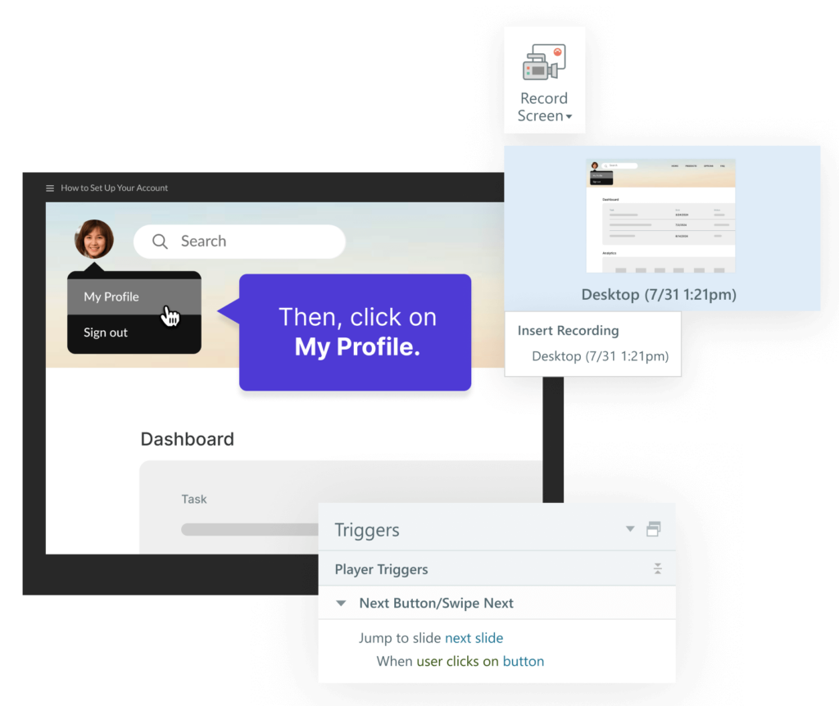
CONCEPT 40 · INTERFACE ORIENTATION
View mode screencast
NAMED ARTIFACT
WSA-040-View-mode-screencast
MECHANISM
Insert recording as Video on a Single Slide for an uninterrupted demonstration
EXPECTED
learner can pause, seek and use captions/transcript
Authentic Articulate interface reference · verify the named control
© 2026 Tertiary Infotech Academy Pte Ltd · Mastering Articulate Storyline 360 for e-Learning Content Creation · TGS-2024042308
Articulate Storyline 360 official guidance; v11 technical anchor register
156

Slide 157
INTERFACE · NAMED CONFIGURATION
View mode screencast
SET THESE CONTROLS
C1=video controls · C2=captions · C3=trim · C4=poster frame
REJECT WHEN
autoplay sound or unreadable cursor detail
VERIFY READBACK
learner can pause, seek and use captions/transcript
Authentic Articulate interface reference · verify the named control
© 2026 Tertiary Infotech Academy Pte Ltd · Mastering Articulate Storyline 360 for e-Learning Content Creation · TGS-2024042308
Articulate Storyline 360 official guidance; v11 technical anchor register
157

Slide 158
TECHNICAL ANCHOR 040 · WORKED SYNTHETIC TRACE
View mode screencast
FAULTY OUTPUT (EXAMPLE)
autoplay sound or unreadable cursor detail
FIX IN NAMED PANEL
video controls; captions; trim; poster frame
EXPECTED AFTER FIX
learner can pause, seek and use captions/transcript · verify in your own…
Authentic Articulate interface reference · verify the named control
© 2026 Tertiary Infotech Academy Pte Ltd · Mastering Articulate Storyline 360 for e-Learning Content Creation · TGS-2024042308
Articulate Storyline 360 official guidance; v11 technical anchor register
158

Slide 159
CONCEPT 41 · INTERFACE ORIENTATION
Try mode simulation
NAMED ARTIFACT
WSA-041-Try-mode-simulation
MECHANISM
Insert recording as Step-by-Step Slides > Try Mode adds coached…
EXPECTED
expected actions advance and wrong actions show actionable coaching
Authentic Articulate interface reference · verify the named control
© 2026 Tertiary Infotech Academy Pte Ltd · Mastering Articulate Storyline 360 for e-Learning Content Creation · TGS-2024042308
Articulate Storyline 360 official guidance; v11 technical anchor register
159

Slide 160
INTERFACE · NAMED CONFIGURATION
Try mode simulation
SET THESE CONTROLS
C1=hint caption · C2=hotspot · C3=failure layer · C4=attempts
REJECT WHEN
automatic steps accepting the wrong target
VERIFY READBACK
expected actions advance and wrong actions show actionable coaching
Authentic Articulate interface reference · verify the named control
© 2026 Tertiary Infotech Academy Pte Ltd · Mastering Articulate Storyline 360 for e-Learning Content Creation · TGS-2024042308
Articulate Storyline 360 official guidance; v11 technical anchor register
160

Slide 161
TECHNICAL ANCHOR 041 · WORKED SYNTHETIC TRACE
Try mode simulation
FAULTY OUTPUT (EXAMPLE)
automatic steps accepting the wrong target
FIX IN NAMED PANEL
hint caption; hotspot; failure layer; attempts
EXPECTED AFTER FIX
expected actions advance and wrong actions show actionable coaching ·…
Authentic Articulate interface reference · verify the named control
© 2026 Tertiary Infotech Academy Pte Ltd · Mastering Articulate Storyline 360 for e-Learning Content Creation · TGS-2024042308
Articulate Storyline 360 official guidance; v11 technical anchor register
161

Slide 162
CONCEPT 42 · INTERFACE ORIENTATION
Test mode simulation
NAMED ARTIFACT
WSA-042-Test-mode-simulation
MECHANISM
Test Mode records scored actions without coaching and reports through a…
EXPECTED
correct and incorrect actions score according to the specification
Authentic Articulate interface reference · verify the named control
© 2026 Tertiary Infotech Academy Pte Ltd · Mastering Articulate Storyline 360 for e-Learning Content Creation · TGS-2024042308
Articulate Storyline 360 official guidance; v11 technical anchor register
162

Slide 163
INTERFACE · NAMED CONFIGURATION
Test mode simulation
SET THESE CONTROLS
C1=score · C2=attempts · C3=feedback · C4=tracked result
REJECT WHEN
testing pixel precision instead of meaningful action
VERIFY READBACK
correct and incorrect actions score according to the specification
Authentic Articulate interface reference · verify the named control
© 2026 Tertiary Infotech Academy Pte Ltd · Mastering Articulate Storyline 360 for e-Learning Content Creation · TGS-2024042308
Articulate Storyline 360 official guidance; v11 technical anchor register
163

Slide 164
TECHNICAL ANCHOR 042 · WORKED SYNTHETIC TRACE
Test mode simulation
FAULTY OUTPUT (EXAMPLE)
testing pixel precision instead of meaningful action
FIX IN NAMED PANEL
score; attempts; feedback; tracked result
EXPECTED AFTER FIX
correct and incorrect actions score according to the specification ·…
Authentic Articulate interface reference · verify the named control
© 2026 Tertiary Infotech Academy Pte Ltd · Mastering Articulate Storyline 360 for e-Learning Content Creation · TGS-2024042308
Articulate Storyline 360 official guidance; v11 technical anchor register
164

Slide 165
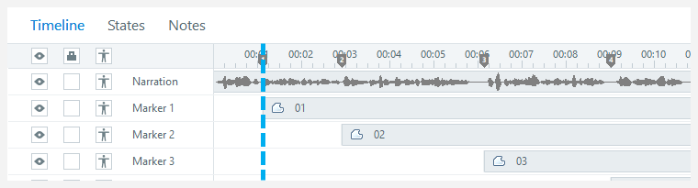
CONCEPT 43 · INTERFACE ORIENTATION
Audio narration import
NAMED ARTIFACT
WSA-043-Audio-narration-import
MECHANISM
Insert > Audio > Audio from File places the supplied WAV/MP3 on the…
EXPECTED
one intelligible track plays and stops at the specified boundary
Authentic Articulate interface reference · verify the named control
© 2026 Tertiary Infotech Academy Pte Ltd · Mastering Articulate Storyline 360 for e-Learning Content Creation · TGS-2024042308
Articulate Storyline 360 official guidance; v11 technical anchor register
165

Slide 166
INTERFACE · NAMED CONFIGURATION
Audio narration import
SET THESE CONTROLS
C1=timeline name · C2=trim · C3=volume · C4=fade · C5=playback
REJECT WHEN
multiple tracks overlapping on revisit
VERIFY READBACK
one intelligible track plays and stops at the specified boundary
Authentic Articulate interface reference · verify the named control
© 2026 Tertiary Infotech Academy Pte Ltd · Mastering Articulate Storyline 360 for e-Learning Content Creation · TGS-2024042308
Articulate Storyline 360 official guidance; v11 technical anchor register
166

Slide 167
TECHNICAL ANCHOR 043 · WORKED SYNTHETIC TRACE
Audio narration import
FAULTY OUTPUT (EXAMPLE)
multiple tracks overlapping on revisit
FIX IN NAMED PANEL
timeline name; trim; volume; fade; playback
EXPECTED AFTER FIX
one intelligible track plays and stops at the specified boundary · verify…
Authentic Articulate interface reference · verify the named control
© 2026 Tertiary Infotech Academy Pte Ltd · Mastering Articulate Storyline 360 for e-Learning Content Creation · TGS-2024042308
Articulate Storyline 360 official guidance; v11 technical anchor register
167

Slide 168
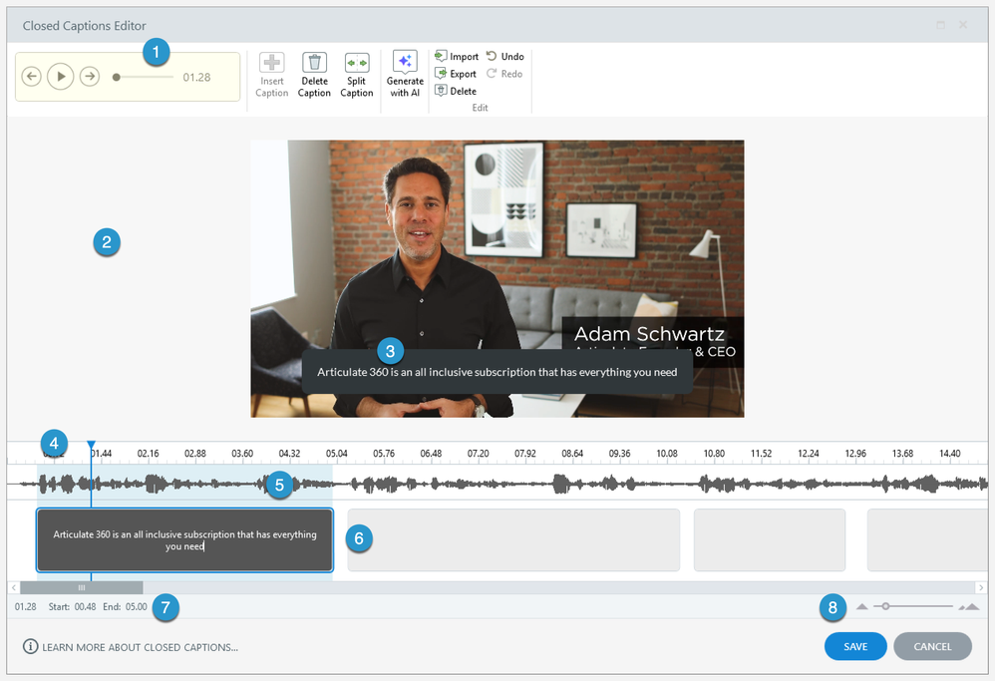
CONCEPT 44 · INTERFACE ORIENTATION
Caption import
NAMED ARTIFACT
WSA-044-Caption-import
MECHANISM
Select the audio, then Options > Import (or Accessibility > Import CC)…
EXPECTED
caption spot-check matches narration at start, middle and end
Authentic Articulate interface reference · verify the named control
© 2026 Tertiary Infotech Academy Pte Ltd · Mastering Articulate Storyline 360 for e-Learning Content Creation · TGS-2024042308
Articulate Storyline 360 official guidance; v11 technical anchor register
168

Slide 169
INTERFACE · NAMED CONFIGURATION
Caption import
SET THESE CONTROLS
C1=VTT timing · C2=speaker labels · C3=meaningful sound · C4=position
REJECT WHEN
captions drifting or covering controls
VERIFY READBACK
caption spot-check matches narration at start, middle and end
Authentic Articulate interface reference · verify the named control
© 2026 Tertiary Infotech Academy Pte Ltd · Mastering Articulate Storyline 360 for e-Learning Content Creation · TGS-2024042308
Articulate Storyline 360 official guidance; v11 technical anchor register
169

Slide 170
TECHNICAL ANCHOR 044 · WORKED SYNTHETIC TRACE
Caption import
FAULTY OUTPUT (EXAMPLE)
captions drifting or covering controls
FIX IN NAMED PANEL
VTT timing; speaker labels; meaningful sound; position
EXPECTED AFTER FIX
caption spot-check matches narration at start, middle and end · verify in…
Authentic Articulate interface reference · verify the named control
© 2026 Tertiary Infotech Academy Pte Ltd · Mastering Articulate Storyline 360 for e-Learning Content Creation · TGS-2024042308
Articulate Storyline 360 official guidance; v11 technical anchor register
170

Slide 171
CONCEPT 45 · HOW IT WORKS
Transcript equivalent
Named HarbourLink WSH artifact
Input / source state
WSA-045-Transcript-equivalent
WSA checkpoint plus equivalent meaning; reading order; download link
Runtime mechanism
Expected output
Resources or an accessible text layer supplies narration plus relevant visual actions
learner can complete the objective without hearing the audio
Rejected output
Evidence record
verbatim transcript omitting visual hazards
WSA-045-Transcript-equivalent: capture the configured control and the runtime readback.
© 2026 Tertiary Infotech Academy Pte Ltd · Mastering Articulate Storyline 360 for e-Learning Content Creation · TGS-2024042308
Articulate Storyline 360 official guidance; v11 technical anchor register
171

Slide 172
EDITABLE CONFIGURATION MODEL
Transcript equivalent
SET THESE CONTROLS
REJECT WHEN
VERIFY READBACK
C1=equivalent meaning · C2=reading order · C3=download link
verbatim transcript omitting visual hazards
learner can complete the objective without hearing the audio
→
→
Editable HarbourLink model · learner can complete the objective without hearing the audio
© 2026 Tertiary Infotech Academy Pte Ltd · Mastering Articulate Storyline 360 for e-Learning Content Creation · TGS-2024042308
Articulate Storyline 360 official guidance; v11 technical anchor register
172

Slide 173
TECHNICAL ANCHOR 045 · WORKED SYNTHETIC TRACE
Transcript equivalent
FAULTY OUTPUT (EXAMPLE)
CORRECT THE RECORD
EXPECTED AFTER FIX
verbatim transcript omitting visual hazards
equivalent meaning; reading order; download link
learner can complete the objective without hearing the audio · verify in your own Preview
→
→
Editable HarbourLink model · learner can complete the objective without hearing the audio
© 2026 Tertiary Infotech Academy Pte Ltd · Mastering Articulate Storyline 360 for e-Learning Content Creation · TGS-2024042308
Articulate Storyline 360 official guidance; v11 technical anchor register
173

Slide 174
CONCEPT 46 · HOW IT WORKS
Focus order panel
Named HarbourLink WSH artifact
Input / source state
WSA-046-Focus-order-panel
WSA checkpoint plus object visibility; order; names; layer focus
Runtime mechanism
Expected output
Home > Focus Order removes decorative objects and sequences interactive content logically
Tab/Shift+Tab follows the intended task sequence
Rejected output
Evidence record
timeline order mistaken for reading order
WSA-046-Focus-order-panel: capture the configured control and the runtime readback.
© 2026 Tertiary Infotech Academy Pte Ltd · Mastering Articulate Storyline 360 for e-Learning Content Creation · TGS-2024042308
Articulate Storyline 360 official guidance; v11 technical anchor register
174

Slide 175
EDITABLE CONFIGURATION MODEL
Focus order panel
SET THESE CONTROLS
REJECT WHEN
VERIFY READBACK
C1=object visibility · C2=order · C3=names · C4=layer focus
timeline order mistaken for reading order
Tab/Shift+Tab follows the intended task sequence
→
→
Editable HarbourLink model · Tab/Shift+Tab follows the intended task sequence
© 2026 Tertiary Infotech Academy Pte Ltd · Mastering Articulate Storyline 360 for e-Learning Content Creation · TGS-2024042308
Articulate Storyline 360 official guidance; v11 technical anchor register
175

Slide 176
TECHNICAL ANCHOR 046 · WORKED SYNTHETIC TRACE
Focus order panel
FAULTY OUTPUT (EXAMPLE)
CORRECT THE RECORD
EXPECTED AFTER FIX
timeline order mistaken for reading order
object visibility; order; names; layer focus
Tab/Shift+Tab follows the intended task sequence · verify in your own Preview
→
→
Editable HarbourLink model · Tab/Shift+Tab follows the intended task sequence
© 2026 Tertiary Infotech Academy Pte Ltd · Mastering Articulate Storyline 360 for e-Learning Content Creation · TGS-2024042308
Articulate Storyline 360 official guidance; v11 technical anchor register
176

Slide 177
CONCEPT 47 · HOW IT WORKS
Alternative text
Named HarbourLink WSH artifact
Input / source state
WSA-047-Alternative-text
WSA checkpoint plus concise purpose; decorative blank; no filename
Runtime mechanism
Expected output
Size and Position > Accessibility names meaningful images and controls
screen-reader output conveys the hazard and available action
Rejected output
Evidence record
describing appearance but omitting instructional meaning
WSA-047-Alternative-text: capture the configured control and the runtime readback.
© 2026 Tertiary Infotech Academy Pte Ltd · Mastering Articulate Storyline 360 for e-Learning Content Creation · TGS-2024042308
Articulate Storyline 360 official guidance; v11 technical anchor register
177

Slide 178
EDITABLE CONFIGURATION MODEL
Alternative text
SET THESE CONTROLS
REJECT WHEN
VERIFY READBACK
C1=concise purpose · C2=decorative blank · C3=no filename
describing appearance but omitting instructional meaning
screen-reader output conveys the hazard and available action
→
→
Editable HarbourLink model · screen-reader output conveys the hazard and available action
© 2026 Tertiary Infotech Academy Pte Ltd · Mastering Articulate Storyline 360 for e-Learning Content Creation · TGS-2024042308
Articulate Storyline 360 official guidance; v11 technical anchor register
178

Slide 179
TECHNICAL ANCHOR 047 · WORKED SYNTHETIC TRACE
Alternative text
FAULTY OUTPUT (EXAMPLE)
CORRECT THE RECORD
EXPECTED AFTER FIX
describing appearance but omitting instructional meaning
concise purpose; decorative blank; no filename
screen-reader output conveys the hazard and available action · verify in your own Preview
→
→
Editable HarbourLink model · screen-reader output conveys the hazard and available action
© 2026 Tertiary Infotech Academy Pte Ltd · Mastering Articulate Storyline 360 for e-Learning Content Creation · TGS-2024042308
Articulate Storyline 360 official guidance; v11 technical anchor register
179

Slide 180
CONCEPT 48 · HOW IT WORKS
Accessible text styling
Named HarbourLink WSH artifact
Input / source state
WSA-048-Accessible-text-styling
WSA checkpoint plus font size; contrast; spacing; heading role
Runtime mechanism
Expected output
Native text, sufficient contrast and restrained formatting preserve zoom and reflow usability
content remains readable at 200% browser zoom
Rejected output
Evidence record
text baked into images or low-contrast overlays
WSA-048-Accessible-text-styling: capture the configured control and the runtime readback.
© 2026 Tertiary Infotech Academy Pte Ltd · Mastering Articulate Storyline 360 for e-Learning Content Creation · TGS-2024042308
Articulate Storyline 360 official guidance; v11 technical anchor register
180

Slide 181
EDITABLE CONFIGURATION MODEL
Accessible text styling
SET THESE CONTROLS
REJECT WHEN
VERIFY READBACK
C1=font size · C2=contrast · C3=spacing · C4=heading role
text baked into images or low-contrast overlays
content remains readable at 200% browser zoom
→
→
Editable HarbourLink model · content remains readable at 200% browser zoom
© 2026 Tertiary Infotech Academy Pte Ltd · Mastering Articulate Storyline 360 for e-Learning Content Creation · TGS-2024042308
Articulate Storyline 360 official guidance; v11 technical anchor register
181

Slide 182
TECHNICAL ANCHOR 048 · WORKED SYNTHETIC TRACE
Accessible text styling
FAULTY OUTPUT (EXAMPLE)
CORRECT THE RECORD
EXPECTED AFTER FIX
text baked into images or low-contrast overlays
font size; contrast; spacing; heading role
content remains readable at 200% browser zoom · verify in your own Preview
→
→
Editable HarbourLink model · content remains readable at 200% browser zoom
© 2026 Tertiary Infotech Academy Pte Ltd · Mastering Articulate Storyline 360 for e-Learning Content Creation · TGS-2024042308
Articulate Storyline 360 official guidance; v11 technical anchor register
182

Slide 183
CONCEPT 49 · HOW IT WORKS
Audience preference matrix
Named HarbourLink WSH artifact
Input / source state
WSA-049-Audience-preference-matrix
WSA checkpoint plus persona; context; device; language; accessibility; format; duration
Runtime mechanism
Expected output
A worked matrix compares new warehouse staff, supervisors and mobile field staff by prior knowledge, language, device, bandwidth, session length and evidence need
each audience difference changes a named media, interaction or delivery choice
Rejected output
Evidence record
using one content style because it is convenient for the author
WSA-049-Audience-preference-matrix: capture the configured control and the runtime readback.
© 2026 Tertiary Infotech Academy Pte Ltd · Mastering Articulate Storyline 360 for e-Learning Content Creation · TGS-2024042308
Articulate Storyline 360 official guidance; v11 technical anchor register
183

Slide 184
EDITABLE CONFIGURATION MODEL
Audience preference matrix
SET THESE CONTROLS
REJECT WHEN
VERIFY READBACK
C1=persona · C2=context · C3=device · C4=language · C5=accessibility · C6=format · C7=duration
using one content style because it is convenient for the author
each audience difference changes a named media, interaction or delivery choice
→
→
Editable HarbourLink model · each audience difference changes a named media, interaction or delivery choice
© 2026 Tertiary Infotech Academy Pte Ltd · Mastering Articulate Storyline 360 for e-Learning Content Creation · TGS-2024042308
Articulate Storyline 360 official guidance; v11 technical anchor register
184

Slide 185
TECHNICAL ANCHOR 049 · WORKED SYNTHETIC TRACE
Audience preference matrix
FAULTY OUTPUT (EXAMPLE)
CORRECT THE RECORD
EXPECTED AFTER FIX
using one content style because it is convenient for the author
persona; context; device; language; accessibility; format; duration
each audience difference changes a named media, interaction or delivery choice · verify in your own Preview
→
→
Editable HarbourLink model · each audience difference changes a named media, interaction or delivery choice
© 2026 Tertiary Infotech Academy Pte Ltd · Mastering Articulate Storyline 360 for e-Learning Content Creation · TGS-2024042308
Articulate Storyline 360 official guidance; v11 technical anchor register
185

Slide 186
CONCEPT 50 · HOW IT WORKS
Content type and style decision
Named HarbourLink WSH artifact
Input / source state
WSA-050-Content-type-and-style-decision
WSA checkpoint plus content type; style; mode; criterion; score; rationale
Runtime mechanism
Expected output
A selection table scores narrated scenario, hotspot inspection, job aid and quiz against immediacy, practice, accessibility and tracking
selected mix has a recorded criterion-level rationale and accessible equivalent
Rejected output
Evidence record
choosing novelty over performance need
WSA-050-Content-type-and-style-decision: capture the configured control and the runtime readback.
© 2026 Tertiary Infotech Academy Pte Ltd · Mastering Articulate Storyline 360 for e-Learning Content Creation · TGS-2024042308
Articulate Storyline 360 official guidance; v11 technical anchor register
186

Slide 187
EDITABLE CONFIGURATION MODEL
Content type and style decision
SET THESE CONTROLS
REJECT WHEN
VERIFY READBACK
C1=content type · C2=style · C3=mode · C4=criterion · C5=score · C6=rationale
choosing novelty over performance need
selected mix has a recorded criterion-level rationale and accessible equivalent
→
→
Editable HarbourLink model · selected mix has a recorded criterion-level rationale and accessible equivalent
© 2026 Tertiary Infotech Academy Pte Ltd · Mastering Articulate Storyline 360 for e-Learning Content Creation · TGS-2024042308
Articulate Storyline 360 official guidance; v11 technical anchor register
187

Slide 188
TECHNICAL ANCHOR 050 · WORKED SYNTHETIC TRACE
Content type and style decision
FAULTY OUTPUT (EXAMPLE)
CORRECT THE RECORD
EXPECTED AFTER FIX
choosing novelty over performance need
content type; style; mode; criterion; score; rationale
selected mix has a recorded criterion-level rationale and accessible equivalent · verify in your own Preview
→
→
Editable HarbourLink model · selected mix has a recorded criterion-level rationale and accessible equivalent
© 2026 Tertiary Infotech Academy Pte Ltd · Mastering Articulate Storyline 360 for e-Learning Content Creation · TGS-2024042308
Articulate Storyline 360 official guidance; v11 technical anchor register
188

Slide 189
CONCEPT 51 · HOW IT WORKS
Safety content feature specification
Named HarbourLink WSH artifact
Input / source state
WSA-051-Safety-content-feature-specification
WSA checkpoint plus accuracy; relevance; clarity; interactivity; accessibility; provenance
Runtime mechanism
Expected output
The specification defines concise copy, realistic hazards, consequence feedback, learner control, captions and persistent progress as mandatory features
each feature has an owner, threshold and preview/publish test
Rejected output
Evidence record
describing features as broad benefits without acceptance values
WSA-051-Safety-content-feature-specification: capture the configured control and the runtime readback.
© 2026 Tertiary Infotech Academy Pte Ltd · Mastering Articulate Storyline 360 for e-Learning Content Creation · TGS-2024042308
Articulate Storyline 360 official guidance; v11 technical anchor register
189

Slide 190
EDITABLE CONFIGURATION MODEL
Safety content feature specification
SET THESE CONTROLS
REJECT WHEN
VERIFY READBACK
C1=accuracy · C2=relevance · C3=clarity · C4=interactivity · C5=accessibility · C6=provenance
describing features as broad benefits without acceptance values
each feature has an owner, threshold and preview/publish test
→
→
Editable HarbourLink model · each feature has an owner, threshold and preview/publish test
© 2026 Tertiary Infotech Academy Pte Ltd · Mastering Articulate Storyline 360 for e-Learning Content Creation · TGS-2024042308
Articulate Storyline 360 official guidance; v11 technical anchor register
190

Slide 191
TECHNICAL ANCHOR 051 · WORKED SYNTHETIC TRACE
Safety content feature specification
FAULTY OUTPUT (EXAMPLE)
CORRECT THE RECORD
EXPECTED AFTER FIX
describing features as broad benefits without acceptance values
accuracy; relevance; clarity; interactivity; accessibility; provenance
each feature has an owner, threshold and preview/publish test · verify in your own Preview
→
→
Editable HarbourLink model · each feature has an owner, threshold and preview/publish test
© 2026 Tertiary Infotech Academy Pte Ltd · Mastering Articulate Storyline 360 for e-Learning Content Creation · TGS-2024042308
Articulate Storyline 360 official guidance; v11 technical anchor register
191

Slide 192
CONCEPT 52 · HOW IT WORKS
Content Library 360 assets
Named HarbourLink WSH artifact
Input / source state
WSA-052-Content-Library-360-assets
WSA checkpoint plus asset type; search/filter; licence context; crop; alt text
Runtime mechanism
Expected output
Insert > Content Library 360 adds a permitted template, character or media asset and records its use
inserted asset is adapted to the WSA theme and has purpose, provenance and accessibility metadata
Rejected output
Evidence record
treating a template as finished instruction or mixing incompatible styles
WSA-052-Content-Library-360-assets: capture the configured control and the runtime readback.
© 2026 Tertiary Infotech Academy Pte Ltd · Mastering Articulate Storyline 360 for e-Learning Content Creation · TGS-2024042308
Articulate Storyline 360 official guidance; v11 technical anchor register
192

Slide 193
EDITABLE CONFIGURATION MODEL
Content Library 360 assets
SET THESE CONTROLS
REJECT WHEN
VERIFY READBACK
C1=asset type · C2=search/filter · C3=licence context · C4=crop · C5=alt text
treating a template as finished instruction or mixing incompatible styles
inserted asset is adapted to the WSA theme and has purpose, provenance and accessibility metadata
→
→
Editable HarbourLink model · inserted asset is adapted to the WSA theme and has purpose, provenance and accessibility metadata
© 2026 Tertiary Infotech Academy Pte Ltd · Mastering Articulate Storyline 360 for e-Learning Content Creation · TGS-2024042308
Articulate Storyline 360 official guidance; v11 technical anchor register
193

Slide 194
TECHNICAL ANCHOR 052 · WORKED SYNTHETIC TRACE
Content Library 360 assets
FAULTY OUTPUT (EXAMPLE)
CORRECT THE RECORD
EXPECTED AFTER FIX
treating a template as finished instruction or mixing incompatible styles
asset type; search/filter; licence context; crop; alt text
inserted asset is adapted to the WSA theme and has purpose, provenance and accessibility metadata · verify in your own Preview
→
→
Editable HarbourLink model · inserted asset is adapted to the WSA theme and has purpose, provenance and accessibility metadata
© 2026 Tertiary Infotech Academy Pte Ltd · Mastering Articulate Storyline 360 for e-Learning Content Creation · TGS-2024042308
Articulate Storyline 360 official guidance; v11 technical anchor register
194

Slide 195
CONCEPT 53 · HOW IT WORKS
360-degree image interaction
Named HarbourLink WSH artifact
Input / source state
WSA-053-360-degree-image-interaction
WSA checkpoint plus initial view; marker label; hotspot target; accessible alternative; completion cue
Runtime mechanism
Expected output
Insert > 360° Image adds an explorable warehouse view with labelled markers and hotspots
all required locations are discoverable with an equivalent keyboard-accessible list and clear completion state
Rejected output
Evidence record
hidden required targets, motion discomfort or mouse-only exploration
WSA-053-360-degree-image-interaction: capture the configured control and the runtime readback.
© 2026 Tertiary Infotech Academy Pte Ltd · Mastering Articulate Storyline 360 for e-Learning Content Creation · TGS-2024042308
Articulate Storyline 360 official guidance; v11 technical anchor register
195

Slide 196
EDITABLE CONFIGURATION MODEL
360-degree image interaction
SET THESE CONTROLS
REJECT WHEN
VERIFY READBACK
C1=initial view · C2=marker label · C3=hotspot target · C4=accessible alternative · C5=completion cue
hidden required targets, motion discomfort or mouse-only exploration
all required locations are discoverable with an equivalent keyboard-accessible list and clear completion state
→
→
Editable HarbourLink model · all required locations are discoverable with an equivalent keyboard-accessible list and clear completion state
© 2026 Tertiary Infotech Academy Pte Ltd · Mastering Articulate Storyline 360 for e-Learning Content Creation · TGS-2024042308
Articulate Storyline 360 official guidance; v11 technical anchor register
196

Slide 197
TECHNICAL ANCHOR 053 · WORKED SYNTHETIC TRACE
360-degree image interaction
FAULTY OUTPUT (EXAMPLE)
CORRECT THE RECORD
EXPECTED AFTER FIX
hidden required targets, motion discomfort or mouse-only exploration
initial view; marker label; hotspot target; accessible alternative; completion cue
all required locations are discoverable with an equivalent keyboard-accessible list and clear completion state · verify in your own Preview
→
→
Editable HarbourLink model · all required locations are discoverable with an equivalent keyboard-accessible list and clear completion state
© 2026 Tertiary Infotech Academy Pte Ltd · Mastering Articulate Storyline 360 for e-Learning Content Creation · TGS-2024042308
Articulate Storyline 360 official guidance; v11 technical anchor register
197

Slide 198
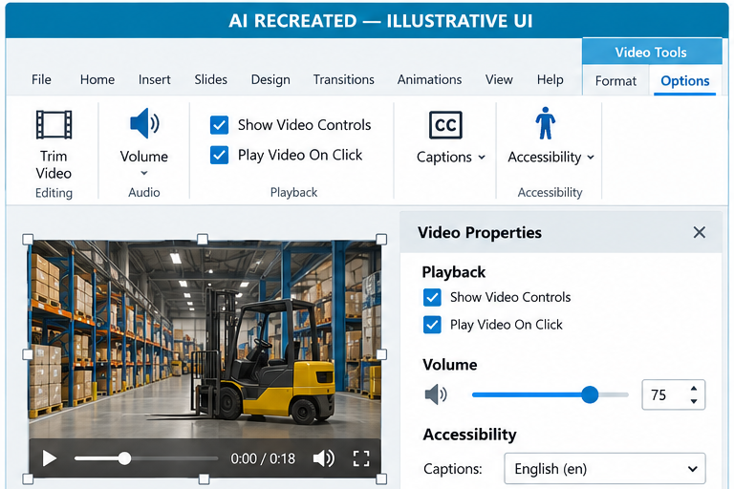
CONCEPT 54 · INTERFACE ORIENTATION
Video insert and edit
NAMED ARTIFACT
WSA-054-Video-insert-and-edit
MECHANISM
Insert > Video adds a safety demonstration; Video Tools configures trim,…
EXPECTED
learner can pause/seek and obtain equivalent meaning through captions and…
AI RECREATED — ILLUSTRATIVE UI · verify the named control
© 2026 Tertiary Infotech Academy Pte Ltd · Mastering Articulate Storyline 360 for e-Learning Content Creation · TGS-2024042308
Articulate Storyline 360 official guidance; v11 technical anchor register
198

Slide 199
INTERFACE · NAMED CONFIGURATION
Video insert and edit
SET THESE CONTROLS
C1=source · C2=trim in/out · C3=playback · C4=compression · C5=captions ·…
REJECT WHEN
autoplay with sound, unreadable detail or captions covering controls
VERIFY READBACK
learner can pause/seek and obtain equivalent meaning through captions and…
AI RECREATED — ILLUSTRATIVE UI · verify the named control
© 2026 Tertiary Infotech Academy Pte Ltd · Mastering Articulate Storyline 360 for e-Learning Content Creation · TGS-2024042308
Articulate Storyline 360 official guidance; v11 technical anchor register
199

Slide 200
TECHNICAL ANCHOR 054 · WORKED SYNTHETIC TRACE
Video insert and edit
FAULTY OUTPUT (EXAMPLE)
autoplay with sound, unreadable detail or captions covering controls
FIX IN NAMED PANEL
source; trim in/out; playback; compression; captions; transcript
EXPECTED AFTER FIX
learner can pause/seek and obtain equivalent meaning through captions and…
AI RECREATED — ILLUSTRATIVE UI · verify the named control
© 2026 Tertiary Infotech Academy Pte Ltd · Mastering Articulate Storyline 360 for e-Learning Content Creation · TGS-2024042308
Articulate Storyline 360 official guidance; v11 technical anchor register
200

Slide 201
CONCEPT 55 · HOW IT WORKS
Native text, shapes and tables
Named HarbourLink WSH artifact
Input / source state
WSA-055-Native-text-shapes-and-tables
WSA checkpoint plus heading hierarchy; margins; table headers; contrast; focus order
Runtime mechanism
Expected output
Insert > Text Box, Shape and Table creates editable safety labels and a risk-control table
content remains editable, readable at 200% zoom and ordered logically for assistive technology
Rejected output
Evidence record
text baked into images or tables used only for layout
WSA-055-Native-text-shapes-and-tables: capture the configured control and the runtime readback.
© 2026 Tertiary Infotech Academy Pte Ltd · Mastering Articulate Storyline 360 for e-Learning Content Creation · TGS-2024042308
Articulate Storyline 360 official guidance; v11 technical anchor register
201

Slide 202
EDITABLE CONFIGURATION MODEL
Native text, shapes and tables
SET THESE CONTROLS
REJECT WHEN
VERIFY READBACK
C1=heading hierarchy · C2=margins · C3=table headers · C4=contrast · C5=focus order
text baked into images or tables used only for layout
content remains editable, readable at 200% zoom and ordered logically for assistive technology
→
→
Editable HarbourLink model · content remains editable, readable at 200% zoom and ordered logically for assistive technology
© 2026 Tertiary Infotech Academy Pte Ltd · Mastering Articulate Storyline 360 for e-Learning Content Creation · TGS-2024042308
Articulate Storyline 360 official guidance; v11 technical anchor register
202

Slide 203
TECHNICAL ANCHOR 055 · WORKED SYNTHETIC TRACE
Native text, shapes and tables
FAULTY OUTPUT (EXAMPLE)
CORRECT THE RECORD
EXPECTED AFTER FIX
text baked into images or tables used only for layout
heading hierarchy; margins; table headers; contrast; focus order
content remains editable, readable at 200% zoom and ordered logically for assistive technology · verify in your own Preview
→
→
Editable HarbourLink model · content remains editable, readable at 200% zoom and ordered logically for assistive technology
© 2026 Tertiary Infotech Academy Pte Ltd · Mastering Articulate Storyline 360 for e-Learning Content Creation · TGS-2024042308
Articulate Storyline 360 official guidance; v11 technical anchor register
203

Slide 204
HANDS-ON APPLICATION · TOPIC 2
Activity 03 · Add Media and Hazard Scene
Construct the warehouse visual with rights-aware media and seven meaningful hazards.
1
2
3
4
5
Analyse
Choose
Apply
Inspect
Evidence
EVIDENCE
Retain the named .story checkpoint, the completed self-check table and one screenshot for each task showing the final state or setting that proves the acceptance criteria.
Full click-by-click procedure · Learner Guide / Activity 03
© 2026 Tertiary Infotech Academy Pte Ltd · Mastering Articulate Storyline 360 for e-Learning Content Creation · TGS-2024042308
204

Slide 205
AUTHENTIC ARTICULATE UI
Activity 03 · Interface Reference
Locate
Use this authentic interface capture to find the named…
Set
In Slide View choose Insert > Picture, browse to…
Verify
Seven hazards are visually plausible.
Evidence
Capture one final-state screenshot for the task; this…
© 2026 Tertiary Infotech Academy Pte Ltd · Mastering Articulate Storyline 360 for e-Learning Content Creation · TGS-2024042308
Articulate official product guidance
205

Slide 206
EDITABLE TECHNICAL MODEL
Activity 03 · Artifact Model
Artifact
Purpose
HarbourLink-WSH-Checkpoint-03-YourName.story
Construct the warehouse visual with rights-aware media and seven meaningful hazards.
Scenario input
Required output
HarbourLink annual WSH refresher; picture-first content, narration, captions, keyboard access and five-question 80% practice quiz.
Seven hazards are visually plausible.
Control point
Readback
Media retains aspect ratio and provenance.
Retain the named .story checkpoint, the completed self-check table and one screenshot for each task showing the final state or setting that proves the acceptance criteria.
© 2026 Tertiary Infotech Academy Pte Ltd · Mastering Articulate Storyline 360 for e-Learning Content Creation · TGS-2024042308
206

Slide 207
EDITABLE TECHNICAL MODEL
Activity 03 · Runtime State Trace
Initial state
Input
Open with declared defaults and no prior test residue.
Use the named WSA asset, learner decision or publish setting.
Control
Stored state
Seven hazards are visually plausible.
Media retains aspect ratio and provenance.
Runtime output
Boundary
Hotspots do not overlap.
Visible keyboard alternatives map one-to-one.
© 2026 Tertiary Infotech Academy Pte Ltd · Mastering Articulate Storyline 360 for e-Learning Content Creation · TGS-2024042308
207

Slide 208
EDITABLE TECHNICAL MODEL
Activity 03 · Worked Failure Case
Expected
Incomplete
Seven hazards are visually plausible.
Fail when: Media retains aspect ratio and provenance. is not demonstrated.
Repeat
Access
Repeat/revisit must preserve: Hotspots do not overlap.
Visible keyboard alternatives map one-to-one.
Recovery
Log
Correct the named setting in the next checkpoint, then rerun the same case.
Record expected, actual, pass/fail and corrected version.
© 2026 Tertiary Infotech Academy Pte Ltd · Mastering Articulate Storyline 360 for e-Learning Content Creation · TGS-2024042308
208

Slide 209
EDITABLE TECHNICAL MODEL
Activity 03 · Evidence Record
Source
Evidence rule
HarbourLink-WSH-Checkpoint-03-YourName.story
One decisive learner screenshot per task.
Setting evidence
Runtime evidence
Seven hazards are visually plausible.
Media retains aspect ratio and provenance.
Regression evidence
Retention
Visible keyboard alternatives map one-to-one.
Retain the named .story checkpoint, the completed self-check table and one screenshot for each task showing the final state or setting that proves the acceptance criteria.
© 2026 Tertiary Infotech Academy Pte Ltd · Mastering Articulate Storyline 360 for e-Learning Content Creation · TGS-2024042308
209

Slide 210
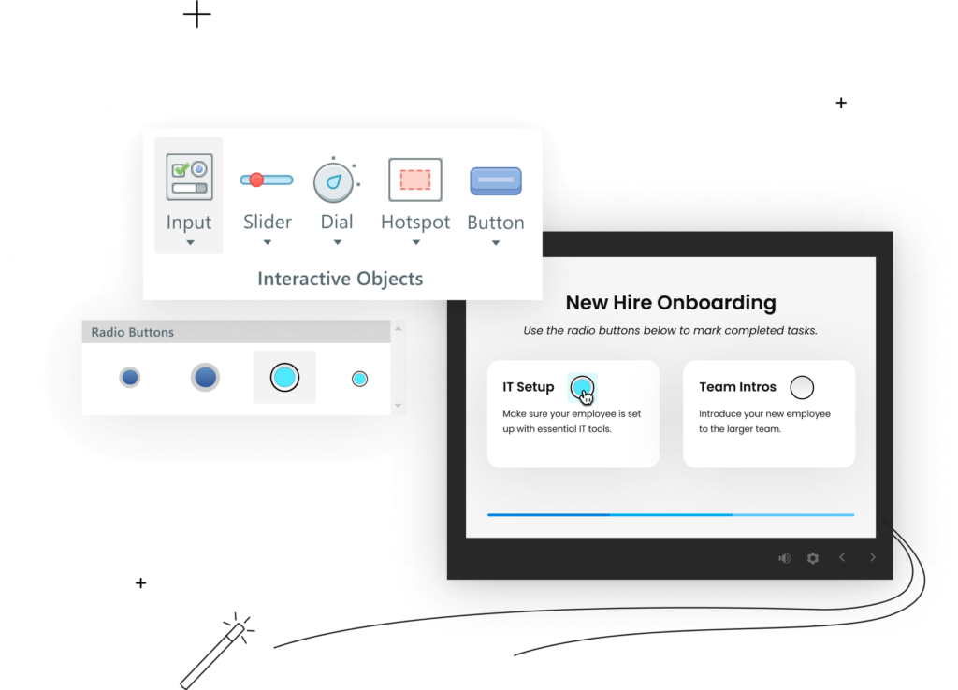
AUTHENTIC ARTICULATE UI
Activity 03 · Verify the Panel
Named setting
Choose Picture Tools — Format > Crop; drag the crop…
Expected output
Seven hazards are visually plausible.
Boundary
Visible keyboard alternatives map one-to-one.
Own evidence
Show the learner-created checkpoint and final setting, not…
© 2026 Tertiary Infotech Academy Pte Ltd · Mastering Articulate Storyline 360 for e-Learning Content Creation · TGS-2024042308
Articulate official product guidance
210

Slide 211
EXPECTED VERSUS ACTUAL
Activity 03 · Test Matrix
Case 1
Case 2
Seven hazards are visually plausible.
Media retains aspect ratio and provenance.
Case 3
Case 4
Hotspots do not overlap.
Visible keyboard alternatives map one-to-one.
Revisit
Record
Navigate away and back; compare actual state with the specified revisit rule.
Log expected, actual, pass/fail, defect owner and corrected checkpoint filename.
© 2026 Tertiary Infotech Academy Pte Ltd · Mastering Articulate Storyline 360 for e-Learning Content Creation · TGS-2024042308
211

Slide 212
HANDS-ON APPLICATION · TOPIC 2
Activity 04 · Add Layers, States, Variables and Gate
Make hazard discovery accessible, persistent and completion-gated.
1
2
3
4
5
Analyse
Choose
Apply
Inspect
Evidence
EVIDENCE
Retain the named .story checkpoint, the completed self-check table and one screenshot for each task showing the final state or setting that proves the acceptance criteria.
Full click-by-click procedure · Learner Guide / Activity 04
© 2026 Tertiary Infotech Academy Pte Ltd · Mastering Articulate Storyline 360 for e-Learning Content Creation · TGS-2024042308
212

Slide 213
AUTHENTIC ARTICULATE UI
Activity 04 · Interface Reference
Locate
Use this authentic interface capture to find the named…
Set
Create True/False variables `Hazard01Found` through…
Verify
Counter never exceeds seven.
Evidence
Capture one final-state screenshot for the task; this…
© 2026 Tertiary Infotech Academy Pte Ltd · Mastering Articulate Storyline 360 for e-Learning Content Creation · TGS-2024042308
Articulate official product guidance
213

Slide 214
EDITABLE TECHNICAL MODEL
Activity 04 · Artifact Model
Artifact
Purpose
HarbourLink-WSH-Checkpoint-04-YourName.story
Make hazard discovery accessible, persistent and completion-gated.
Scenario input
Required output
HarbourLink annual WSH refresher; picture-first content, narration, captions, keyboard access and five-question 80% practice quiz.
Counter never exceeds seven.
Control point
Readback
Repeated selections do not inflate progress.
Retain the named .story checkpoint, the completed self-check table and one screenshot for each task showing the final state or setting that proves the acceptance criteria.
© 2026 Tertiary Infotech Academy Pte Ltd · Mastering Articulate Storyline 360 for e-Learning Content Creation · TGS-2024042308
214

Slide 215
EDITABLE TECHNICAL MODEL
Activity 04 · Runtime State Trace
Initial state
Input
Open with declared defaults and no prior test residue.
Use the named WSA asset, learner decision or publish setting.
Control
Stored state
Counter never exceeds seven.
Repeated selections do not inflate progress.
Runtime output
Boundary
Six hazards block and seven permit progression.
Pointer and keyboard paths show identical content.
© 2026 Tertiary Infotech Academy Pte Ltd · Mastering Articulate Storyline 360 for e-Learning Content Creation · TGS-2024042308
215

Slide 216
EDITABLE TECHNICAL MODEL
Activity 04 · Worked Failure Case
Expected
Incomplete
Counter never exceeds seven.
Fail when: Repeated selections do not inflate progress. is not demonstrated.
Repeat
Access
Repeat/revisit must preserve: Six hazards block and seven permit progression.
Pointer and keyboard paths show identical content.
Recovery
Log
Correct the named setting in the next checkpoint, then rerun the same case.
Record expected, actual, pass/fail and corrected version.
© 2026 Tertiary Infotech Academy Pte Ltd · Mastering Articulate Storyline 360 for e-Learning Content Creation · TGS-2024042308
216

Slide 217
EDITABLE TECHNICAL MODEL
Activity 04 · Evidence Record
Source
Evidence rule
HarbourLink-WSH-Checkpoint-04-YourName.story
One decisive learner screenshot per task.
Setting evidence
Runtime evidence
Counter never exceeds seven.
Repeated selections do not inflate progress.
Regression evidence
Retention
Pointer and keyboard paths show identical content.
Retain the named .story checkpoint, the completed self-check table and one screenshot for each task showing the final state or setting that proves the acceptance criteria.
© 2026 Tertiary Infotech Academy Pte Ltd · Mastering Articulate Storyline 360 for e-Learning Content Creation · TGS-2024042308
217

Slide 218
AUTHENTIC ARTICULATE UI
Activity 04 · Verify the Panel
Named setting
Open Slide Layers > New Layer; create `lyr_Hazard01`…
Expected output
Counter never exceeds seven.
Boundary
Pointer and keyboard paths show identical content.
Own evidence
Show the learner-created checkpoint and final setting, not…
© 2026 Tertiary Infotech Academy Pte Ltd · Mastering Articulate Storyline 360 for e-Learning Content Creation · TGS-2024042308
Articulate official product guidance
218

Slide 219
EXPECTED VERSUS ACTUAL
Activity 04 · Test Matrix
Case 1
Case 2
Counter never exceeds seven.
Repeated selections do not inflate progress.
Case 3
Case 4
Six hazards block and seven permit progression.
Pointer and keyboard paths show identical content.
Revisit
Record
Navigate away and back; compare actual state with the specified revisit rule.
Log expected, actual, pass/fail, defect owner and corrected checkpoint filename.
© 2026 Tertiary Infotech Academy Pte Ltd · Mastering Articulate Storyline 360 for e-Learning Content Creation · TGS-2024042308
219

Slide 220
HANDS-ON APPLICATION · TOPIC 2
Activity 05 · Build Motion, Slider and Dial Controls
Use motion and data controls to explain dynamic workplace risk.
1
2
3
4
5
Analyse
Choose
Apply
Inspect
Evidence
EVIDENCE
Retain the named .story checkpoint, the completed self-check table and one screenshot for each task showing the final state or setting that proves the acceptance criteria.
Full click-by-click procedure · Learner Guide / Activity 05
© 2026 Tertiary Infotech Academy Pte Ltd · Mastering Articulate Storyline 360 for e-Learning Content Creation · TGS-2024042308
220

Slide 221
AUTHENTIC ARTICULATE UI
Activity 05 · Interface Reference
Locate
Use this authentic interface capture to find the named…
Set
Insert a slider on the risk screen; select Slider Tools —…
Verify
Motion is learner-controlled.
Evidence
Capture one final-state screenshot for the task; this…
© 2026 Tertiary Infotech Academy Pte Ltd · Mastering Articulate Storyline 360 for e-Learning Content Creation · TGS-2024042308
Articulate official product guidance
221

Slide 222
EDITABLE TECHNICAL MODEL
Activity 05 · Artifact Model
Artifact
Purpose
HarbourLink-WSH-Checkpoint-05-YourName.story
Use motion and data controls to explain dynamic workplace risk.
Scenario input
Required output
HarbourLink annual WSH refresher; picture-first content, narration, captions, keyboard access and five-question 80% practice quiz.
Motion is learner-controlled.
Control point
Readback
All slider values have text equivalents.
Retain the named .story checkpoint, the completed self-check table and one screenshot for each task showing the final state or setting that proves the acceptance criteria.
© 2026 Tertiary Infotech Academy Pte Ltd · Mastering Articulate Storyline 360 for e-Learning Content Creation · TGS-2024042308
222

Slide 223
EDITABLE TECHNICAL MODEL
Activity 05 · Runtime State Trace
Initial state
Input
Open with declared defaults and no prior test residue.
Use the named WSA asset, learner decision or publish setting.
Control
Stored state
Motion is learner-controlled.
All slider values have text equivalents.
Runtime output
Boundary
Every dial detent maps to one zone.
Revisit matches the specification.
© 2026 Tertiary Infotech Academy Pte Ltd · Mastering Articulate Storyline 360 for e-Learning Content Creation · TGS-2024042308
223

Slide 224
EDITABLE TECHNICAL MODEL
Activity 05 · Worked Failure Case
Expected
Incomplete
Motion is learner-controlled.
Fail when: All slider values have text equivalents. is not demonstrated.
Repeat
Access
Repeat/revisit must preserve: Every dial detent maps to one zone.
Revisit matches the specification.
Recovery
Log
Correct the named setting in the next checkpoint, then rerun the same case.
Record expected, actual, pass/fail and corrected version.
© 2026 Tertiary Infotech Academy Pte Ltd · Mastering Articulate Storyline 360 for e-Learning Content Creation · TGS-2024042308
224

Slide 225
EDITABLE TECHNICAL MODEL
Activity 05 · Evidence Record
Source
Evidence rule
HarbourLink-WSH-Checkpoint-05-YourName.story
One decisive learner screenshot per task.
Setting evidence
Runtime evidence
Motion is learner-controlled.
All slider values have text equivalents.
Regression evidence
Retention
Revisit matches the specification.
Retain the named .story checkpoint, the completed self-check table and one screenshot for each task showing the final state or setting that proves the acceptance criteria.
© 2026 Tertiary Infotech Academy Pte Ltd · Mastering Articulate Storyline 360 for e-Learning Content Creation · TGS-2024042308
225

Slide 226
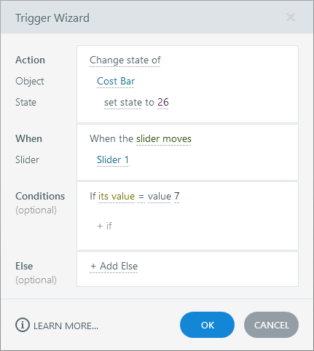
AUTHENTIC ARTICULATE UI
Activity 05 · Verify the Panel
Named setting
In Slider Tools — Design > Variable bind the slider to…
Expected output
Motion is learner-controlled.
Boundary
Revisit matches the specification.
Own evidence
Show the learner-created checkpoint and final setting, not…
© 2026 Tertiary Infotech Academy Pte Ltd · Mastering Articulate Storyline 360 for e-Learning Content Creation · TGS-2024042308
Articulate official product guidance
226

Slide 227
EXPECTED VERSUS ACTUAL
Activity 05 · Test Matrix
Case 1
Case 2
Motion is learner-controlled.
All slider values have text equivalents.
Case 3
Case 4
Every dial detent maps to one zone.
Revisit matches the specification.
Revisit
Record
Navigate away and back; compare actual state with the specified revisit rule.
Log expected, actual, pass/fail, defect owner and corrected checkpoint filename.
© 2026 Tertiary Infotech Academy Pte Ltd · Mastering Articulate Storyline 360 for e-Learning Content Creation · TGS-2024042308
227

Slide 228
HANDS-ON APPLICATION · TOPIC 2
Activity 06 · Create View, Try and Test Simulations
Capture and deploy the supplied incident-report simulation in three Storyline modes.
1
2
3
4
5
Analyse
Choose
Apply
Inspect
Evidence
EVIDENCE
Retain the named .story checkpoint, the completed self-check table and one screenshot for each task showing the final state or setting that proves the acceptance criteria.
Full click-by-click procedure · Learner Guide / Activity 06
© 2026 Tertiary Infotech Academy Pte Ltd · Mastering Articulate Storyline 360 for e-Learning Content Creation · TGS-2024042308
228

Slide 229
AUTHENTIC ARTICULATE UI
Activity 06 · Interface Reference
Locate
Use this authentic interface capture to find the named…
Set
Open `source/incident-report/index.html`, use fictional…
Verify
Recording exposes no private data.
Evidence
Capture one final-state screenshot for the task; this…
© 2026 Tertiary Infotech Academy Pte Ltd · Mastering Articulate Storyline 360 for e-Learning Content Creation · TGS-2024042308
Articulate official product guidance
229

Slide 230
EDITABLE TECHNICAL MODEL
Activity 06 · Artifact Model
Artifact
Purpose
HarbourLink-WSH-Checkpoint-06-YourName.story
Capture and deploy the supplied incident-report simulation in three Storyline modes.
Scenario input
Required output
HarbourLink annual WSH refresher; picture-first content, narration, captions, keyboard access and five-question 80% practice quiz.
Recording exposes no private data.
Control point
Readback
View mode can pause and seek.
Retain the named .story checkpoint, the completed self-check table and one screenshot for each task showing the final state or setting that proves the acceptance criteria.
© 2026 Tertiary Infotech Academy Pte Ltd · Mastering Articulate Storyline 360 for e-Learning Content Creation · TGS-2024042308
230

Slide 231
EDITABLE TECHNICAL MODEL
Activity 06 · Runtime State Trace
Initial state
Input
Open with declared defaults and no prior test residue.
Use the named WSA asset, learner decision or publish setting.
Control
Stored state
Recording exposes no private data.
View mode can pause and seek.
Runtime output
Boundary
Try mode coaches wrong actions.
Test mode scores specified actions.
© 2026 Tertiary Infotech Academy Pte Ltd · Mastering Articulate Storyline 360 for e-Learning Content Creation · TGS-2024042308
231

Slide 232
EDITABLE TECHNICAL MODEL
Activity 06 · Worked Failure Case
Expected
Incomplete
Recording exposes no private data.
Fail when: View mode can pause and seek. is not demonstrated.
Repeat
Access
Repeat/revisit must preserve: Try mode coaches wrong actions.
Test mode scores specified actions.
Recovery
Log
Correct the named setting in the next checkpoint, then rerun the same case.
Record expected, actual, pass/fail and corrected version.
© 2026 Tertiary Infotech Academy Pte Ltd · Mastering Articulate Storyline 360 for e-Learning Content Creation · TGS-2024042308
232

Slide 233
EDITABLE TECHNICAL MODEL
Activity 06 · Evidence Record
Source
Evidence rule
HarbourLink-WSH-Checkpoint-06-YourName.story
One decisive learner screenshot per task.
Setting evidence
Runtime evidence
Recording exposes no private data.
View mode can pause and seek.
Regression evidence
Retention
Test mode scores specified actions.
Retain the named .story checkpoint, the completed self-check table and one screenshot for each task showing the final state or setting that proves the acceptance criteria.
© 2026 Tertiary Infotech Academy Pte Ltd · Mastering Articulate Storyline 360 for e-Learning Content Creation · TGS-2024042308
233

Slide 234
AUTHENTIC ARTICULATE UI
Activity 06 · Verify the Panel
Named setting
Record a readable bounded region with Slides > Record Screen.
Expected output
Recording exposes no private data.
Boundary
Test mode scores specified actions.
Own evidence
Show the learner-created checkpoint and final setting, not…
© 2026 Tertiary Infotech Academy Pte Ltd · Mastering Articulate Storyline 360 for e-Learning Content Creation · TGS-2024042308
Articulate official product guidance
234

Slide 235
EXPECTED VERSUS ACTUAL
Activity 06 · Test Matrix
Case 1
Case 2
Recording exposes no private data.
View mode can pause and seek.
Case 3
Case 4
Try mode coaches wrong actions.
Test mode scores specified actions.
Revisit
Record
Navigate away and back; compare actual state with the specified revisit rule.
Log expected, actual, pass/fail, defect owner and corrected checkpoint filename.
© 2026 Tertiary Infotech Academy Pte Ltd · Mastering Articulate Storyline 360 for e-Learning Content Creation · TGS-2024042308
235

Slide 236
HANDS-ON APPLICATION · TOPIC 2
Activity 07 · Add Audio, Captions and Accessibility
Add the supplied eight-scene HarbourLink annual WSH narration with one matching MP3/VTT pair per screen, equivalent transcript and keyboard-operable Replay/Stop controls.
1
2
3
4
5
Analyse
Choose
Apply
Inspect
Evidence
EVIDENCE
Retain the named .story checkpoint, the completed self-check table and one screenshot for each task showing the final state or setting that proves the acceptance criteria.
Full click-by-click procedure · Learner Guide / Activity 07
© 2026 Tertiary Infotech Academy Pte Ltd · Mastering Articulate Storyline 360 for e-Learning Content Creation · TGS-2024042308
236

Slide 237
AUTHENTIC ARTICULATE UI
Activity 07 · Interface Reference
Locate
Use this authentic interface capture to find the named…
Set
For each screen 01–08, choose Insert > Audio > Audio from…
Verify
Narration and captions synchronise.
Evidence
Capture one final-state screenshot for the task; this…
© 2026 Tertiary Infotech Academy Pte Ltd · Mastering Articulate Storyline 360 for e-Learning Content Creation · TGS-2024042308
Articulate official product guidance
237

Slide 238
EDITABLE TECHNICAL MODEL
Activity 07 · Artifact Model
Artifact
Purpose
HarbourLink-WSH-Checkpoint-07-YourName.story
Add the supplied eight-scene HarbourLink annual WSH narration with one matching MP3/VTT pair per screen, equivalent transcript and keyboard-operable Replay/Stop controls.
Scenario input
Required output
HarbourLink annual WSH refresher; picture-first content, narration, captions, keyboard access and five-question 80% practice quiz.
Narration and captions synchronise.
Control point
Readback
Transcript conveys equivalent visual meaning.
Retain the named .story checkpoint, the completed self-check table and one screenshot for each task showing the final state or setting that proves the acceptance criteria.
© 2026 Tertiary Infotech Academy Pte Ltd · Mastering Articulate Storyline 360 for e-Learning Content Creation · TGS-2024042308
238

Slide 239
EDITABLE TECHNICAL MODEL
Activity 07 · Runtime State Trace
Initial state
Input
Open with declared defaults and no prior test residue.
Use the named WSA asset, learner decision or publish setting.
Control
Stored state
Narration and captions synchronise.
Transcript conveys equivalent visual meaning.
Runtime output
Boundary
Focus order is logical.
No task depends on hearing or precise pointer input.
© 2026 Tertiary Infotech Academy Pte Ltd · Mastering Articulate Storyline 360 for e-Learning Content Creation · TGS-2024042308
239

Slide 240
EDITABLE TECHNICAL MODEL
Activity 07 · Worked Failure Case
Expected
Incomplete
Narration and captions synchronise.
Fail when: Transcript conveys equivalent visual meaning. is not demonstrated.
Repeat
Access
Repeat/revisit must preserve: Focus order is logical.
No task depends on hearing or precise pointer input.
Recovery
Log
Correct the named setting in the next checkpoint, then rerun the same case.
Record expected, actual, pass/fail and corrected version.
© 2026 Tertiary Infotech Academy Pte Ltd · Mastering Articulate Storyline 360 for e-Learning Content Creation · TGS-2024042308
240

Slide 241
EDITABLE TECHNICAL MODEL
Activity 07 · Evidence Record
Source
Evidence rule
HarbourLink-WSH-Checkpoint-07-YourName.story
One decisive learner screenshot per task.
Setting evidence
Runtime evidence
Narration and captions synchronise.
Transcript conveys equivalent visual meaning.
Regression evidence
Retention
No task depends on hearing or precise pointer input.
Retain the named .story checkpoint, the completed self-check table and one screenshot for each task showing the final state or setting that proves the acceptance criteria.
© 2026 Tertiary Infotech Academy Pte Ltd · Mastering Articulate Storyline 360 for e-Learning Content Creation · TGS-2024042308
241

Slide 242
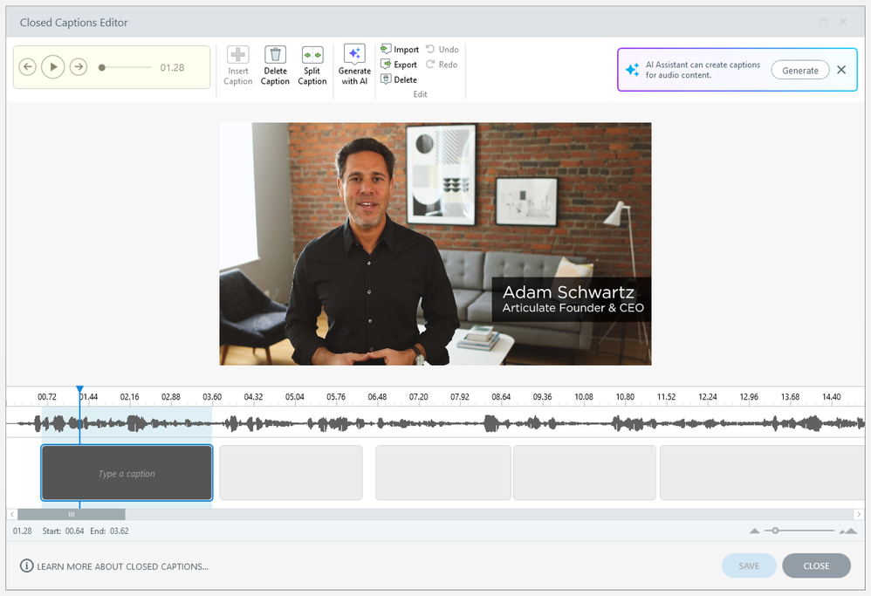
AUTHENTIC ARTICULATE UI
Activity 07 · Verify the Panel
Named setting
Rename each Timeline audio object `aud_HLL_01` through…
Expected output
Narration and captions synchronise.
Boundary
No task depends on hearing or precise pointer input.
Own evidence
Show the learner-created checkpoint and final setting, not…
© 2026 Tertiary Infotech Academy Pte Ltd · Mastering Articulate Storyline 360 for e-Learning Content Creation · TGS-2024042308
Articulate official product guidance
242

Slide 243
EXPECTED VERSUS ACTUAL
Activity 07 · Test Matrix
Case 1
Case 2
Narration and captions synchronise.
Transcript conveys equivalent visual meaning.
Case 3
Case 4
Focus order is logical.
No task depends on hearing or precise pointer input.
Revisit
Record
Navigate away and back; compare actual state with the specified revisit rule.
Log expected, actual, pass/fail, defect owner and corrected checkpoint filename.
© 2026 Tertiary Infotech Academy Pte Ltd · Mastering Articulate Storyline 360 for e-Learning Content Creation · TGS-2024042308
243

Slide 244
WSA ACCEPTANCE MODEL
Topic 2 Checkpoint
Source
Hazards
Dialog
HarbourLink-WSH-Checkpoint-07-YourName.story
Seven unique targets; duplicate clicks do not increment
Named layer, focus trap, Close/return focus
Media
Simulation
Evidence
9 s mock narration + matching VTT + transcript
View/Try/Test paths separated
7-of-7 runtime and accessibility test
© 2026 Tertiary Infotech Academy Pte Ltd · Mastering Articulate Storyline 360 for e-Learning Content Creation · TGS-2024042308
244

Slide 245
03
Branching, Questions and Results
Branching · freeform · feedback · question banks · result slide · retry · review · completion
LO3 · A6 · K6
© 2026 Tertiary Infotech Academy Pte Ltd · Mastering Articulate Storyline 360 for e-Learning Content Creation · TGS-2024042308
245

Slide 246
EDITABLE QA-PLANNING CHART
Interaction Complexity Risk
Linear reveal
3
READ THE CHART
Layered explore
6
Illustrative test-case counts grow faster than the number of visible screens. Map trigger order, revisit, retry and accessibility before adding complexity.
Variable gate
10
Branching scenario
16
Quiz + resume
20
Editable PowerPoint shape chart
Test cases
© 2026 Tertiary Infotech Academy Pte Ltd · Mastering Articulate Storyline 360 for e-Learning Content Creation · TGS-2024042308
Course QA model
246

Slide 247
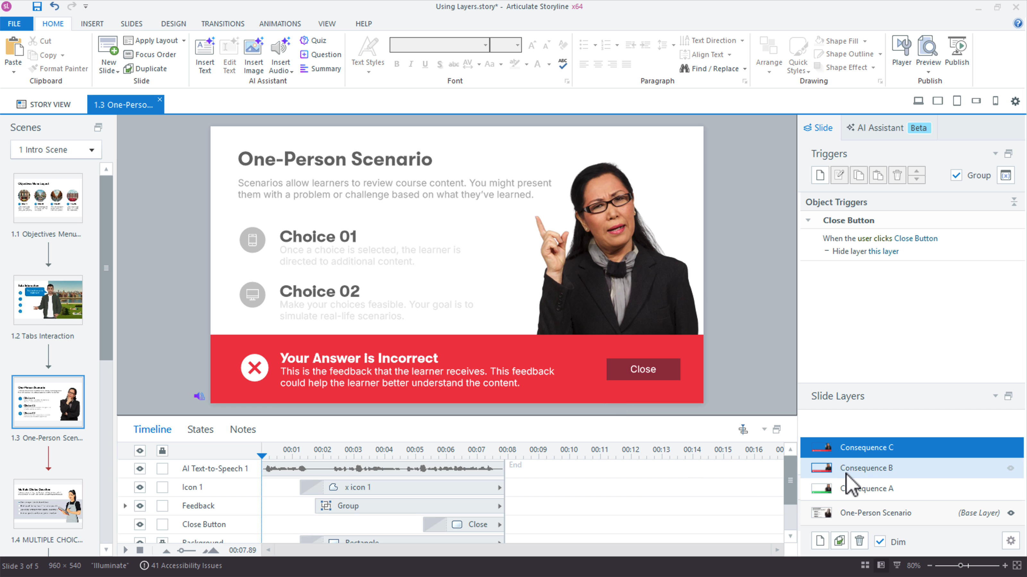
CONCEPT 56 · INTERFACE ORIENTATION
Branching decision scene
NAMED ARTIFACT
WSA-056-Branching-decision-scene
MECHANISM
Three response choices route to consequence layers and reconverge deliberately
EXPECTED
every path reaches feedback and the specified continuation
Authentic Articulate interface reference · verify the named control
© 2026 Tertiary Infotech Academy Pte Ltd · Mastering Articulate Storyline 360 for e-Learning Content Creation · TGS-2024042308
Articulate Storyline 360 official guidance; v11 technical anchor register
247

Slide 248
INTERFACE · NAMED CONFIGURATION
Branching decision scene
SET THESE CONTROLS
C1=choice trigger · C2=consequence · C3=return · C4=state preservation
REJECT WHEN
branches with no return or unearned success
VERIFY READBACK
every path reaches feedback and the specified continuation
Authentic Articulate interface reference · verify the named control
© 2026 Tertiary Infotech Academy Pte Ltd · Mastering Articulate Storyline 360 for e-Learning Content Creation · TGS-2024042308
Articulate Storyline 360 official guidance; v11 technical anchor register
248

Slide 249
TECHNICAL ANCHOR 056 · WORKED SYNTHETIC TRACE
Branching decision scene
FAULTY OUTPUT (EXAMPLE)
branches with no return or unearned success
FIX IN NAMED PANEL
choice trigger; consequence; return; state preservation
EXPECTED AFTER FIX
every path reaches feedback and the specified continuation · verify in…
Authentic Articulate interface reference · verify the named control
© 2026 Tertiary Infotech Academy Pte Ltd · Mastering Articulate Storyline 360 for e-Learning Content Creation · TGS-2024042308
Articulate Storyline 360 official guidance; v11 technical anchor register
249

Slide 250
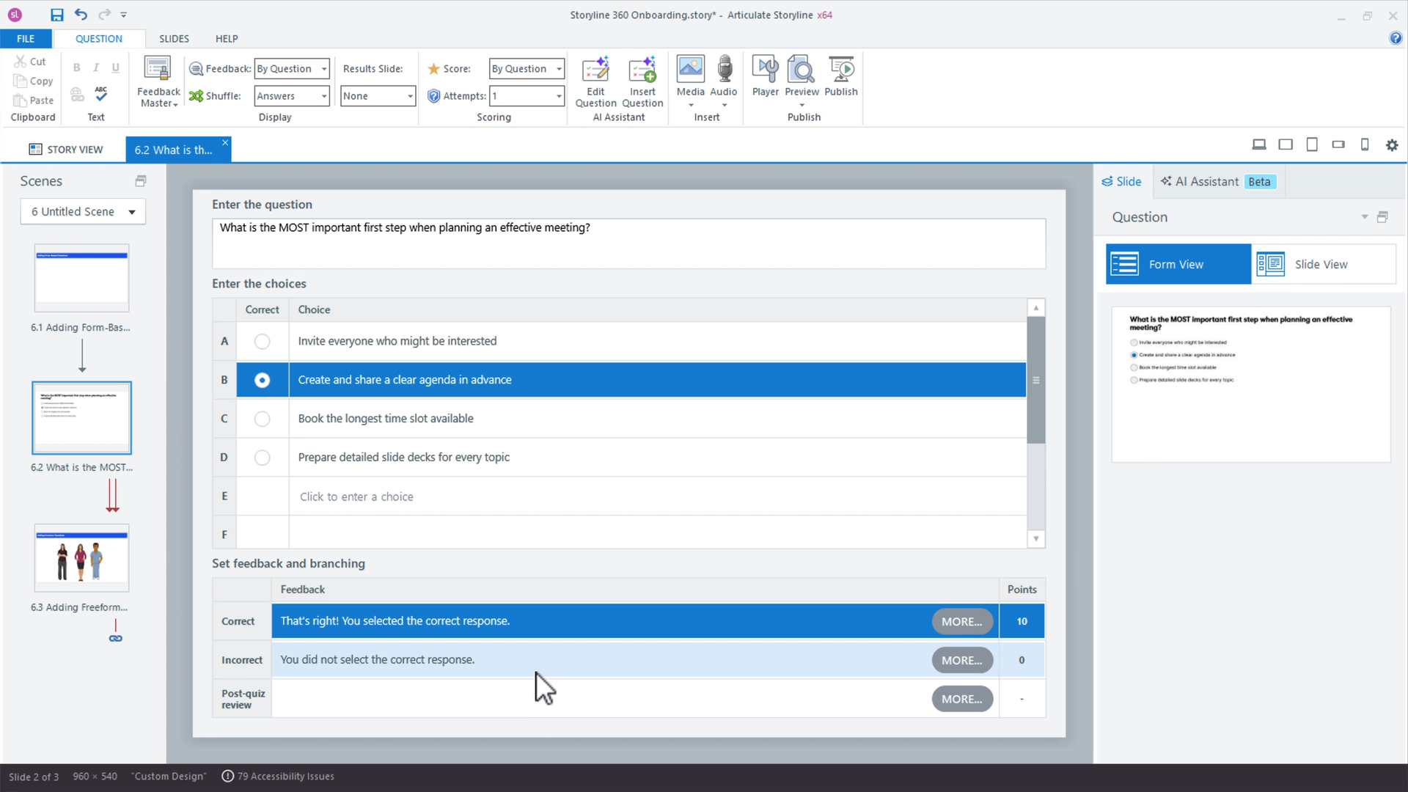
CONCEPT 57 · INTERFACE ORIENTATION
Freeform pick-one conversion
NAMED ARTIFACT
WSA-057-Freeform-pick-one-conversion
MECHANISM
Insert > Convert to Freeform turns workplace objects into a scored…
EXPECTED
selection can be revised before Submit and scores correctly
Authentic Articulate interface reference · verify the named control
© 2026 Tertiary Infotech Academy Pte Ltd · Mastering Articulate Storyline 360 for e-Learning Content Creation · TGS-2024042308
Articulate Storyline 360 official guidance; v11 technical anchor register
250

Slide 251
INTERFACE · NAMED CONFIGURATION
Freeform pick-one conversion
SET THESE CONTROLS
C1=response set · C2=correct object · C3=states · C4=submit
REJECT WHEN
visual ambiguity or automatic submission
VERIFY READBACK
selection can be revised before Submit and scores correctly
Authentic Articulate interface reference · verify the named control
© 2026 Tertiary Infotech Academy Pte Ltd · Mastering Articulate Storyline 360 for e-Learning Content Creation · TGS-2024042308
Articulate Storyline 360 official guidance; v11 technical anchor register
251

Slide 252
TECHNICAL ANCHOR 057 · WORKED SYNTHETIC TRACE
Freeform pick-one conversion
FAULTY OUTPUT (EXAMPLE)
visual ambiguity or automatic submission
FIX IN NAMED PANEL
response set; correct object; states; submit
EXPECTED AFTER FIX
selection can be revised before Submit and scores correctly · verify in…
Authentic Articulate interface reference · verify the named control
© 2026 Tertiary Infotech Academy Pte Ltd · Mastering Articulate Storyline 360 for e-Learning Content Creation · TGS-2024042308
Articulate Storyline 360 official guidance; v11 technical anchor register
252

Slide 253
CONCEPT 58 · HOW IT WORKS
Freeform hotspot question
Named HarbourLink WSH artifact
Input / source state
WSA-058-Freeform-hotspot-question
WSA checkpoint plus hotspot region; score; attempts; feedback
Runtime mechanism
Expected output
A screenshot-based hazard question uses defined regions and consequence feedback
an equivalent keyboard-operable response path is provided
Rejected output
Evidence record
mouse-only graded task
WSA-058-Freeform-hotspot-question: capture the configured control and the runtime readback.
© 2026 Tertiary Infotech Academy Pte Ltd · Mastering Articulate Storyline 360 for e-Learning Content Creation · TGS-2024042308
Articulate Storyline 360 official guidance; v11 technical anchor register
253

Slide 254
EDITABLE CONFIGURATION MODEL
Freeform hotspot question
SET THESE CONTROLS
REJECT WHEN
VERIFY READBACK
C1=hotspot region · C2=score · C3=attempts · C4=feedback
mouse-only graded task
an equivalent keyboard-operable response path is provided
→
→
Editable HarbourLink model · an equivalent keyboard-operable response path is provided
© 2026 Tertiary Infotech Academy Pte Ltd · Mastering Articulate Storyline 360 for e-Learning Content Creation · TGS-2024042308
Articulate Storyline 360 official guidance; v11 technical anchor register
254

Slide 255
TECHNICAL ANCHOR 058 · WORKED SYNTHETIC TRACE
Freeform hotspot question
FAULTY OUTPUT (EXAMPLE)
CORRECT THE RECORD
EXPECTED AFTER FIX
mouse-only graded task
hotspot region; score; attempts; feedback
an equivalent keyboard-operable response path is provided · verify in your own Preview
→
→
Editable HarbourLink model · an equivalent keyboard-operable response path is provided
© 2026 Tertiary Infotech Academy Pte Ltd · Mastering Articulate Storyline 360 for e-Learning Content Creation · TGS-2024042308
Articulate Storyline 360 official guidance; v11 technical anchor register
255

Slide 256
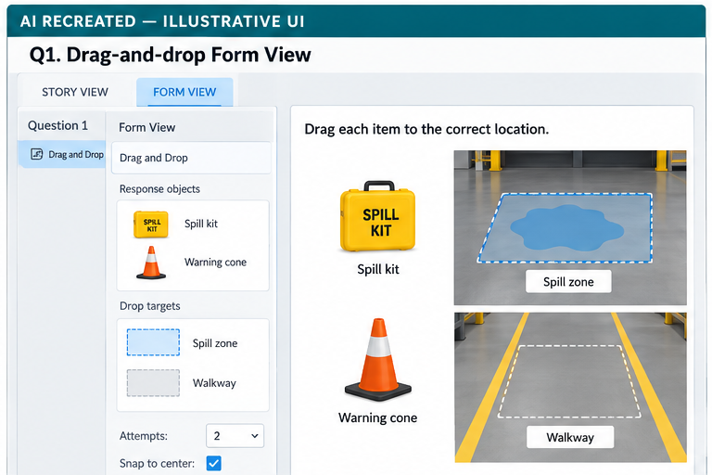
CONCEPT 59 · INTERFACE ORIENTATION
Drag-and-drop fallback
NAMED ARTIFACT
WSA-059-Drag-and-drop-fallback
MECHANISM
A sorting interaction includes keyboard-accessible buttons or an…
EXPECTED
both paths create the same instructional and scoring outcome
AI RECREATED — ILLUSTRATIVE UI · verify the named control
© 2026 Tertiary Infotech Academy Pte Ltd · Mastering Articulate Storyline 360 for e-Learning Content Creation · TGS-2024042308
Articulate Storyline 360 official guidance; v11 technical anchor register
256

Slide 257
INTERFACE · NAMED CONFIGURATION
Drag-and-drop fallback
SET THESE CONTROLS
C1=drag item · C2=drop target · C3=snap · C4=reset · C5=fallback
REJECT WHEN
requiring precise dragging as the only route
VERIFY READBACK
both paths create the same instructional and scoring outcome
AI RECREATED — ILLUSTRATIVE UI · verify the named control
© 2026 Tertiary Infotech Academy Pte Ltd · Mastering Articulate Storyline 360 for e-Learning Content Creation · TGS-2024042308
Articulate Storyline 360 official guidance; v11 technical anchor register
257

Slide 258
TECHNICAL ANCHOR 059 · WORKED SYNTHETIC TRACE
Drag-and-drop fallback
FAULTY OUTPUT (EXAMPLE)
requiring precise dragging as the only route
FIX IN NAMED PANEL
drag item; drop target; snap; reset; fallback
EXPECTED AFTER FIX
both paths create the same instructional and scoring outcome · verify in…
AI RECREATED — ILLUSTRATIVE UI · verify the named control
© 2026 Tertiary Infotech Academy Pte Ltd · Mastering Articulate Storyline 360 for e-Learning Content Creation · TGS-2024042308
Articulate Storyline 360 official guidance; v11 technical anchor register
258

Slide 259
CONCEPT 60 · INTERFACE ORIENTATION
Question form configuration
NAMED ARTIFACT
WSA-060-Question-form-configuration
MECHANISM
Form View defines prompt, choices, score, attempts, shuffle and feedback…
EXPECTED
question specification matches runtime scoring
Authentic Articulate interface reference · verify the named control
© 2026 Tertiary Infotech Academy Pte Ltd · Mastering Articulate Storyline 360 for e-Learning Content Creation · TGS-2024042308
Articulate Storyline 360 official guidance; v11 technical anchor register
259

Slide 260
INTERFACE · NAMED CONFIGURATION
Question form configuration
SET THESE CONTROLS
C1=question type · C2=points · C3=required · C4=attempts
REJECT WHEN
styling before the scoring model is stable
VERIFY READBACK
question specification matches runtime scoring
Authentic Articulate interface reference · verify the named control
© 2026 Tertiary Infotech Academy Pte Ltd · Mastering Articulate Storyline 360 for e-Learning Content Creation · TGS-2024042308
Articulate Storyline 360 official guidance; v11 technical anchor register
260

Slide 261
TECHNICAL ANCHOR 060 · WORKED SYNTHETIC TRACE
Question form configuration
FAULTY OUTPUT (EXAMPLE)
styling before the scoring model is stable
FIX IN NAMED PANEL
question type; points; required; attempts
EXPECTED AFTER FIX
question specification matches runtime scoring · verify in your own Preview
Authentic Articulate interface reference · verify the named control
© 2026 Tertiary Infotech Academy Pte Ltd · Mastering Articulate Storyline 360 for e-Learning Content Creation · TGS-2024042308
Articulate Storyline 360 official guidance; v11 technical anchor register
261

Slide 262
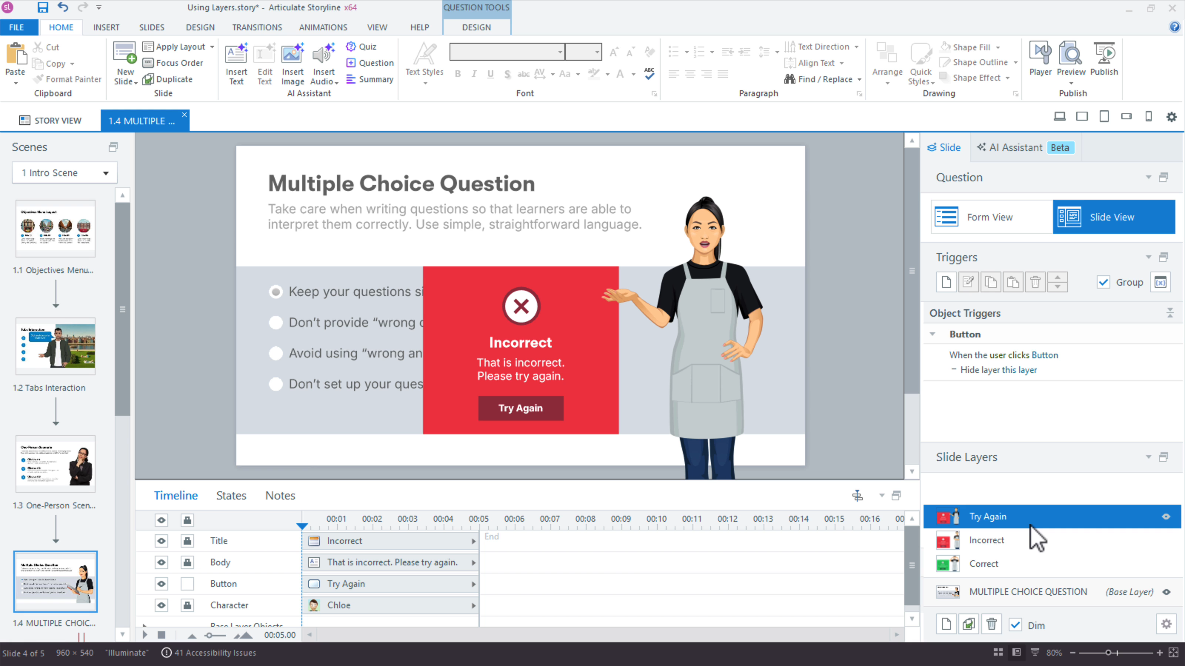
CONCEPT 61 · INTERFACE ORIENTATION
Feedback layers
NAMED ARTIFACT
WSA-061-Feedback-layers
MECHANISM
Correct, Incorrect and Try Again layers explain the safety consequence and…
EXPECTED
learner can state why the response changes risk
Authentic Articulate interface reference · verify the named control
© 2026 Tertiary Infotech Academy Pte Ltd · Mastering Articulate Storyline 360 for e-Learning Content Creation · TGS-2024042308
Articulate Storyline 360 official guidance; v11 technical anchor register
262

Slide 263
INTERFACE · NAMED CONFIGURATION
Feedback layers
SET THESE CONTROLS
C1=layer text · C2=continue · C3=focus · C4=attempts
REJECT WHEN
feedback saying only correct/incorrect
VERIFY READBACK
learner can state why the response changes risk
Authentic Articulate interface reference · verify the named control
© 2026 Tertiary Infotech Academy Pte Ltd · Mastering Articulate Storyline 360 for e-Learning Content Creation · TGS-2024042308
Articulate Storyline 360 official guidance; v11 technical anchor register
263

Slide 264
TECHNICAL ANCHOR 061 · WORKED SYNTHETIC TRACE
Feedback layers
FAULTY OUTPUT (EXAMPLE)
feedback saying only correct/incorrect
FIX IN NAMED PANEL
layer text; continue; focus; attempts
EXPECTED AFTER FIX
learner can state why the response changes risk · verify in your own Preview
Authentic Articulate interface reference · verify the named control
© 2026 Tertiary Infotech Academy Pte Ltd · Mastering Articulate Storyline 360 for e-Learning Content Creation · TGS-2024042308
Articulate Storyline 360 official guidance; v11 technical anchor register
264

Slide 265
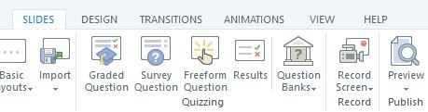
CONCEPT 62 · INTERFACE ORIENTATION
Question bank design
NAMED ARTIFACT
WSA-062-Question-bank-design
MECHANISM
A Safety Bank groups items by criterion and supports controlled random draws
EXPECTED
repeated draws preserve minimum content coverage
Authentic Articulate interface reference · verify the named control
© 2026 Tertiary Infotech Academy Pte Ltd · Mastering Articulate Storyline 360 for e-Learning Content Creation · TGS-2024042308
Articulate Storyline 360 official guidance; v11 technical anchor register
265

Slide 266
INTERFACE · NAMED CONFIGURATION
Question bank design
SET THESE CONTROLS
C1=bank name · C2=criterion tags · C3=draw count · C4=randomisation
REJECT WHEN
random draw missing a required criterion
VERIFY READBACK
repeated draws preserve minimum content coverage
Authentic Articulate interface reference · verify the named control
© 2026 Tertiary Infotech Academy Pte Ltd · Mastering Articulate Storyline 360 for e-Learning Content Creation · TGS-2024042308
Articulate Storyline 360 official guidance; v11 technical anchor register
266

Slide 267
TECHNICAL ANCHOR 062 · WORKED SYNTHETIC TRACE
Question bank design
FAULTY OUTPUT (EXAMPLE)
random draw missing a required criterion
FIX IN NAMED PANEL
bank name; criterion tags; draw count; randomisation
EXPECTED AFTER FIX
repeated draws preserve minimum content coverage · verify in your own Preview
Authentic Articulate interface reference · verify the named control
© 2026 Tertiary Infotech Academy Pte Ltd · Mastering Articulate Storyline 360 for e-Learning Content Creation · TGS-2024042308
Articulate Storyline 360 official guidance; v11 technical anchor register
267

Slide 268
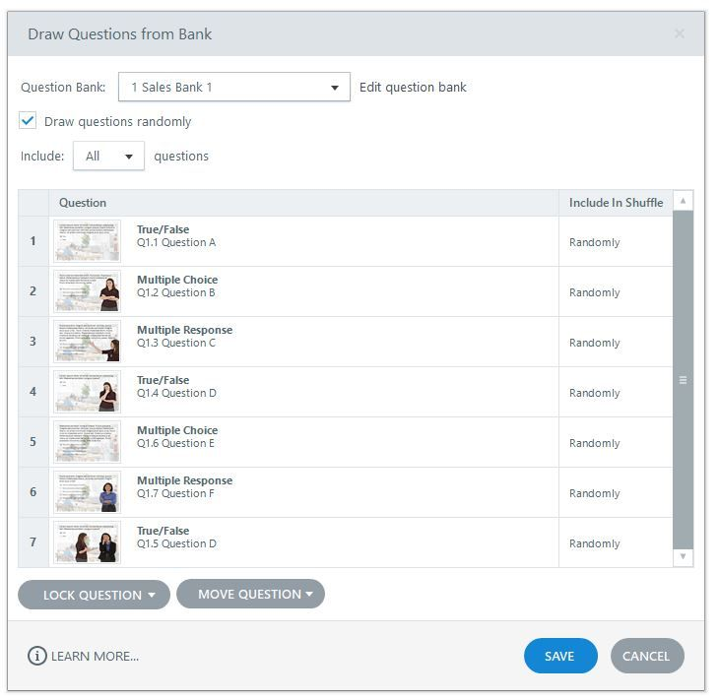
CONCEPT 63 · INTERFACE ORIENTATION
Draw from question bank
NAMED ARTIFACT
WSA-063-Draw-from-question-bank
MECHANISM
Slides > Question Banks > New Draw from Question Bank selects the intended…
EXPECTED
preview draws the configured count and result slide includes them
Authentic Articulate interface reference · verify the named control
© 2026 Tertiary Infotech Academy Pte Ltd · Mastering Articulate Storyline 360 for e-Learning Content Creation · TGS-2024042308
Articulate Storyline 360 official guidance; v11 technical anchor register
268

Slide 269
INTERFACE · NAMED CONFIGURATION
Draw from question bank
SET THESE CONTROLS
C1=draw count · C2=include/exclude · C3=lock order
REJECT WHEN
tracking the bank source instead of delivered questions
VERIFY READBACK
preview draws the configured count and result slide includes them
Authentic Articulate interface reference · verify the named control
© 2026 Tertiary Infotech Academy Pte Ltd · Mastering Articulate Storyline 360 for e-Learning Content Creation · TGS-2024042308
Articulate Storyline 360 official guidance; v11 technical anchor register
269

Slide 270
TECHNICAL ANCHOR 063 · WORKED SYNTHETIC TRACE
Draw from question bank
FAULTY OUTPUT (EXAMPLE)
tracking the bank source instead of delivered questions
FIX IN NAMED PANEL
draw count; include/exclude; lock order
EXPECTED AFTER FIX
preview draws the configured count and result slide includes them · verify…
Authentic Articulate interface reference · verify the named control
© 2026 Tertiary Infotech Academy Pte Ltd · Mastering Articulate Storyline 360 for e-Learning Content Creation · TGS-2024042308
Articulate Storyline 360 official guidance; v11 technical anchor register
270

Slide 271
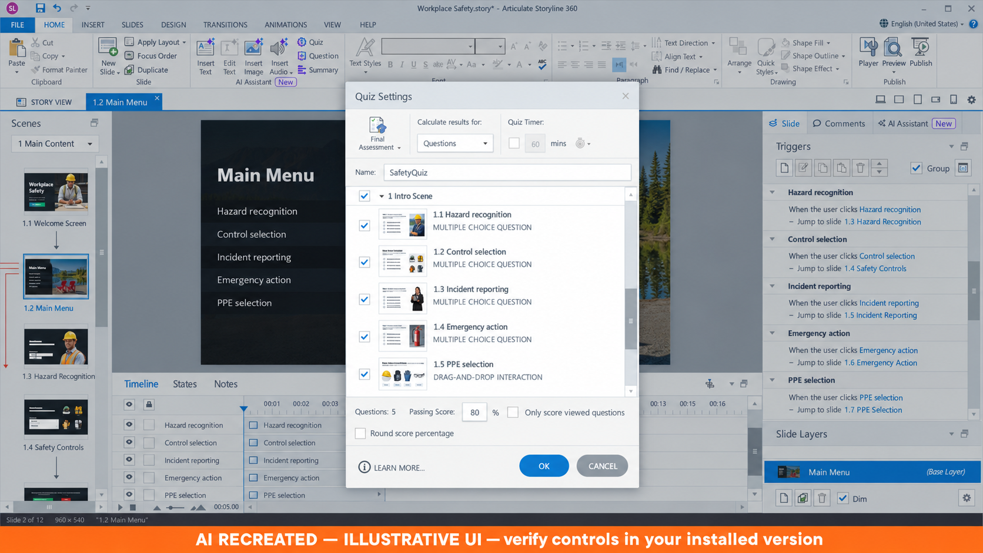
CONCEPT 64 · INTERFACE ORIENTATION
Result slide tracking
NAMED ARTIFACT
WSA-064-Result-slide-tracking
MECHANISM
Insert > New Slide > Results tracks only the scored quiz and sets 80% pass
EXPECTED
known answer sets return expected percentage and pass/fail
AI RECREATED — ILLUSTRATIVE UI · verify the named control
© 2026 Tertiary Infotech Academy Pte Ltd · Mastering Articulate Storyline 360 for e-Learning Content Creation · TGS-2024042308
Articulate Storyline 360 official guidance; v11 technical anchor register
271

Slide 272
INTERFACE · NAMED CONFIGURATION
Result slide tracking
SET THESE CONTROLS
C1=tracked questions · C2=passing score · C3=score display
REJECT WHEN
tracking the wrong questions or allowing slides-viewed bypass
VERIFY READBACK
known answer sets return expected percentage and pass/fail
AI RECREATED — ILLUSTRATIVE UI · verify the named control
© 2026 Tertiary Infotech Academy Pte Ltd · Mastering Articulate Storyline 360 for e-Learning Content Creation · TGS-2024042308
Articulate Storyline 360 official guidance; v11 technical anchor register
272

Slide 273
TECHNICAL ANCHOR 064 · WORKED SYNTHETIC TRACE
Result slide tracking
FAULTY OUTPUT (EXAMPLE)
tracking the wrong questions or allowing slides-viewed bypass
FIX IN NAMED PANEL
tracked questions; passing score; score display
EXPECTED AFTER FIX
known answer sets return expected percentage and pass/fail · verify in…
AI RECREATED — ILLUSTRATIVE UI · verify the named control
© 2026 Tertiary Infotech Academy Pte Ltd · Mastering Articulate Storyline 360 for e-Learning Content Creation · TGS-2024042308
Articulate Storyline 360 official guidance; v11 technical anchor register
273

Slide 274
CONCEPT 65 · HOW IT WORKS
Retry quiz trigger
Named HarbourLink WSH artifact
Input / source state
WSA-065-Retry-quiz-trigger
WSA checkpoint plus reset results; destination; attempt count
Runtime mechanism
Expected output
Retry Quiz resets tracked questions and relevant variables before returning to the quiz
second attempt starts clean while permitted course progress remains
Rejected output
Evidence record
old answers or hazard variables contaminating retry
WSA-065-Retry-quiz-trigger: capture the configured control and the runtime readback.
© 2026 Tertiary Infotech Academy Pte Ltd · Mastering Articulate Storyline 360 for e-Learning Content Creation · TGS-2024042308
Articulate Storyline 360 official guidance; v11 technical anchor register
274

Slide 275
EDITABLE CONFIGURATION MODEL
Retry quiz trigger
SET THESE CONTROLS
REJECT WHEN
VERIFY READBACK
C1=reset results · C2=destination · C3=attempt count
old answers or hazard variables contaminating retry
second attempt starts clean while permitted course progress remains
→
→
Editable HarbourLink model · second attempt starts clean while permitted course progress remains
© 2026 Tertiary Infotech Academy Pte Ltd · Mastering Articulate Storyline 360 for e-Learning Content Creation · TGS-2024042308
Articulate Storyline 360 official guidance; v11 technical anchor register
275

Slide 276
TECHNICAL ANCHOR 065 · WORKED SYNTHETIC TRACE
Retry quiz trigger
FAULTY OUTPUT (EXAMPLE)
CORRECT THE RECORD
EXPECTED AFTER FIX
old answers or hazard variables contaminating retry
reset results; destination; attempt count
second attempt starts clean while permitted course progress remains · verify in your own Preview
→
→
Editable HarbourLink model · second attempt starts clean while permitted course progress remains
© 2026 Tertiary Infotech Academy Pte Ltd · Mastering Articulate Storyline 360 for e-Learning Content Creation · TGS-2024042308
Articulate Storyline 360 official guidance; v11 technical anchor register
276

Slide 277
CONCEPT 66 · HOW IT WORKS
Review quiz behaviour
Named HarbourLink WSH artifact
Input / source state
WSA-066-Review-quiz-behaviour
WSA checkpoint plus review state; correct-answer display; navigation
Runtime mechanism
Expected output
Review Quiz shows submitted responses without exposing answers before completion
review is unavailable until submission and then matches policy
Rejected output
Evidence record
answer leakage during the active attempt
WSA-066-Review-quiz-behaviour: capture the configured control and the runtime readback.
© 2026 Tertiary Infotech Academy Pte Ltd · Mastering Articulate Storyline 360 for e-Learning Content Creation · TGS-2024042308
Articulate Storyline 360 official guidance; v11 technical anchor register
277

Slide 278
EDITABLE CONFIGURATION MODEL
Review quiz behaviour
SET THESE CONTROLS
REJECT WHEN
VERIFY READBACK
C1=review state · C2=correct-answer display · C3=navigation
answer leakage during the active attempt
review is unavailable until submission and then matches policy
→
→
Editable HarbourLink model · review is unavailable until submission and then matches policy
© 2026 Tertiary Infotech Academy Pte Ltd · Mastering Articulate Storyline 360 for e-Learning Content Creation · TGS-2024042308
Articulate Storyline 360 official guidance; v11 technical anchor register
278

Slide 279
TECHNICAL ANCHOR 066 · WORKED SYNTHETIC TRACE
Review quiz behaviour
FAULTY OUTPUT (EXAMPLE)
CORRECT THE RECORD
EXPECTED AFTER FIX
answer leakage during the active attempt
review state; correct-answer display; navigation
review is unavailable until submission and then matches policy · verify in your own Preview
→
→
Editable HarbourLink model · review is unavailable until submission and then matches policy
© 2026 Tertiary Infotech Academy Pte Ltd · Mastering Articulate Storyline 360 for e-Learning Content Creation · TGS-2024042308
Articulate Storyline 360 official guidance; v11 technical anchor register
279

Slide 280
CONCEPT 67 · HOW IT WORKS
Submit-all interaction
Named HarbourLink WSH artifact
Input / source state
WSA-067-Submit-all-interaction
WSA checkpoint plus submit mode; confirmation; unanswered check
Runtime mechanism
Expected output
Submit All Responses defers scoring when the design requires final review
confirmation identifies unanswered items before final scoring
Rejected output
Evidence record
learner submits incomplete quiz accidentally
WSA-067-Submit-all-interaction: capture the configured control and the runtime readback.
© 2026 Tertiary Infotech Academy Pte Ltd · Mastering Articulate Storyline 360 for e-Learning Content Creation · TGS-2024042308
Articulate Storyline 360 official guidance; v11 technical anchor register
280

Slide 281
EDITABLE CONFIGURATION MODEL
Submit-all interaction
SET THESE CONTROLS
REJECT WHEN
VERIFY READBACK
C1=submit mode · C2=confirmation · C3=unanswered check
learner submits incomplete quiz accidentally
confirmation identifies unanswered items before final scoring
→
→
Editable HarbourLink model · confirmation identifies unanswered items before final scoring
© 2026 Tertiary Infotech Academy Pte Ltd · Mastering Articulate Storyline 360 for e-Learning Content Creation · TGS-2024042308
Articulate Storyline 360 official guidance; v11 technical anchor register
281

Slide 282
TECHNICAL ANCHOR 067 · WORKED SYNTHETIC TRACE
Submit-all interaction
FAULTY OUTPUT (EXAMPLE)
CORRECT THE RECORD
EXPECTED AFTER FIX
learner submits incomplete quiz accidentally
submit mode; confirmation; unanswered check
confirmation identifies unanswered items before final scoring · verify in your own Preview
→
→
Editable HarbourLink model · confirmation identifies unanswered items before final scoring
© 2026 Tertiary Infotech Academy Pte Ltd · Mastering Articulate Storyline 360 for e-Learning Content Creation · TGS-2024042308
Articulate Storyline 360 official guidance; v11 technical anchor register
282

Slide 283
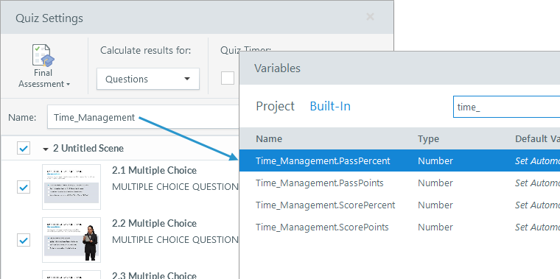
CONCEPT 68 · INTERFACE ORIENTATION
Results variables
NAMED ARTIFACT
WSA-068-Results-variables
MECHANISM
Built-in SafetyQuiz.ScorePercent and SafetyQuiz.PassPercent support…
EXPECTED
displayed values match LMS debug data
Authentic Articulate interface reference · verify the named control
© 2026 Tertiary Infotech Academy Pte Ltd · Mastering Articulate Storyline 360 for e-Learning Content Creation · TGS-2024042308
Articulate Storyline 360 official guidance; v11 technical anchor register
283

Slide 284
INTERFACE · NAMED CONFIGURATION
Results variables
SET THESE CONTROLS
C1=variable reference · C2=rounding · C3=pass threshold
REJECT WHEN
manual score formulas drifting from Storyline results
VERIFY READBACK
displayed values match LMS debug data
Authentic Articulate interface reference · verify the named control
© 2026 Tertiary Infotech Academy Pte Ltd · Mastering Articulate Storyline 360 for e-Learning Content Creation · TGS-2024042308
Articulate Storyline 360 official guidance; v11 technical anchor register
284

Slide 285
TECHNICAL ANCHOR 068 · WORKED SYNTHETIC TRACE
Results variables
FAULTY OUTPUT (EXAMPLE)
manual score formulas drifting from Storyline results
FIX IN NAMED PANEL
variable reference; rounding; pass threshold
EXPECTED AFTER FIX
displayed values match LMS debug data · verify in your own Preview
Authentic Articulate interface reference · verify the named control
© 2026 Tertiary Infotech Academy Pte Ltd · Mastering Articulate Storyline 360 for e-Learning Content Creation · TGS-2024042308
Articulate Storyline 360 official guidance; v11 technical anchor register
285

Slide 286
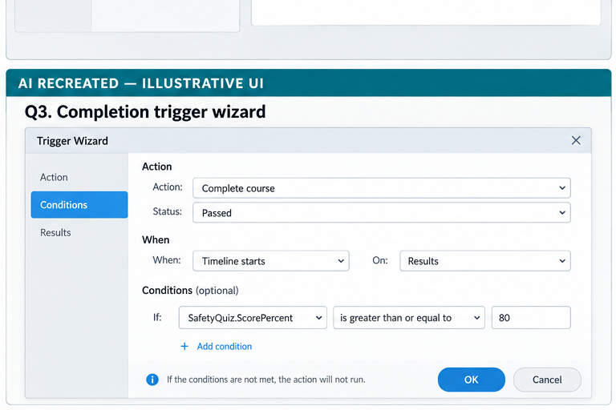
CONCEPT 69 · INTERFACE ORIENTATION
Completion trigger
NAMED ARTIFACT
WSA-069-Completion-trigger
MECHANISM
Course completion reports from the selected quiz result, with no competing…
EXPECTED
viewing every slide without passing does not report successful completion
AI RECREATED — ILLUSTRATIVE UI · verify the named control
© 2026 Tertiary Infotech Academy Pte Ltd · Mastering Articulate Storyline 360 for e-Learning Content Creation · TGS-2024042308
Articulate Storyline 360 official guidance; v11 technical anchor register
286

Slide 287
INTERFACE · NAMED CONFIGURATION
Completion trigger
SET THESE CONTROLS
C1=complete/pass trigger · C2=result slide · C3=conditions
REJECT WHEN
multiple completion criteria using OR and bypassing the quiz
VERIFY READBACK
viewing every slide without passing does not report successful completion
AI RECREATED — ILLUSTRATIVE UI · verify the named control
© 2026 Tertiary Infotech Academy Pte Ltd · Mastering Articulate Storyline 360 for e-Learning Content Creation · TGS-2024042308
Articulate Storyline 360 official guidance; v11 technical anchor register
287

Slide 288
TECHNICAL ANCHOR 069 · WORKED SYNTHETIC TRACE
Completion trigger
FAULTY OUTPUT (EXAMPLE)
multiple completion criteria using OR and bypassing the quiz
FIX IN NAMED PANEL
complete/pass trigger; result slide; conditions
EXPECTED AFTER FIX
viewing every slide without passing does not report successful completion…
AI RECREATED — ILLUSTRATIVE UI · verify the named control
© 2026 Tertiary Infotech Academy Pte Ltd · Mastering Articulate Storyline 360 for e-Learning Content Creation · TGS-2024042308
Articulate Storyline 360 official guidance; v11 technical anchor register
288

Slide 289
CONCEPT 70 · HOW IT WORKS
Branch and quiz test matrix
Named HarbourLink WSH artifact
Input / source state
WSA-070-Branch-and-quiz-test-matrix
WSA checkpoint plus expected state; actual state; evidence; defect owner
Runtime mechanism
Expected output
A structured matrix covers correct, incorrect, incomplete, retry, review, revisit and resume
all high-risk cases have recorded results and resolved defects
Rejected output
Evidence record
testing only the happy path
WSA-070-Branch-and-quiz-test-matrix: capture the configured control and the runtime readback.
© 2026 Tertiary Infotech Academy Pte Ltd · Mastering Articulate Storyline 360 for e-Learning Content Creation · TGS-2024042308
Articulate Storyline 360 official guidance; v11 technical anchor register
289

Slide 290
EDITABLE CONFIGURATION MODEL
Branch and quiz test matrix
SET THESE CONTROLS
REJECT WHEN
VERIFY READBACK
C1=expected state · C2=actual state · C3=evidence · C4=defect owner
testing only the happy path
all high-risk cases have recorded results and resolved defects
→
→
Editable HarbourLink model · all high-risk cases have recorded results and resolved defects
© 2026 Tertiary Infotech Academy Pte Ltd · Mastering Articulate Storyline 360 for e-Learning Content Creation · TGS-2024042308
Articulate Storyline 360 official guidance; v11 technical anchor register
290

Slide 291
TECHNICAL ANCHOR 070 · WORKED SYNTHETIC TRACE
Branch and quiz test matrix
FAULTY OUTPUT (EXAMPLE)
CORRECT THE RECORD
EXPECTED AFTER FIX
testing only the happy path
expected state; actual state; evidence; defect owner
all high-risk cases have recorded results and resolved defects · verify in your own Preview
→
→
Editable HarbourLink model · all high-risk cases have recorded results and resolved defects
© 2026 Tertiary Infotech Academy Pte Ltd · Mastering Articulate Storyline 360 for e-Learning Content Creation · TGS-2024042308
Articulate Storyline 360 official guidance; v11 technical anchor register
291

Slide 292
CONCEPT 71 · HOW IT WORKS
Zoom region timing
Named HarbourLink WSH artifact
Input / source state
WSA-071-Zoom-region-timing
WSA checkpoint plus region bounds; timeline start/end; duration; return to normal
Runtime mechanism
Expected output
Insert > Zoom Region enlarges a named detail only during the explanatory cue-point interval
zoom begins at the named cue point, reveals the required detail and returns before the next task
Rejected output
Evidence record
decorative zoom or loss of context
WSA-071-Zoom-region-timing: capture the configured control and the runtime readback.
© 2026 Tertiary Infotech Academy Pte Ltd · Mastering Articulate Storyline 360 for e-Learning Content Creation · TGS-2024042308
Articulate Storyline 360 official guidance; v11 technical anchor register
292

Slide 293
EDITABLE CONFIGURATION MODEL
Zoom region timing
SET THESE CONTROLS
REJECT WHEN
VERIFY READBACK
C1=region bounds · C2=timeline start/end · C3=duration · C4=return to normal
decorative zoom or loss of context
zoom begins at the named cue point, reveals the required detail and returns before the next task
→
→
Editable HarbourLink model · zoom begins at the named cue point, reveals the required detail and returns before the next task
© 2026 Tertiary Infotech Academy Pte Ltd · Mastering Articulate Storyline 360 for e-Learning Content Creation · TGS-2024042308
Articulate Storyline 360 official guidance; v11 technical anchor register
293

Slide 294
TECHNICAL ANCHOR 071 · WORKED SYNTHETIC TRACE
Zoom region timing
FAULTY OUTPUT (EXAMPLE)
CORRECT THE RECORD
EXPECTED AFTER FIX
decorative zoom or loss of context
region bounds; timeline start/end; duration; return to normal
zoom begins at the named cue point, reveals the required detail and returns before the next task · verify in your own Preview
→
→
Editable HarbourLink model · zoom begins at the named cue point, reveals the required detail and returns before the next task
© 2026 Tertiary Infotech Academy Pte Ltd · Mastering Articulate Storyline 360 for e-Learning Content Creation · TGS-2024042308
Articulate Storyline 360 official guidance; v11 technical anchor register
294

Slide 295
CONCEPT 72 · HOW IT WORKS
Slide transitions
Named HarbourLink WSH artifact
Input / source state
WSA-072-Slide-transitions
WSA checkpoint plus transition type; duration; advance mode; reduced-motion alternative
Runtime mechanism
Expected output
Transitions applies one restrained transition at scene boundaries and records timing
scene change remains predictable and no essential meaning depends on motion
Rejected output
Evidence record
different transitions on every slide or automatic advance before content completes
WSA-072-Slide-transitions: capture the configured control and the runtime readback.
© 2026 Tertiary Infotech Academy Pte Ltd · Mastering Articulate Storyline 360 for e-Learning Content Creation · TGS-2024042308
Articulate Storyline 360 official guidance; v11 technical anchor register
295

Slide 296
EDITABLE CONFIGURATION MODEL
Slide transitions
SET THESE CONTROLS
REJECT WHEN
VERIFY READBACK
C1=transition type · C2=duration · C3=advance mode · C4=reduced-motion alternative
different transitions on every slide or automatic advance before content completes
scene change remains predictable and no essential meaning depends on motion
→
→
Editable HarbourLink model · scene change remains predictable and no essential meaning depends on motion
© 2026 Tertiary Infotech Academy Pte Ltd · Mastering Articulate Storyline 360 for e-Learning Content Creation · TGS-2024042308
Articulate Storyline 360 official guidance; v11 technical anchor register
296

Slide 297
TECHNICAL ANCHOR 072 · WORKED SYNTHETIC TRACE
Slide transitions
FAULTY OUTPUT (EXAMPLE)
CORRECT THE RECORD
EXPECTED AFTER FIX
different transitions on every slide or automatic advance before content completes
transition type; duration; advance mode; reduced-motion alternative
scene change remains predictable and no essential meaning depends on motion · verify in your own Preview
→
→
Editable HarbourLink model · scene change remains predictable and no essential meaning depends on motion
© 2026 Tertiary Infotech Academy Pte Ltd · Mastering Articulate Storyline 360 for e-Learning Content Creation · TGS-2024042308
Articulate Storyline 360 official guidance; v11 technical anchor register
297

Slide 298
HANDS-ON APPLICATION · TOPIC 3
Activity 08 · Build Branching and Freeform Decisions
Create consequence-based decisions and an accessible freeform interaction.
1
2
3
4
5
Analyse
Choose
Apply
Inspect
Evidence
EVIDENCE
Retain the named .story checkpoint, the completed self-check table and one screenshot for each task showing the final state or setting that proves the acceptance criteria.
Full click-by-click procedure · Learner Guide / Activity 08
© 2026 Tertiary Infotech Academy Pte Ltd · Mastering Articulate Storyline 360 for e-Learning Content Creation · TGS-2024042308
298

Slide 299
AUTHENTIC ARTICULATE UI
Activity 08 · Interface Reference
Locate
Use this authentic interface capture to find the named…
Set
Create three choice buttons and three Dialog consequence…
Verify
All branches reach feedback and continuation.
Evidence
Capture one final-state screenshot for the task; this…
© 2026 Tertiary Infotech Academy Pte Ltd · Mastering Articulate Storyline 360 for e-Learning Content Creation · TGS-2024042308
Articulate official product guidance
299

Slide 300
EDITABLE TECHNICAL MODEL
Activity 08 · Artifact Model
Artifact
Purpose
HarbourLink-WSH-Checkpoint-08-YourName.story
Create consequence-based decisions and an accessible freeform interaction.
Scenario input
Required output
HarbourLink annual WSH refresher; picture-first content, narration, captions, keyboard access and five-question 80% practice quiz.
All branches reach feedback and continuation.
Control point
Readback
Freeform scoring matches the specification.
Retain the named .story checkpoint, the completed self-check table and one screenshot for each task showing the final state or setting that proves the acceptance criteria.
© 2026 Tertiary Infotech Academy Pte Ltd · Mastering Articulate Storyline 360 for e-Learning Content Creation · TGS-2024042308
300

Slide 301
EDITABLE TECHNICAL MODEL
Activity 08 · Runtime State Trace
Initial state
Input
Open with declared defaults and no prior test residue.
Use the named WSA asset, learner decision or publish setting.
Control
Stored state
All branches reach feedback and continuation.
Freeform scoring matches the specification.
Runtime output
Boundary
Feedback explains consequence.
Equivalent keyboard route is complete.
© 2026 Tertiary Infotech Academy Pte Ltd · Mastering Articulate Storyline 360 for e-Learning Content Creation · TGS-2024042308
301

Slide 302
EDITABLE TECHNICAL MODEL
Activity 08 · Worked Failure Case
Expected
Incomplete
All branches reach feedback and continuation.
Fail when: Freeform scoring matches the specification. is not demonstrated.
Repeat
Access
Repeat/revisit must preserve: Feedback explains consequence.
Equivalent keyboard route is complete.
Recovery
Log
Correct the named setting in the next checkpoint, then rerun the same case.
Record expected, actual, pass/fail and corrected version.
© 2026 Tertiary Infotech Academy Pte Ltd · Mastering Articulate Storyline 360 for e-Learning Content Creation · TGS-2024042308
302

Slide 303
EDITABLE TECHNICAL MODEL
Activity 08 · Evidence Record
Source
Evidence rule
HarbourLink-WSH-Checkpoint-08-YourName.story
One decisive learner screenshot per task.
Setting evidence
Runtime evidence
All branches reach feedback and continuation.
Freeform scoring matches the specification.
Regression evidence
Retention
Equivalent keyboard route is complete.
Retain the named .story checkpoint, the completed self-check table and one screenshot for each task showing the final state or setting that proves the acceptance criteria.
© 2026 Tertiary Infotech Academy Pte Ltd · Mastering Articulate Storyline 360 for e-Learning Content Creation · TGS-2024042308
303

Slide 304
AUTHENTIC ARTICULATE UI
Activity 08 · Verify the Panel
Named setting
Create or open placeholder `WSA-220 Reconvergence`; add…
Expected output
All branches reach feedback and continuation.
Boundary
Equivalent keyboard route is complete.
Own evidence
Show the learner-created checkpoint and final setting, not…
© 2026 Tertiary Infotech Academy Pte Ltd · Mastering Articulate Storyline 360 for e-Learning Content Creation · TGS-2024042308
Articulate official product guidance
304

Slide 305
EXPECTED VERSUS ACTUAL
Activity 08 · Test Matrix
Case 1
Case 2
All branches reach feedback and continuation.
Freeform scoring matches the specification.
Case 3
Case 4
Feedback explains consequence.
Equivalent keyboard route is complete.
Revisit
Record
Navigate away and back; compare actual state with the specified revisit rule.
Log expected, actual, pass/fail, defect owner and corrected checkpoint filename.
© 2026 Tertiary Infotech Academy Pte Ltd · Mastering Articulate Storyline 360 for e-Learning Content Creation · TGS-2024042308
305

Slide 306
HANDS-ON APPLICATION · TOPIC 3
Activity 09 · Build the Safety Question Bank and Quiz
Create a five-question graded quiz with controlled bank coverage and 80% pass.
1
2
3
4
5
Analyse
Choose
Apply
Inspect
Evidence
EVIDENCE
Retain the named .story checkpoint, the completed self-check table and one screenshot for each task showing the final state or setting that proves the acceptance criteria.
Full click-by-click procedure · Learner Guide / Activity 09
© 2026 Tertiary Infotech Academy Pte Ltd · Mastering Articulate Storyline 360 for e-Learning Content Creation · TGS-2024042308
306

Slide 307
AUTHENTIC ARTICULATE UI
Activity 09 · Interface Reference
Locate
Use this authentic interface capture to find the named…
Set
Create five graded items: hazard recognition, control…
Verify
Five criteria are covered.
Evidence
Capture one final-state screenshot for the task; this…
© 2026 Tertiary Infotech Academy Pte Ltd · Mastering Articulate Storyline 360 for e-Learning Content Creation · TGS-2024042308
Articulate official product guidance
307

Slide 308
EDITABLE TECHNICAL MODEL
Activity 09 · Artifact Model
Artifact
Purpose
HarbourLink-WSH-Checkpoint-09-YourName.story
Create a five-question graded quiz with controlled bank coverage and 80% pass.
Scenario input
Required output
HarbourLink annual WSH refresher; picture-first content, narration, captions, keyboard access and five-question 80% practice quiz.
Five criteria are covered.
Control point
Readback
Scoring is reproducible.
Retain the named .story checkpoint, the completed self-check table and one screenshot for each task showing the final state or setting that proves the acceptance criteria.
© 2026 Tertiary Infotech Academy Pte Ltd · Mastering Articulate Storyline 360 for e-Learning Content Creation · TGS-2024042308
308

Slide 309
EDITABLE TECHNICAL MODEL
Activity 09 · Runtime State Trace
Initial state
Input
Open with declared defaults and no prior test residue.
Use the named WSA asset, learner decision or publish setting.
Control
Stored state
Five criteria are covered.
Scoring is reproducible.
Runtime output
Boundary
Instructions and states are accessible.
Answers are not leaked before submission.
© 2026 Tertiary Infotech Academy Pte Ltd · Mastering Articulate Storyline 360 for e-Learning Content Creation · TGS-2024042308
309

Slide 310
EDITABLE TECHNICAL MODEL
Activity 09 · Worked Failure Case
Expected
Incomplete
Five criteria are covered.
Fail when: Scoring is reproducible. is not demonstrated.
Repeat
Access
Repeat/revisit must preserve: Instructions and states are accessible.
Answers are not leaked before submission.
Recovery
Log
Correct the named setting in the next checkpoint, then rerun the same case.
Record expected, actual, pass/fail and corrected version.
© 2026 Tertiary Infotech Academy Pte Ltd · Mastering Articulate Storyline 360 for e-Learning Content Creation · TGS-2024042308
310

Slide 311
EDITABLE TECHNICAL MODEL
Activity 09 · Evidence Record
Source
Evidence rule
HarbourLink-WSH-Checkpoint-09-YourName.story
One decisive learner screenshot per task.
Setting evidence
Runtime evidence
Five criteria are covered.
Scoring is reproducible.
Regression evidence
Retention
Answers are not leaked before submission.
Retain the named .story checkpoint, the completed self-check table and one screenshot for each task showing the final state or setting that proves the acceptance criteria.
© 2026 Tertiary Infotech Academy Pte Ltd · Mastering Articulate Storyline 360 for e-Learning Content Creation · TGS-2024042308
311

Slide 312
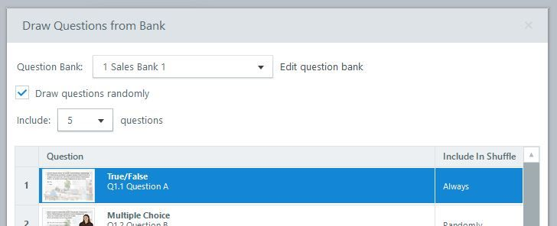
AUTHENTIC ARTICULATE UI
Activity 09 · Verify the Panel
Named setting
For each item open Form View and enter the prompt, choices…
Expected output
Five criteria are covered.
Boundary
Answers are not leaked before submission.
Own evidence
Show the learner-created checkpoint and final setting, not…
© 2026 Tertiary Infotech Academy Pte Ltd · Mastering Articulate Storyline 360 for e-Learning Content Creation · TGS-2024042308
Articulate official product guidance
312

Slide 313
EXPECTED VERSUS ACTUAL
Activity 09 · Test Matrix
Case 1
Case 2
Five criteria are covered.
Scoring is reproducible.
Case 3
Case 4
Instructions and states are accessible.
Answers are not leaked before submission.
Revisit
Record
Navigate away and back; compare actual state with the specified revisit rule.
Log expected, actual, pass/fail, defect owner and corrected checkpoint filename.
© 2026 Tertiary Infotech Academy Pte Ltd · Mastering Articulate Storyline 360 for e-Learning Content Creation · TGS-2024042308
313

Slide 314
HANDS-ON APPLICATION · TOPIC 3
Activity 10 · Configure Results, Retry and Completion
Track only the scored quiz, set 80% pass and prove retry/review behaviour.
1
2
3
4
5
Analyse
Choose
Apply
Inspect
Evidence
EVIDENCE
Retain the named .story checkpoint, the completed self-check table and one screenshot for each task showing the final state or setting that proves the acceptance criteria.
Full click-by-click procedure · Learner Guide / Activity 10
© 2026 Tertiary Infotech Academy Pte Ltd · Mastering Articulate Storyline 360 for e-Learning Content Creation · TGS-2024042308
314

Slide 315
AUTHENTIC ARTICULATE UI
Activity 10 · Interface Reference
Locate
Use this authentic interface capture to find the named…
Set
Open Result Tools — Design > Quiz Settings and select only…
Verify
80% threshold is exact.
Evidence
Capture one final-state screenshot for the task; this…
© 2026 Tertiary Infotech Academy Pte Ltd · Mastering Articulate Storyline 360 for e-Learning Content Creation · TGS-2024042308
Articulate official product guidance
315

Slide 316
EDITABLE TECHNICAL MODEL
Activity 10 · Artifact Model
Artifact
Purpose
HarbourLink-WSH-Checkpoint-10-YourName.story
Track only the scored quiz, set 80% pass and prove retry/review behaviour.
Scenario input
Required output
HarbourLink annual WSH refresher; picture-first content, narration, captions, keyboard access and five-question 80% practice quiz.
80% threshold is exact.
Control point
Readback
Slides viewed cannot bypass the quiz.
Retain the named .story checkpoint, the completed self-check table and one screenshot for each task showing the final state or setting that proves the acceptance criteria.
© 2026 Tertiary Infotech Academy Pte Ltd · Mastering Articulate Storyline 360 for e-Learning Content Creation · TGS-2024042308
316

Slide 317
EDITABLE TECHNICAL MODEL
Activity 10 · Runtime State Trace
Initial state
Input
Open with declared defaults and no prior test residue.
Use the named WSA asset, learner decision or publish setting.
Control
Stored state
80% threshold is exact.
Slides viewed cannot bypass the quiz.
Runtime output
Boundary
Retry starts a clean quiz attempt.
Review appears only after submission.
© 2026 Tertiary Infotech Academy Pte Ltd · Mastering Articulate Storyline 360 for e-Learning Content Creation · TGS-2024042308
317

Slide 318
EDITABLE TECHNICAL MODEL
Activity 10 · Worked Failure Case
Expected
Incomplete
80% threshold is exact.
Fail when: Slides viewed cannot bypass the quiz. is not demonstrated.
Repeat
Access
Repeat/revisit must preserve: Retry starts a clean quiz attempt.
Review appears only after submission.
Recovery
Log
Correct the named setting in the next checkpoint, then rerun the same case.
Record expected, actual, pass/fail and corrected version.
© 2026 Tertiary Infotech Academy Pte Ltd · Mastering Articulate Storyline 360 for e-Learning Content Creation · TGS-2024042308
318

Slide 319
EDITABLE TECHNICAL MODEL
Activity 10 · Evidence Record
Source
Evidence rule
HarbourLink-WSH-Checkpoint-10-YourName.story
One decisive learner screenshot per task.
Setting evidence
Runtime evidence
80% threshold is exact.
Slides viewed cannot bypass the quiz.
Regression evidence
Retention
Review appears only after submission.
Retain the named .story checkpoint, the completed self-check table and one screenshot for each task showing the final state or setting that proves the acceptance criteria.
© 2026 Tertiary Infotech Academy Pte Ltd · Mastering Articulate Storyline 360 for e-Learning Content Creation · TGS-2024042308
319

Slide 320
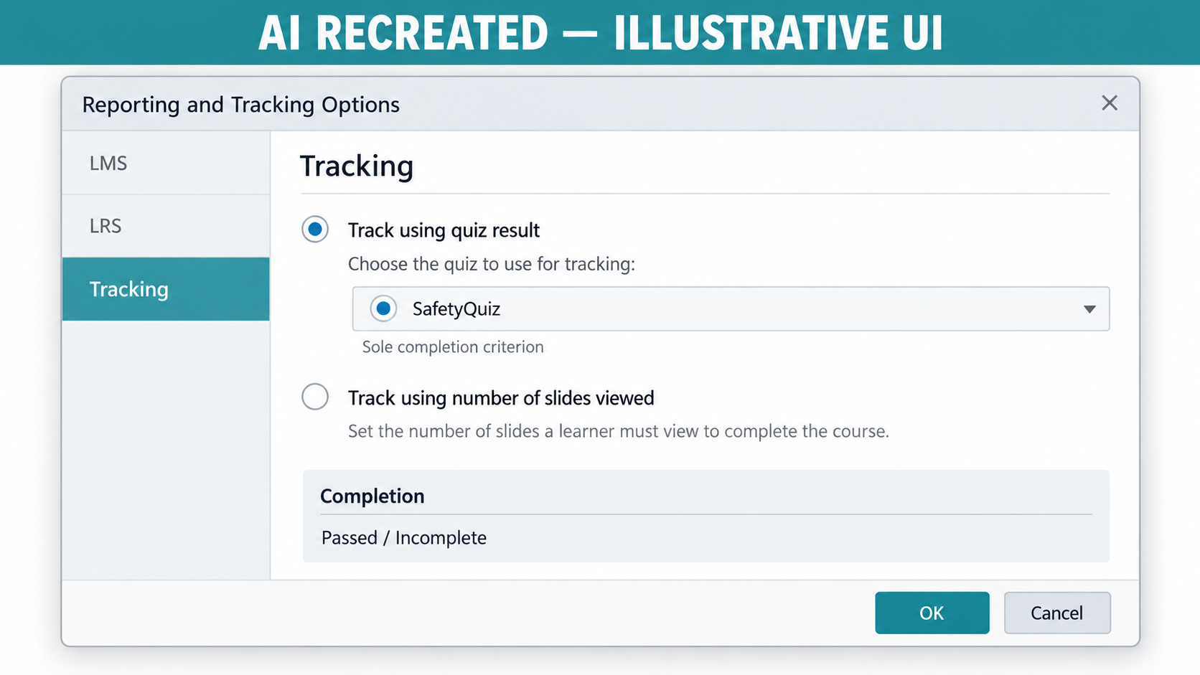
AUTHENTIC ARTICULATE UI
Activity 10 · Verify the Panel
Named setting
In Result Tools — Design set Quiz Type to `Final…
Expected output
80% threshold is exact.
Boundary
Review appears only after submission.
Own evidence
Show the learner-created checkpoint and final setting, not…
© 2026 Tertiary Infotech Academy Pte Ltd · Mastering Articulate Storyline 360 for e-Learning Content Creation · TGS-2024042308
Articulate official product guidance
320

Slide 321
EXPECTED VERSUS ACTUAL
Activity 10 · Test Matrix
Case 1
Case 2
80% threshold is exact.
Slides viewed cannot bypass the quiz.
Case 3
Case 4
Retry starts a clean quiz attempt.
Review appears only after submission.
Revisit
Record
Navigate away and back; compare actual state with the specified revisit rule.
Log expected, actual, pass/fail, defect owner and corrected checkpoint filename.
© 2026 Tertiary Infotech Academy Pte Ltd · Mastering Articulate Storyline 360 for e-Learning Content Creation · TGS-2024042308
321

Slide 322
WSA ACCEPTANCE MODEL
Topic 3 Checkpoint
Source
Quiz
Results
HarbourLink-WSH-Checkpoint-10-YourName.story
Five criteria; 80% classroom pass
3/5 fail · 4/5 pass · 5/5 pass
Retry
Tracking
Evidence
Reset result before jump
Quiz Result only; no slides-viewed bypass
Result properties and pass/fail readback
© 2026 Tertiary Infotech Academy Pte Ltd · Mastering Articulate Storyline 360 for e-Learning Content Creation · TGS-2024042308
322

Slide 323
04
Review, Publishing and Governance
Player · translation · Review 360 · SCORM 1.2/2004 · Tin Can xAPI · LMS/LRS tests · retention
LO4 · A4 · A7 · K4
© 2026 Tertiary Infotech Academy Pte Ltd · Mastering Articulate Storyline 360 for e-Learning Content Creation · TGS-2024042308
323

Slide 324
EDITABLE CHANNEL COMPARISON
Distribution Capability
Review 360
5
READ THE CHART
2
Web
5
Illustrative 1–5 comparison: choose the channel from interaction, tracking, review and governance requirements—not from export convenience alone.
5
1
Video
2
1
1
LMS/LRS
2
5
5
Editable PowerPoint shape chart
3
Interactivity
Tracking
Review
© 2026 Tertiary Infotech Academy Pte Ltd · Mastering Articulate Storyline 360 for e-Learning Content Creation · TGS-2024042308
Articulate publishing guidance
324

Slide 325
CONCEPT 73 · INTERFACE ORIENTATION
Player accessibility controls
NAMED ARTIFACT
WSA-073-Player-accessibility-controls
MECHANISM
Player Properties retains volume, captions, keyboard focus and clear labels
EXPECTED
keyboard and screen-reader test reaches each enabled control
Authentic Articulate interface reference · verify the named control
© 2026 Tertiary Infotech Academy Pte Ltd · Mastering Articulate Storyline 360 for e-Learning Content Creation · TGS-2024042308
Articulate Storyline 360 official guidance; v11 technical anchor register
325

Slide 326
INTERFACE · NAMED CONFIGURATION
Player accessibility controls
SET THESE CONTROLS
C1=controls · C2=colour · C3=language · C4=menu · C5=seekbar
REJECT WHEN
hiding controls required for media access
VERIFY READBACK
keyboard and screen-reader test reaches each enabled control
Authentic Articulate interface reference · verify the named control
© 2026 Tertiary Infotech Academy Pte Ltd · Mastering Articulate Storyline 360 for e-Learning Content Creation · TGS-2024042308
Articulate Storyline 360 official guidance; v11 technical anchor register
326

Slide 327
TECHNICAL ANCHOR 073 · WORKED SYNTHETIC TRACE
Player accessibility controls
FAULTY OUTPUT (EXAMPLE)
hiding controls required for media access
FIX IN NAMED PANEL
controls; colour; language; menu; seekbar
EXPECTED AFTER FIX
keyboard and screen-reader test reaches each enabled control · verify in…
Authentic Articulate interface reference · verify the named control
© 2026 Tertiary Infotech Academy Pte Ltd · Mastering Articulate Storyline 360 for e-Learning Content Creation · TGS-2024042308
Articulate Storyline 360 official guidance; v11 technical anchor register
327

Slide 328
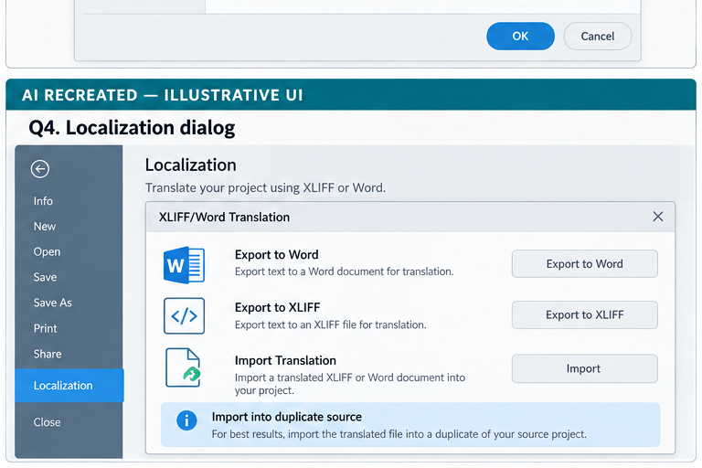
CONCEPT 74 · INTERFACE ORIENTATION
Translation workflow
NAMED ARTIFACT
WSA-074-Translation-workflow
MECHANISM
File > Localization > XLIFF/Word Translation exports text, protects…
EXPECTED
import preserves triggers and representative layouts fit
AI RECREATED — ILLUSTRATIVE UI · verify the named control
© 2026 Tertiary Infotech Academy Pte Ltd · Mastering Articulate Storyline 360 for e-Learning Content Creation · TGS-2024042308
Articulate Storyline 360 official guidance; v11 technical anchor register
328

Slide 329
INTERFACE · NAMED CONFIGURATION
Translation workflow
SET THESE CONTROLS
C1=XLIFF/Word workflow · C2=locale · C3=font · C4=expansion
REJECT WHEN
editing object IDs or truncating expanded text
VERIFY READBACK
import preserves triggers and representative layouts fit
AI RECREATED — ILLUSTRATIVE UI · verify the named control
© 2026 Tertiary Infotech Academy Pte Ltd · Mastering Articulate Storyline 360 for e-Learning Content Creation · TGS-2024042308
Articulate Storyline 360 official guidance; v11 technical anchor register
329

Slide 330
TECHNICAL ANCHOR 074 · WORKED SYNTHETIC TRACE
Translation workflow
FAULTY OUTPUT (EXAMPLE)
editing object IDs or truncating expanded text
FIX IN NAMED PANEL
XLIFF/Word workflow; locale; font; expansion
EXPECTED AFTER FIX
import preserves triggers and representative layouts fit · verify in your…
AI RECREATED — ILLUSTRATIVE UI · verify the named control
© 2026 Tertiary Infotech Academy Pte Ltd · Mastering Articulate Storyline 360 for e-Learning Content Creation · TGS-2024042308
Articulate Storyline 360 official guidance; v11 technical anchor register
330

Slide 331
CONCEPT 75 · HOW IT WORKS
Review 360 publishing
Named HarbourLink WSH artifact
Input / source state
WSA-075-Review-360-publishing
WSA checkpoint plus item name; version; comments; resolve/reopen
Runtime mechanism
Expected output
Home > Publish > Review 360 creates a versioned review item with named reviewers
each comment has owner, disposition and source version
Rejected output
Evidence record
treating comments as the only requirement record
WSA-075-Review-360-publishing: capture the configured control and the runtime readback.
© 2026 Tertiary Infotech Academy Pte Ltd · Mastering Articulate Storyline 360 for e-Learning Content Creation · TGS-2024042308
Articulate Storyline 360 official guidance; v11 technical anchor register
331

Slide 332
EDITABLE CONFIGURATION MODEL
Review 360 publishing
SET THESE CONTROLS
REJECT WHEN
VERIFY READBACK
C1=item name · C2=version · C3=comments · C4=resolve/reopen
treating comments as the only requirement record
each comment has owner, disposition and source version
→
→
Editable HarbourLink model · each comment has owner, disposition and source version
© 2026 Tertiary Infotech Academy Pte Ltd · Mastering Articulate Storyline 360 for e-Learning Content Creation · TGS-2024042308
Articulate Storyline 360 official guidance; v11 technical anchor register
332

Slide 333
TECHNICAL ANCHOR 075 · WORKED SYNTHETIC TRACE
Review 360 publishing
FAULTY OUTPUT (EXAMPLE)
CORRECT THE RECORD
EXPECTED AFTER FIX
treating comments as the only requirement record
item name; version; comments; resolve/reopen
each comment has owner, disposition and source version · verify in your own Preview
→
→
Editable HarbourLink model · each comment has owner, disposition and source version
© 2026 Tertiary Infotech Academy Pte Ltd · Mastering Articulate Storyline 360 for e-Learning Content Creation · TGS-2024042308
Articulate Storyline 360 official guidance; v11 technical anchor register
333

Slide 334
CONCEPT 76 · HOW IT WORKS
Review version control
Named HarbourLink WSH artifact
Input / source state
WSA-076-Review-version-control
WSA checkpoint plus review URL; version label; approval snapshot
Runtime mechanism
Expected output
Update an existing Review 360 item only when continuity is intended; otherwise create a new item
approved comment set maps to a retained .story checksum
Rejected output
Evidence record
overwriting an approved review with untracked changes
WSA-076-Review-version-control: capture the configured control and the runtime readback.
© 2026 Tertiary Infotech Academy Pte Ltd · Mastering Articulate Storyline 360 for e-Learning Content Creation · TGS-2024042308
Articulate Storyline 360 official guidance; v11 technical anchor register
334

Slide 335
EDITABLE CONFIGURATION MODEL
Review version control
SET THESE CONTROLS
REJECT WHEN
VERIFY READBACK
C1=review URL · C2=version label · C3=approval snapshot
overwriting an approved review with untracked changes
approved comment set maps to a retained .story checksum
→
→
Editable HarbourLink model · approved comment set maps to a retained .story checksum
© 2026 Tertiary Infotech Academy Pte Ltd · Mastering Articulate Storyline 360 for e-Learning Content Creation · TGS-2024042308
Articulate Storyline 360 official guidance; v11 technical anchor register
335

Slide 336
TECHNICAL ANCHOR 076 · WORKED SYNTHETIC TRACE
Review version control
FAULTY OUTPUT (EXAMPLE)
CORRECT THE RECORD
EXPECTED AFTER FIX
overwriting an approved review with untracked changes
review URL; version label; approval snapshot
approved comment set maps to a retained .story checksum · verify in your own Preview
→
→
Editable HarbourLink model · approved comment set maps to a retained .story checksum
© 2026 Tertiary Infotech Academy Pte Ltd · Mastering Articulate Storyline 360 for e-Learning Content Creation · TGS-2024042308
Articulate Storyline 360 official guidance; v11 technical anchor register
336

Slide 337
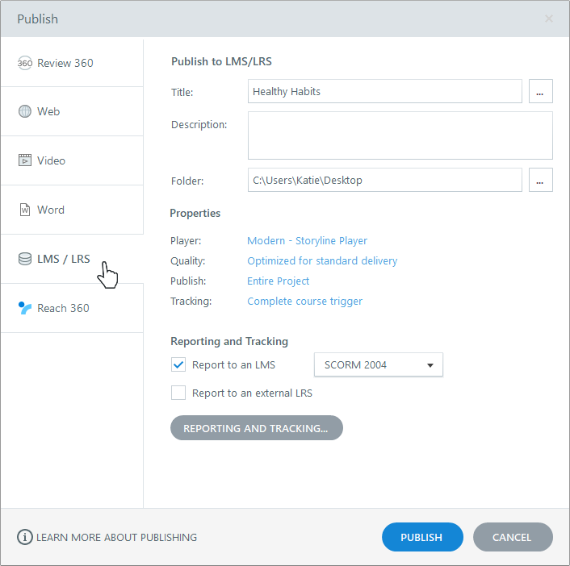
CONCEPT 77 · INTERFACE ORIENTATION
LMS/LRS publish target
NAMED ARTIFACT
WSA-077-LMS-LRS-publish-target
MECHANISM
Home > Publish > LMS/LRS opens title, folder, quality, reporting and…
EXPECTED
local publish completes and the settings record identifies the package
Authentic Articulate interface reference · verify the named control
© 2026 Tertiary Infotech Academy Pte Ltd · Mastering Articulate Storyline 360 for e-Learning Content Creation · TGS-2024042308
Articulate Storyline 360 official guidance; v11 technical anchor register
337

Slide 338
INTERFACE · NAMED CONFIGURATION
LMS/LRS publish target
SET THESE CONTROLS
C1=publish path · C2=title · C3=identifier · C4=standard · C5=tracking
REJECT WHEN
publishing to a synced/network folder or reusing IDs carelessly
VERIFY READBACK
local publish completes and the settings record identifies the package
Authentic Articulate interface reference · verify the named control
© 2026 Tertiary Infotech Academy Pte Ltd · Mastering Articulate Storyline 360 for e-Learning Content Creation · TGS-2024042308
Articulate Storyline 360 official guidance; v11 technical anchor register
338

Slide 339
TECHNICAL ANCHOR 077 · WORKED SYNTHETIC TRACE
LMS/LRS publish target
FAULTY OUTPUT (EXAMPLE)
publishing to a synced/network folder or reusing IDs carelessly
FIX IN NAMED PANEL
publish path; title; identifier; standard; tracking
EXPECTED AFTER FIX
local publish completes and the settings record identifies the package ·…
Authentic Articulate interface reference · verify the named control
© 2026 Tertiary Infotech Academy Pte Ltd · Mastering Articulate Storyline 360 for e-Learning Content Creation · TGS-2024042308
Articulate Storyline 360 official guidance; v11 technical anchor register
339

Slide 340
CONCEPT 78 · HOW IT WORKS
SCORM 1.2 reporting
Named HarbourLink WSH artifact
Input / source state
WSA-078-SCORM-1-2-reporting
WSA checkpoint plus Passed/Incomplete; Passed/Failed; identifier; title
Runtime mechanism
Expected output
Reporting and Tracking selects SCORM 1.2 and the LMS status pair required by the target LMS
sandbox records score, lesson status, location and suspend data
Rejected output
Evidence record
choosing a status model without LMS validation
WSA-078-SCORM-1-2-reporting: capture the configured control and the runtime readback.
© 2026 Tertiary Infotech Academy Pte Ltd · Mastering Articulate Storyline 360 for e-Learning Content Creation · TGS-2024042308
Articulate Storyline 360 official guidance; v11 technical anchor register
340

Slide 341
EDITABLE CONFIGURATION MODEL
SCORM 1.2 reporting
SET THESE CONTROLS
REJECT WHEN
VERIFY READBACK
C1=Passed/Incomplete · C2=Passed/Failed · C3=identifier · C4=title
choosing a status model without LMS validation
sandbox records score, lesson status, location and suspend data
→
→
Editable HarbourLink model · sandbox records score, lesson status, location and suspend data
© 2026 Tertiary Infotech Academy Pte Ltd · Mastering Articulate Storyline 360 for e-Learning Content Creation · TGS-2024042308
Articulate Storyline 360 official guidance; v11 technical anchor register
341

Slide 342
TECHNICAL ANCHOR 078 · WORKED SYNTHETIC TRACE
SCORM 1.2 reporting
FAULTY OUTPUT (EXAMPLE)
CORRECT THE RECORD
EXPECTED AFTER FIX
choosing a status model without LMS validation
Passed/Incomplete; Passed/Failed; identifier; title
sandbox records score, lesson status, location and suspend data · verify in your own Preview
→
→
Editable HarbourLink model · sandbox records score, lesson status, location and suspend data
© 2026 Tertiary Infotech Academy Pte Ltd · Mastering Articulate Storyline 360 for e-Learning Content Creation · TGS-2024042308
Articulate Storyline 360 official guidance; v11 technical anchor register
342

Slide 343
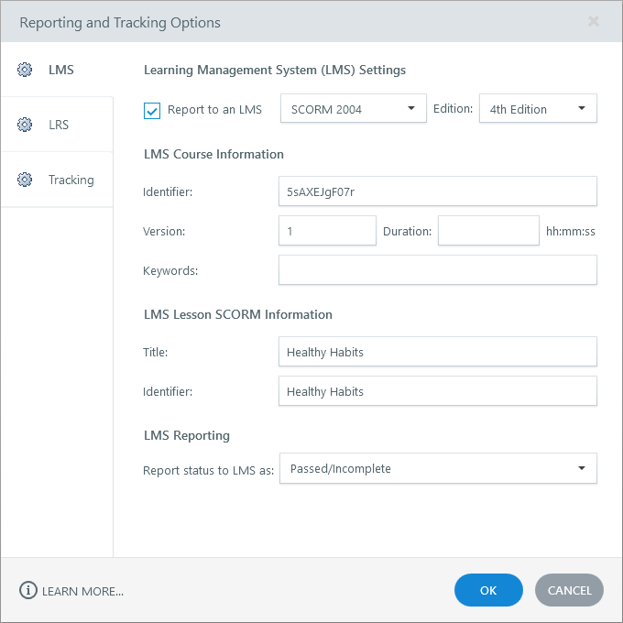
CONCEPT 79 · INTERFACE ORIENTATION
SCORM 2004 editions
NAMED ARTIFACT
WSA-079-SCORM-2004-editions
MECHANISM
Reporting and Tracking selects the LMS-supported SCORM 2004 edition and…
EXPECTED
sandbox launch, suspend/resume and score readback pass
Authentic Articulate interface reference · verify the named control
© 2026 Tertiary Infotech Academy Pte Ltd · Mastering Articulate Storyline 360 for e-Learning Content Creation · TGS-2024042308
Articulate Storyline 360 official guidance; v11 technical anchor register
343

Slide 344
INTERFACE · NAMED CONFIGURATION
SCORM 2004 editions
SET THESE CONTROLS
C1=edition · C2=completion · C3=success · C4=score · C5=identifier
REJECT WHEN
assuming every LMS supports the same edition
VERIFY READBACK
sandbox launch, suspend/resume and score readback pass
Authentic Articulate interface reference · verify the named control
© 2026 Tertiary Infotech Academy Pte Ltd · Mastering Articulate Storyline 360 for e-Learning Content Creation · TGS-2024042308
Articulate Storyline 360 official guidance; v11 technical anchor register
344

Slide 345
TECHNICAL ANCHOR 079 · WORKED SYNTHETIC TRACE
SCORM 2004 editions
FAULTY OUTPUT (EXAMPLE)
assuming every LMS supports the same edition
FIX IN NAMED PANEL
edition; completion; success; score; identifier
EXPECTED AFTER FIX
sandbox launch, suspend/resume and score readback pass · verify in your…
Authentic Articulate interface reference · verify the named control
© 2026 Tertiary Infotech Academy Pte Ltd · Mastering Articulate Storyline 360 for e-Learning Content Creation · TGS-2024042308
Articulate Storyline 360 official guidance; v11 technical anchor register
345

Slide 346
CONCEPT 80 · HOW IT WORKS
Tin Can xAPI publishing
Named HarbourLink WSH artifact
Input / source state
WSA-080-Tin-Can-xAPI-publishing
WSA checkpoint plus activity ID; actor; endpoint; auth; statements
Runtime mechanism
Expected output
Reporting and Tracking selects xAPI (Tin Can API) and uses launch-supplied actor/LRS configuration
test launch sends expected statements without credentials stored in the package
Rejected output
Evidence record
embedding LRS secrets in learner assets
WSA-080-Tin-Can-xAPI-publishing: capture the configured control and the runtime readback.
© 2026 Tertiary Infotech Academy Pte Ltd · Mastering Articulate Storyline 360 for e-Learning Content Creation · TGS-2024042308
Articulate Storyline 360 official guidance; v11 technical anchor register
346

Slide 347
EDITABLE CONFIGURATION MODEL
Tin Can xAPI publishing
SET THESE CONTROLS
REJECT WHEN
VERIFY READBACK
C1=activity ID · C2=actor · C3=endpoint · C4=auth · C5=statements
embedding LRS secrets in learner assets
test launch sends expected statements without credentials stored in the package
→
→
Editable HarbourLink model · test launch sends expected statements without credentials stored in the package
© 2026 Tertiary Infotech Academy Pte Ltd · Mastering Articulate Storyline 360 for e-Learning Content Creation · TGS-2024042308
Articulate Storyline 360 official guidance; v11 technical anchor register
347

Slide 348
TECHNICAL ANCHOR 080 · WORKED SYNTHETIC TRACE
Tin Can xAPI publishing
FAULTY OUTPUT (EXAMPLE)
CORRECT THE RECORD
EXPECTED AFTER FIX
embedding LRS secrets in learner assets
activity ID; actor; endpoint; auth; statements
test launch sends expected statements without credentials stored in the package · verify in your own Preview
→
→
Editable HarbourLink model · test launch sends expected statements without credentials stored in the package
© 2026 Tertiary Infotech Academy Pte Ltd · Mastering Articulate Storyline 360 for e-Learning Content Creation · TGS-2024042308
Articulate Storyline 360 official guidance; v11 technical anchor register
348

Slide 349
CONCEPT 81 · HOW IT WORKS
cmi5 boundary
Named HarbourLink WSH artifact
Input / source state
WSA-081-cmi5-boundary
WSA checkpoint plus AU launch; session; moveOn; masteryScore
Runtime mechanism
Expected output
cmi5 is chosen only when the LMS supports its launch/session rules and xAPI statement profile
cmi5 conformance test shows launched, completed and passed lifecycle
Rejected output
Evidence record
treating generic xAPI and cmi5 as interchangeable
WSA-081-cmi5-boundary: capture the configured control and the runtime readback.
© 2026 Tertiary Infotech Academy Pte Ltd · Mastering Articulate Storyline 360 for e-Learning Content Creation · TGS-2024042308
Articulate Storyline 360 official guidance; v11 technical anchor register
349

Slide 350
EDITABLE CONFIGURATION MODEL
cmi5 boundary
SET THESE CONTROLS
REJECT WHEN
VERIFY READBACK
C1=AU launch · C2=session · C3=moveOn · C4=masteryScore
treating generic xAPI and cmi5 as interchangeable
cmi5 conformance test shows launched, completed and passed lifecycle
→
→
Editable HarbourLink model · cmi5 conformance test shows launched, completed and passed lifecycle
© 2026 Tertiary Infotech Academy Pte Ltd · Mastering Articulate Storyline 360 for e-Learning Content Creation · TGS-2024042308
Articulate Storyline 360 official guidance; v11 technical anchor register
350

Slide 351
TECHNICAL ANCHOR 081 · WORKED SYNTHETIC TRACE
cmi5 boundary
FAULTY OUTPUT (EXAMPLE)
CORRECT THE RECORD
EXPECTED AFTER FIX
treating generic xAPI and cmi5 as interchangeable
AU launch; session; moveOn; masteryScore
cmi5 conformance test shows launched, completed and passed lifecycle · verify in your own Preview
→
→
Editable HarbourLink model · cmi5 conformance test shows launched, completed and passed lifecycle
© 2026 Tertiary Infotech Academy Pte Ltd · Mastering Articulate Storyline 360 for e-Learning Content Creation · TGS-2024042308
Articulate Storyline 360 official guidance; v11 technical anchor register
351

Slide 352
CONCEPT 82 · INTERFACE ORIENTATION
Tracking criteria semantics
NAMED ARTIFACT
WSA-082-Tracking-criteria-semantics
MECHANISM
The scored safety module tracks the quiz result only because multiple…
EXPECTED
slides-viewed alone cannot complete the scored module
AI RECREATED — ILLUSTRATIVE UI · verify the named control
© 2026 Tertiary Infotech Academy Pte Ltd · Mastering Articulate Storyline 360 for e-Learning Content Creation · TGS-2024042308
Articulate Storyline 360 official guidance; v11 technical anchor register
352

Slide 353
INTERFACE · NAMED CONFIGURATION
Tracking criteria semantics
SET THESE CONTROLS
C1=result slide · C2=criteria list · C3=completion trigger
REJECT WHEN
adding slides viewed and allowing a bypass
VERIFY READBACK
slides-viewed alone cannot complete the scored module
AI RECREATED — ILLUSTRATIVE UI · verify the named control
© 2026 Tertiary Infotech Academy Pte Ltd · Mastering Articulate Storyline 360 for e-Learning Content Creation · TGS-2024042308
Articulate Storyline 360 official guidance; v11 technical anchor register
353

Slide 354
TECHNICAL ANCHOR 082 · WORKED SYNTHETIC TRACE
Tracking criteria semantics
FAULTY OUTPUT (EXAMPLE)
adding slides viewed and allowing a bypass
FIX IN NAMED PANEL
result slide; criteria list; completion trigger
EXPECTED AFTER FIX
slides-viewed alone cannot complete the scored module · verify in your own…
AI RECREATED — ILLUSTRATIVE UI · verify the named control
© 2026 Tertiary Infotech Academy Pte Ltd · Mastering Articulate Storyline 360 for e-Learning Content Creation · TGS-2024042308
Articulate Storyline 360 official guidance; v11 technical anchor register
354

Slide 355
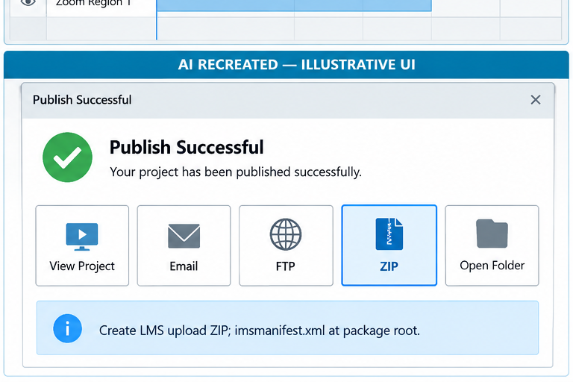
CONCEPT 83 · INTERFACE ORIENTATION
Publish Success ZIP
NAMED ARTIFACT
WSA-083-Publish-Success-ZIP
MECHANISM
Publish Successful > ZIP creates an upload package with imsmanifest.xml…
EXPECTED
archive inspection finds manifest and launch assets at root
AI RECREATED — ILLUSTRATIVE UI · verify the named control
© 2026 Tertiary Infotech Academy Pte Ltd · Mastering Articulate Storyline 360 for e-Learning Content Creation · TGS-2024042308
Articulate Storyline 360 official guidance; v11 technical anchor register
355

Slide 356
INTERFACE · NAMED CONFIGURATION
Publish Success ZIP
SET THESE CONTROLS
C1=ZIP command · C2=manifest root · C3=no extra wrapper folder
REJECT WHEN
zipping the containing folder manually
VERIFY READBACK
archive inspection finds manifest and launch assets at root
AI RECREATED — ILLUSTRATIVE UI · verify the named control
© 2026 Tertiary Infotech Academy Pte Ltd · Mastering Articulate Storyline 360 for e-Learning Content Creation · TGS-2024042308
Articulate Storyline 360 official guidance; v11 technical anchor register
356

Slide 357
TECHNICAL ANCHOR 083 · WORKED SYNTHETIC TRACE
Publish Success ZIP
FAULTY OUTPUT (EXAMPLE)
zipping the containing folder manually
FIX IN NAMED PANEL
ZIP command; manifest root; no extra wrapper folder
EXPECTED AFTER FIX
archive inspection finds manifest and launch assets at root · verify in…
AI RECREATED — ILLUSTRATIVE UI · verify the named control
© 2026 Tertiary Infotech Academy Pte Ltd · Mastering Articulate Storyline 360 for e-Learning Content Creation · TGS-2024042308
Articulate Storyline 360 official guidance; v11 technical anchor register
357

Slide 358
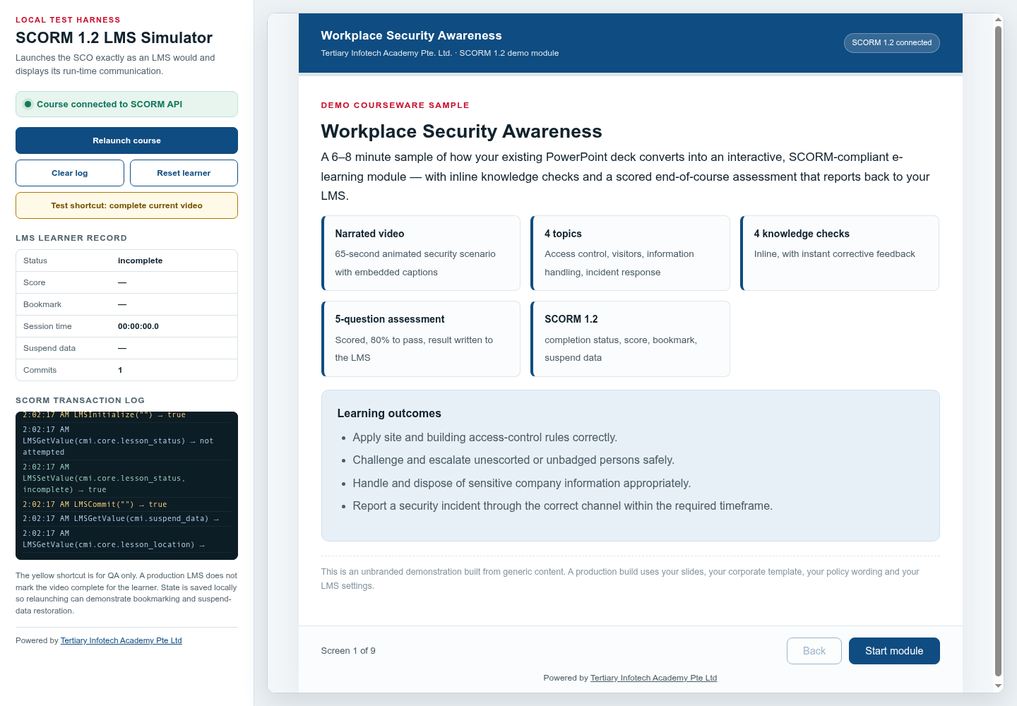
CONCEPT 84 · INTERFACE ORIENTATION
LMS sandbox upload
NAMED ARTIFACT
WSA-084-LMS-sandbox-upload
MECHANISM
A non-production LMS course tests launch, completion, score, bookmark,…
EXPECTED
fresh, failed, passed and resumed attempts read back correctly
Authentic Articulate interface reference · verify the named control
© 2026 Tertiary Infotech Academy Pte Ltd · Mastering Articulate Storyline 360 for e-Learning Content Creation · TGS-2024042308
Articulate Storyline 360 official guidance; v11 technical anchor register
358

Slide 359
INTERFACE · NAMED CONFIGURATION
LMS sandbox upload
SET THESE CONTROLS
C1=learner ID · C2=attempt · C3=status · C4=score · C5=resume · C6=debug log
REJECT WHEN
using production learners for package debugging
VERIFY READBACK
fresh, failed, passed and resumed attempts read back correctly
Authentic Articulate interface reference · verify the named control
© 2026 Tertiary Infotech Academy Pte Ltd · Mastering Articulate Storyline 360 for e-Learning Content Creation · TGS-2024042308
Articulate Storyline 360 official guidance; v11 technical anchor register
359

Slide 360
TECHNICAL ANCHOR 084 · WORKED SYNTHETIC TRACE
LMS sandbox upload
FAULTY OUTPUT (EXAMPLE)
using production learners for package debugging
FIX IN NAMED PANEL
learner ID; attempt; status; score; resume; debug log
EXPECTED AFTER FIX
fresh, failed, passed and resumed attempts read back correctly · verify in…
Authentic Articulate interface reference · verify the named control
© 2026 Tertiary Infotech Academy Pte Ltd · Mastering Articulate Storyline 360 for e-Learning Content Creation · TGS-2024042308
Articulate Storyline 360 official guidance; v11 technical anchor register
360

Slide 361
CONCEPT 85 · INTERFACE ORIENTATION
SCORM runtime reference
NAMED ARTIFACT
WSA-085-SCORM-runtime-reference
MECHANISM
The supplied workplacesafety-scorm site informs runtime test structure,…
EXPECTED
comparison notes distinguish its SCORM demo role from the new Storyline build
Authentic Articulate interface reference · verify the named control
© 2026 Tertiary Infotech Academy Pte Ltd · Mastering Articulate Storyline 360 for e-Learning Content Creation · TGS-2024042308
Articulate Storyline 360 official guidance; v11 technical anchor register
361

Slide 362
INTERFACE · NAMED CONFIGURATION
SCORM runtime reference
SET THESE CONTROLS
C1=API discovery · C2=status · C3=score · C4=bookmark · C5=session time ·…
REJECT WHEN
claiming the reference is Storyline output or an xAPI tester
VERIFY READBACK
comparison notes distinguish its SCORM demo role from the new Storyline build
Authentic Articulate interface reference · verify the named control
© 2026 Tertiary Infotech Academy Pte Ltd · Mastering Articulate Storyline 360 for e-Learning Content Creation · TGS-2024042308
Articulate Storyline 360 official guidance; v11 technical anchor register
362

Slide 363
TECHNICAL ANCHOR 085 · WORKED SYNTHETIC TRACE
SCORM runtime reference
FAULTY OUTPUT (EXAMPLE)
claiming the reference is Storyline output or an xAPI tester
FIX IN NAMED PANEL
API discovery; status; score; bookmark; session time; suspend data
EXPECTED AFTER FIX
comparison notes distinguish its SCORM demo role from the new Storyline…
Authentic Articulate interface reference · verify the named control
© 2026 Tertiary Infotech Academy Pte Ltd · Mastering Articulate Storyline 360 for e-Learning Content Creation · TGS-2024042308
Articulate Storyline 360 official guidance; v11 technical anchor register
363

Slide 364
CONCEPT 86 · HOW IT WORKS
Standalone preview boundary
Named HarbourLink WSH artifact
Input / source state
WSA-086-Standalone-preview-boundary
WSA checkpoint plus preview notice; no tracking claim; fallback
Runtime mechanism
Expected output
course.html style standalone preview is used for visual checks only because no LMS API is present
test report labels standalone and LMS evidence separately
Rejected output
Evidence record
equating local browser preview with LMS completion
WSA-086-Standalone-preview-boundary: capture the configured control and the runtime readback.
© 2026 Tertiary Infotech Academy Pte Ltd · Mastering Articulate Storyline 360 for e-Learning Content Creation · TGS-2024042308
Articulate Storyline 360 official guidance; v11 technical anchor register
364

Slide 365
EDITABLE CONFIGURATION MODEL
Standalone preview boundary
SET THESE CONTROLS
REJECT WHEN
VERIFY READBACK
C1=preview notice · C2=no tracking claim · C3=fallback
equating local browser preview with LMS completion
test report labels standalone and LMS evidence separately
→
→
Editable HarbourLink model · test report labels standalone and LMS evidence separately
© 2026 Tertiary Infotech Academy Pte Ltd · Mastering Articulate Storyline 360 for e-Learning Content Creation · TGS-2024042308
Articulate Storyline 360 official guidance; v11 technical anchor register
365

Slide 366
TECHNICAL ANCHOR 086 · WORKED SYNTHETIC TRACE
Standalone preview boundary
FAULTY OUTPUT (EXAMPLE)
CORRECT THE RECORD
EXPECTED AFTER FIX
equating local browser preview with LMS completion
preview notice; no tracking claim; fallback
test report labels standalone and LMS evidence separately · verify in your own Preview
→
→
Editable HarbourLink model · test report labels standalone and LMS evidence separately
© 2026 Tertiary Infotech Academy Pte Ltd · Mastering Articulate Storyline 360 for e-Learning Content Creation · TGS-2024042308
Articulate Storyline 360 official guidance; v11 technical anchor register
366

Slide 367
CONCEPT 87 · HOW IT WORKS
LMS debug diagnosis
Named HarbourLink WSH artifact
Input / source state
WSA-087-LMS-debug-diagnosis
WSA checkpoint plus API found; Initialize; SetValue; Commit; Terminate
Runtime mechanism
Expected output
Browser console and LMS debug logs isolate API discovery, commit, status and suspend-data failures
log timestamps identify the failing runtime call and value
Rejected output
Evidence record
guessing from a visible course screen
WSA-087-LMS-debug-diagnosis: capture the configured control and the runtime readback.
© 2026 Tertiary Infotech Academy Pte Ltd · Mastering Articulate Storyline 360 for e-Learning Content Creation · TGS-2024042308
Articulate Storyline 360 official guidance; v11 technical anchor register
367

Slide 368
EDITABLE CONFIGURATION MODEL
LMS debug diagnosis
SET THESE CONTROLS
REJECT WHEN
VERIFY READBACK
C1=API found · C2=Initialize · C3=SetValue · C4=Commit · C5=Terminate
guessing from a visible course screen
log timestamps identify the failing runtime call and value
→
→
Editable HarbourLink model · log timestamps identify the failing runtime call and value
© 2026 Tertiary Infotech Academy Pte Ltd · Mastering Articulate Storyline 360 for e-Learning Content Creation · TGS-2024042308
Articulate Storyline 360 official guidance; v11 technical anchor register
368

Slide 369
TECHNICAL ANCHOR 087 · WORKED SYNTHETIC TRACE
LMS debug diagnosis
FAULTY OUTPUT (EXAMPLE)
CORRECT THE RECORD
EXPECTED AFTER FIX
guessing from a visible course screen
API found; Initialize; SetValue; Commit; Terminate
log timestamps identify the failing runtime call and value · verify in your own Preview
→
→
Editable HarbourLink model · log timestamps identify the failing runtime call and value
© 2026 Tertiary Infotech Academy Pte Ltd · Mastering Articulate Storyline 360 for e-Learning Content Creation · TGS-2024042308
Articulate Storyline 360 official guidance; v11 technical anchor register
369

Slide 370
CONCEPT 88 · HOW IT WORKS
Package regression test
Named HarbourLink WSH artifact
Input / source state
WSA-088-Package-regression-test
WSA checkpoint plus source version; package checksum; clean state; results
Runtime mechanism
Expected output
Republish after source changes and rerun the full high-risk matrix against a clean learner attempt
new package checksum and clean readback match the release register
Rejected output
Evidence record
reusing a contaminated learner attempt
WSA-088-Package-regression-test: capture the configured control and the runtime readback.
© 2026 Tertiary Infotech Academy Pte Ltd · Mastering Articulate Storyline 360 for e-Learning Content Creation · TGS-2024042308
Articulate Storyline 360 official guidance; v11 technical anchor register
370

Slide 371
EDITABLE CONFIGURATION MODEL
Package regression test
SET THESE CONTROLS
REJECT WHEN
VERIFY READBACK
C1=source version · C2=package checksum · C3=clean state · C4=results
reusing a contaminated learner attempt
new package checksum and clean readback match the release register
→
→
Editable HarbourLink model · new package checksum and clean readback match the release register
© 2026 Tertiary Infotech Academy Pte Ltd · Mastering Articulate Storyline 360 for e-Learning Content Creation · TGS-2024042308
Articulate Storyline 360 official guidance; v11 technical anchor register
371

Slide 372
TECHNICAL ANCHOR 088 · WORKED SYNTHETIC TRACE
Package regression test
FAULTY OUTPUT (EXAMPLE)
CORRECT THE RECORD
EXPECTED AFTER FIX
reusing a contaminated learner attempt
source version; package checksum; clean state; results
new package checksum and clean readback match the release register · verify in your own Preview
→
→
Editable HarbourLink model · new package checksum and clean readback match the release register
© 2026 Tertiary Infotech Academy Pte Ltd · Mastering Articulate Storyline 360 for e-Learning Content Creation · TGS-2024042308
Articulate Storyline 360 official guidance; v11 technical anchor register
372

Slide 373
CONCEPT 89 · HOW IT WORKS
Release retention
Named HarbourLink WSH artifact
Input / source state
WSA-089-Release-retention
WSA checkpoint plus owner; date; version; checksum; review trigger
Runtime mechanism
Expected output
Retain .story, publish settings, ZIP, test log, review approval and asset provenance together
auditor can reproduce which source and settings created the live package
Rejected output
Evidence record
keeping only the uploaded ZIP
WSA-089-Release-retention: capture the configured control and the runtime readback.
© 2026 Tertiary Infotech Academy Pte Ltd · Mastering Articulate Storyline 360 for e-Learning Content Creation · TGS-2024042308
Articulate Storyline 360 official guidance; v11 technical anchor register
373

Slide 374
EDITABLE CONFIGURATION MODEL
Release retention
SET THESE CONTROLS
REJECT WHEN
VERIFY READBACK
C1=owner · C2=date · C3=version · C4=checksum · C5=review trigger
keeping only the uploaded ZIP
auditor can reproduce which source and settings created the live package
→
→
Editable HarbourLink model · auditor can reproduce which source and settings created the live package
© 2026 Tertiary Infotech Academy Pte Ltd · Mastering Articulate Storyline 360 for e-Learning Content Creation · TGS-2024042308
Articulate Storyline 360 official guidance; v11 technical anchor register
374

Slide 375
TECHNICAL ANCHOR 089 · WORKED SYNTHETIC TRACE
Release retention
FAULTY OUTPUT (EXAMPLE)
CORRECT THE RECORD
EXPECTED AFTER FIX
keeping only the uploaded ZIP
owner; date; version; checksum; review trigger
auditor can reproduce which source and settings created the live package · verify in your own Preview
→
→
Editable HarbourLink model · auditor can reproduce which source and settings created the live package
© 2026 Tertiary Infotech Academy Pte Ltd · Mastering Articulate Storyline 360 for e-Learning Content Creation · TGS-2024042308
Articulate Storyline 360 official guidance; v11 technical anchor register
375

Slide 376
CONCEPT 90 · HOW IT WORKS
Articulate Labs boundary
Named HarbourLink WSH artifact
Input / source state
WSA-090-Articulate-Labs-boundary
WSA checkpoint plus duplicate source; experiment flag; fallback; review
Runtime mechanism
Expected output
Experimental Articulate Labs features are tried only in a duplicate sandbox project with manual fallback
baseline remains buildable without the experiment
Rejected output
Evidence record
making an experimental feature mandatory in production
WSA-090-Articulate-Labs-boundary: capture the configured control and the runtime readback.
© 2026 Tertiary Infotech Academy Pte Ltd · Mastering Articulate Storyline 360 for e-Learning Content Creation · TGS-2024042308
Articulate Storyline 360 official guidance; v11 technical anchor register
376

Slide 377
EDITABLE CONFIGURATION MODEL
Articulate Labs boundary
SET THESE CONTROLS
REJECT WHEN
VERIFY READBACK
C1=duplicate source · C2=experiment flag · C3=fallback · C4=review
making an experimental feature mandatory in production
baseline remains buildable without the experiment
→
→
Editable HarbourLink model · baseline remains buildable without the experiment
© 2026 Tertiary Infotech Academy Pte Ltd · Mastering Articulate Storyline 360 for e-Learning Content Creation · TGS-2024042308
Articulate Storyline 360 official guidance; v11 technical anchor register
377

Slide 378
TECHNICAL ANCHOR 090 · WORKED SYNTHETIC TRACE
Articulate Labs boundary
FAULTY OUTPUT (EXAMPLE)
CORRECT THE RECORD
EXPECTED AFTER FIX
making an experimental feature mandatory in production
duplicate source; experiment flag; fallback; review
baseline remains buildable without the experiment · verify in your own Preview
→
→
Editable HarbourLink model · baseline remains buildable without the experiment
© 2026 Tertiary Infotech Academy Pte Ltd · Mastering Articulate Storyline 360 for e-Learning Content Creation · TGS-2024042308
Articulate Storyline 360 official guidance; v11 technical anchor register
378

Slide 379
CONCEPT 91 · HOW IT WORKS
AI-assisted authoring fallback
Named HarbourLink WSH artifact
Input / source state
WSA-091-AI-assisted-authoring-fallback
WSA checkpoint plus prompt record; provenance; human review; manual path
Runtime mechanism
Expected output
Optional AI proposes copy or imagery, while the author verifies accuracy, rights and accessibility
release evidence identifies reviewer and the non-AI fallback
Rejected output
Evidence record
publishing generated output without verification
WSA-091-AI-assisted-authoring-fallback: capture the configured control and the runtime readback.
© 2026 Tertiary Infotech Academy Pte Ltd · Mastering Articulate Storyline 360 for e-Learning Content Creation · TGS-2024042308
Articulate Storyline 360 official guidance; v11 technical anchor register
379

Slide 380
EDITABLE CONFIGURATION MODEL
AI-assisted authoring fallback
SET THESE CONTROLS
REJECT WHEN
VERIFY READBACK
C1=prompt record · C2=provenance · C3=human review · C4=manual path
publishing generated output without verification
release evidence identifies reviewer and the non-AI fallback
→
→
Editable HarbourLink model · release evidence identifies reviewer and the non-AI fallback
© 2026 Tertiary Infotech Academy Pte Ltd · Mastering Articulate Storyline 360 for e-Learning Content Creation · TGS-2024042308
Articulate Storyline 360 official guidance; v11 technical anchor register
380

Slide 381
TECHNICAL ANCHOR 091 · WORKED SYNTHETIC TRACE
AI-assisted authoring fallback
FAULTY OUTPUT (EXAMPLE)
CORRECT THE RECORD
EXPECTED AFTER FIX
publishing generated output without verification
prompt record; provenance; human review; manual path
release evidence identifies reviewer and the non-AI fallback · verify in your own Preview
→
→
Editable HarbourLink model · release evidence identifies reviewer and the non-AI fallback
© 2026 Tertiary Infotech Academy Pte Ltd · Mastering Articulate Storyline 360 for e-Learning Content Creation · TGS-2024042308
Articulate Storyline 360 official guidance; v11 technical anchor register
381

Slide 382
CONCEPT 92 · HOW IT WORKS
Distribution mode comparison
Named HarbourLink WSH artifact
Input / source state
WSA-092-Distribution-mode-comparison
WSA checkpoint plus channel; launch; tracking; interaction; security; maintenance
Runtime mechanism
Expected output
A worked decision table compares Review 360, web, video, SCORM LMS and xAPI/cmi5 by interactivity, identity, score, resume, review and analytics
SCORM LMS wins for scored induction and the rejected modes have recorded reasons
Rejected output
Evidence record
selecting the easiest export rather than the required evidence
WSA-092-Distribution-mode-comparison: capture the configured control and the runtime readback.
© 2026 Tertiary Infotech Academy Pte Ltd · Mastering Articulate Storyline 360 for e-Learning Content Creation · TGS-2024042308
Articulate Storyline 360 official guidance; v11 technical anchor register
382

Slide 383
EDITABLE CONFIGURATION MODEL
Distribution mode comparison
SET THESE CONTROLS
REJECT WHEN
VERIFY READBACK
C1=channel · C2=launch · C3=tracking · C4=interaction · C5=security · C6=maintenance
selecting the easiest export rather than the required evidence
SCORM LMS wins for scored induction and the rejected modes have recorded reasons
→
→
Editable HarbourLink model · SCORM LMS wins for scored induction and the rejected modes have recorded reasons
© 2026 Tertiary Infotech Academy Pte Ltd · Mastering Articulate Storyline 360 for e-Learning Content Creation · TGS-2024042308
Articulate Storyline 360 official guidance; v11 technical anchor register
383

Slide 384
TECHNICAL ANCHOR 092 · WORKED SYNTHETIC TRACE
Distribution mode comparison
FAULTY OUTPUT (EXAMPLE)
CORRECT THE RECORD
EXPECTED AFTER FIX
selecting the easiest export rather than the required evidence
channel; launch; tracking; interaction; security; maintenance
SCORM LMS wins for scored induction and the rejected modes have recorded reasons · verify in your own Preview
→
→
Editable HarbourLink model · SCORM LMS wins for scored induction and the rejected modes have recorded reasons
© 2026 Tertiary Infotech Academy Pte Ltd · Mastering Articulate Storyline 360 for e-Learning Content Creation · TGS-2024042308
Articulate Storyline 360 official guidance; v11 technical anchor register
384

Slide 385
CONCEPT 93 · HOW IT WORKS
Delivery cadence calculation
Named HarbourLink WSH artifact
Input / source state
WSA-093-Delivery-cadence-calculation
WSA checkpoint plus trigger date; audience; channel; owner; stop condition; review interval
Runtime mechanism
Expected output
A 30-day induction cadence schedules launch on Day 0, reminders on Days 3 and 7, supervisor escalation on Day 10 and content review every 180 days
calendar table totals each touchpoint and stops when completion status is read back
Rejected output
Evidence record
sending reminders after completion or setting cadence without an owner
WSA-093-Delivery-cadence-calculation: capture the configured control and the runtime readback.
© 2026 Tertiary Infotech Academy Pte Ltd · Mastering Articulate Storyline 360 for e-Learning Content Creation · TGS-2024042308
Articulate Storyline 360 official guidance; v11 technical anchor register
385

Slide 386
EDITABLE CONFIGURATION MODEL
Delivery cadence calculation
SET THESE CONTROLS
REJECT WHEN
VERIFY READBACK
C1=trigger date · C2=audience · C3=channel · C4=owner · C5=stop condition · C6=review interval
sending reminders after completion or setting cadence without an owner
calendar table totals each touchpoint and stops when completion status is read back
→
→
Editable HarbourLink model · calendar table totals each touchpoint and stops when completion status is read back
© 2026 Tertiary Infotech Academy Pte Ltd · Mastering Articulate Storyline 360 for e-Learning Content Creation · TGS-2024042308
Articulate Storyline 360 official guidance; v11 technical anchor register
386

Slide 387
TECHNICAL ANCHOR 093 · WORKED SYNTHETIC TRACE
Delivery cadence calculation
FAULTY OUTPUT (EXAMPLE)
CORRECT THE RECORD
EXPECTED AFTER FIX
sending reminders after completion or setting cadence without an owner
trigger date; audience; channel; owner; stop condition; review interval
calendar table totals each touchpoint and stops when completion status is read back · verify in your own Preview
→
→
Editable HarbourLink model · calendar table totals each touchpoint and stops when completion status is read back
© 2026 Tertiary Infotech Academy Pte Ltd · Mastering Articulate Storyline 360 for e-Learning Content Creation · TGS-2024042308
Articulate Storyline 360 official guidance; v11 technical anchor register
387

Slide 388
CONCEPT 94 · HOW IT WORKS
Cadence exception rules
Named HarbourLink WSH artifact
Input / source state
WSA-094-Cadence-exception-rules
WSA checkpoint plus status; threshold; retry; suppression; escalation; privacy
Runtime mechanism
Expected output
Status-driven rules suppress reminders for passed learners, route failed learners to retry guidance and escalate overdue incomplete learners
test learner records produce the correct next contact and no unnecessary disclosure
Rejected output
Evidence record
broadcasting scores or sending identical messages to every status
WSA-094-Cadence-exception-rules: capture the configured control and the runtime readback.
© 2026 Tertiary Infotech Academy Pte Ltd · Mastering Articulate Storyline 360 for e-Learning Content Creation · TGS-2024042308
Articulate Storyline 360 official guidance; v11 technical anchor register
388

Slide 389
EDITABLE CONFIGURATION MODEL
Cadence exception rules
SET THESE CONTROLS
REJECT WHEN
VERIFY READBACK
C1=status · C2=threshold · C3=retry · C4=suppression · C5=escalation · C6=privacy
broadcasting scores or sending identical messages to every status
test learner records produce the correct next contact and no unnecessary disclosure
→
→
Editable HarbourLink model · test learner records produce the correct next contact and no unnecessary disclosure
© 2026 Tertiary Infotech Academy Pte Ltd · Mastering Articulate Storyline 360 for e-Learning Content Creation · TGS-2024042308
Articulate Storyline 360 official guidance; v11 technical anchor register
389

Slide 390
TECHNICAL ANCHOR 094 · WORKED SYNTHETIC TRACE
Cadence exception rules
FAULTY OUTPUT (EXAMPLE)
CORRECT THE RECORD
EXPECTED AFTER FIX
broadcasting scores or sending identical messages to every status
status; threshold; retry; suppression; escalation; privacy
test learner records produce the correct next contact and no unnecessary disclosure · verify in your own Preview
→
→
Editable HarbourLink model · test learner records produce the correct next contact and no unnecessary disclosure
© 2026 Tertiary Infotech Academy Pte Ltd · Mastering Articulate Storyline 360 for e-Learning Content Creation · TGS-2024042308
Articulate Storyline 360 official guidance; v11 technical anchor register
390

Slide 391
CONCEPT 95 · HOW IT WORKS
Content execution guideline register
Named HarbourLink WSH artifact
Input / source state
WSA-095-Content-execution-guideline-register
WSA checkpoint plus rule ID; rationale; owner; verification; exception; review date
Runtime mechanism
Expected output
The WSA guideline records tone, terminology, template, object naming, accessibility, review, publish ID, cadence and archive controls
a release reviewer can accept or reject each rule from retained evidence
Rejected output
Evidence record
guidelines with no verifier or exception path
WSA-095-Content-execution-guideline-register: capture the configured control and the runtime readback.
© 2026 Tertiary Infotech Academy Pte Ltd · Mastering Articulate Storyline 360 for e-Learning Content Creation · TGS-2024042308
Articulate Storyline 360 official guidance; v11 technical anchor register
391

Slide 392
EDITABLE CONFIGURATION MODEL
Content execution guideline register
SET THESE CONTROLS
REJECT WHEN
VERIFY READBACK
C1=rule ID · C2=rationale · C3=owner · C4=verification · C5=exception · C6=review date
guidelines with no verifier or exception path
a release reviewer can accept or reject each rule from retained evidence
→
→
Editable HarbourLink model · a release reviewer can accept or reject each rule from retained evidence
© 2026 Tertiary Infotech Academy Pte Ltd · Mastering Articulate Storyline 360 for e-Learning Content Creation · TGS-2024042308
Articulate Storyline 360 official guidance; v11 technical anchor register
392

Slide 393
TECHNICAL ANCHOR 095 · WORKED SYNTHETIC TRACE
Content execution guideline register
FAULTY OUTPUT (EXAMPLE)
CORRECT THE RECORD
EXPECTED AFTER FIX
guidelines with no verifier or exception path
rule ID; rationale; owner; verification; exception; review date
a release reviewer can accept or reject each rule from retained evidence · verify in your own Preview
→
→
Editable HarbourLink model · a release reviewer can accept or reject each rule from retained evidence
© 2026 Tertiary Infotech Academy Pte Ltd · Mastering Articulate Storyline 360 for e-Learning Content Creation · TGS-2024042308
Articulate Storyline 360 official guidance; v11 technical anchor register
393

Slide 394
CONCEPT 96 · HOW IT WORKS
Lifecycle metric decision
Named HarbourLink WSH artifact
Input / source state
WSA-096-Lifecycle-metric-decision
WSA checkpoint plus metric; source; threshold; action; owner; review date
Runtime mechanism
Expected output
A worked register links completion, pass rate, retry rate, incident-report simulation errors and overdue rate to a defined action threshold
each threshold triggers a named content, coaching or cadence response
Rejected output
Evidence record
collecting analytics without a decision purpose
WSA-096-Lifecycle-metric-decision: capture the configured control and the runtime readback.
© 2026 Tertiary Infotech Academy Pte Ltd · Mastering Articulate Storyline 360 for e-Learning Content Creation · TGS-2024042308
Articulate Storyline 360 official guidance; v11 technical anchor register
394

Slide 395
EDITABLE CONFIGURATION MODEL
Lifecycle metric decision
SET THESE CONTROLS
REJECT WHEN
VERIFY READBACK
C1=metric · C2=source · C3=threshold · C4=action · C5=owner · C6=review date
collecting analytics without a decision purpose
each threshold triggers a named content, coaching or cadence response
→
→
Editable HarbourLink model · each threshold triggers a named content, coaching or cadence response
© 2026 Tertiary Infotech Academy Pte Ltd · Mastering Articulate Storyline 360 for e-Learning Content Creation · TGS-2024042308
Articulate Storyline 360 official guidance; v11 technical anchor register
395

Slide 396
TECHNICAL ANCHOR 096 · WORKED SYNTHETIC TRACE
Lifecycle metric decision
FAULTY OUTPUT (EXAMPLE)
CORRECT THE RECORD
EXPECTED AFTER FIX
collecting analytics without a decision purpose
metric; source; threshold; action; owner; review date
each threshold triggers a named content, coaching or cadence response · verify in your own Preview
→
→
Editable HarbourLink model · each threshold triggers a named content, coaching or cadence response
© 2026 Tertiary Infotech Academy Pte Ltd · Mastering Articulate Storyline 360 for e-Learning Content Creation · TGS-2024042308
Articulate Storyline 360 official guidance; v11 technical anchor register
396

Slide 397
HANDS-ON APPLICATION · TOPIC 4
Activity 11 · Configure Player, Translation and Review 360
Prepare the module for accessible review and localisation.
1
2
3
4
5
Analyse
Choose
Apply
Inspect
Evidence
EVIDENCE
Retain the named .story checkpoint, the completed self-check table and one screenshot for each task showing the final state or setting that proves the acceptance criteria.
Full click-by-click procedure · Learner Guide / Activity 11
© 2026 Tertiary Infotech Academy Pte Ltd · Mastering Articulate Storyline 360 for e-Learning Content Creation · TGS-2024042308
397

Slide 398
AUTHENTIC ARTICULATE UI
Activity 11 · Interface Reference
Locate
Use this authentic interface capture to find the named…
Set
Open Player Properties and enable only required controls,…
Verify
Player controls are keyboard accessible.
Evidence
Capture one final-state screenshot for the task; this…
© 2026 Tertiary Infotech Academy Pte Ltd · Mastering Articulate Storyline 360 for e-Learning Content Creation · TGS-2024042308
Articulate official product guidance
398

Slide 399
EDITABLE TECHNICAL MODEL
Activity 11 · Artifact Model
Artifact
Purpose
HarbourLink-WSH-Checkpoint-11-YourName.story
Prepare the module for accessible review and localisation.
Scenario input
Required output
HarbourLink annual WSH refresher; picture-first content, narration, captions, keyboard access and five-question 80% practice quiz.
Player controls are keyboard accessible.
Control point
Readback
Translation workflow protects logic identifiers.
Retain the named .story checkpoint, the completed self-check table and one screenshot for each task showing the final state or setting that proves the acceptance criteria.
© 2026 Tertiary Infotech Academy Pte Ltd · Mastering Articulate Storyline 360 for e-Learning Content Creation · TGS-2024042308
399

Slide 400
EDITABLE TECHNICAL MODEL
Activity 11 · Runtime State Trace
Initial state
Input
Open with declared defaults and no prior test residue.
Use the named WSA asset, learner decision or publish setting.
Control
Stored state
Player controls are keyboard accessible.
Translation workflow protects logic identifiers.
Runtime output
Boundary
Review ownership is explicit.
No upload is claimed without readback.
© 2026 Tertiary Infotech Academy Pte Ltd · Mastering Articulate Storyline 360 for e-Learning Content Creation · TGS-2024042308
400

Slide 401
EDITABLE TECHNICAL MODEL
Activity 11 · Worked Failure Case
Expected
Incomplete
Player controls are keyboard accessible.
Fail when: Translation workflow protects logic identifiers. is not demonstrated.
Repeat
Access
Repeat/revisit must preserve: Review ownership is explicit.
No upload is claimed without readback.
Recovery
Log
Correct the named setting in the next checkpoint, then rerun the same case.
Record expected, actual, pass/fail and corrected version.
© 2026 Tertiary Infotech Academy Pte Ltd · Mastering Articulate Storyline 360 for e-Learning Content Creation · TGS-2024042308
401

Slide 402
EDITABLE TECHNICAL MODEL
Activity 11 · Evidence Record
Source
Evidence rule
HarbourLink-WSH-Checkpoint-11-YourName.story
One decisive learner screenshot per task.
Setting evidence
Runtime evidence
Player controls are keyboard accessible.
Translation workflow protects logic identifiers.
Regression evidence
Retention
No upload is claimed without readback.
Retain the named .story checkpoint, the completed self-check table and one screenshot for each task showing the final state or setting that proves the acceptance criteria.
© 2026 Tertiary Infotech Academy Pte Ltd · Mastering Articulate Storyline 360 for e-Learning Content Creation · TGS-2024042308
402

Slide 403
AUTHENTIC ARTICULATE UI
Activity 11 · Verify the Panel
Named setting
Choose File > Localization > XLIFF/Word Translation >…
Expected output
Player controls are keyboard accessible.
Boundary
No upload is claimed without readback.
Own evidence
Show the learner-created checkpoint and final setting, not…
© 2026 Tertiary Infotech Academy Pte Ltd · Mastering Articulate Storyline 360 for e-Learning Content Creation · TGS-2024042308
Articulate official product guidance
403

Slide 404
EXPECTED VERSUS ACTUAL
Activity 11 · Test Matrix
Case 1
Case 2
Player controls are keyboard accessible.
Translation workflow protects logic identifiers.
Case 3
Case 4
Review ownership is explicit.
No upload is claimed without readback.
Revisit
Record
Navigate away and back; compare actual state with the specified revisit rule.
Log expected, actual, pass/fail, defect owner and corrected checkpoint filename.
© 2026 Tertiary Infotech Academy Pte Ltd · Mastering Articulate Storyline 360 for e-Learning Content Creation · TGS-2024042308
404

Slide 405
HANDS-ON APPLICATION · TOPIC 4
Activity 12 · Publish and Test SCORM 1.2 and 2004
Create root-correct SCORM packages and verify runtime behaviour in a sandbox.
1
2
3
4
5
Analyse
Choose
Apply
Inspect
Evidence
EVIDENCE
Retain the named .story checkpoint, the completed self-check table and one screenshot for each task showing the final state or setting that proves the acceptance criteria.
Full click-by-click procedure · Learner Guide / Activity 12
© 2026 Tertiary Infotech Academy Pte Ltd · Mastering Articulate Storyline 360 for e-Learning Content Creation · TGS-2024042308
405

Slide 406
AUTHENTIC ARTICULATE UI
Activity 12 · Interface Reference
Locate
Use this authentic interface capture to find the named…
Set
Open Reporting and Tracking; select `SCORM 1.2`.
Verify
Two distinct packages and setting records exist.
Evidence
Capture one final-state screenshot for the task; this…
© 2026 Tertiary Infotech Academy Pte Ltd · Mastering Articulate Storyline 360 for e-Learning Content Creation · TGS-2024042308
Articulate official product guidance
406

Slide 407
EDITABLE TECHNICAL MODEL
Activity 12 · Artifact Model
Artifact
Purpose
HarbourLink-WSH-Checkpoint-12-YourName.story
Create root-correct SCORM packages and verify runtime behaviour in a sandbox.
Scenario input
Required output
HarbourLink annual WSH refresher; picture-first content, narration, captions, keyboard access and five-question 80% practice quiz.
Two distinct packages and setting records exist.
Control point
Readback
Manifest is at archive root.
Retain the named .story checkpoint, the completed self-check table and one screenshot for each task showing the final state or setting that proves the acceptance criteria.
© 2026 Tertiary Infotech Academy Pte Ltd · Mastering Articulate Storyline 360 for e-Learning Content Creation · TGS-2024042308
407

Slide 408
EDITABLE TECHNICAL MODEL
Activity 12 · Runtime State Trace
Initial state
Input
Open with declared defaults and no prior test residue.
Use the named WSA asset, learner decision or publish setting.
Control
Stored state
Two distinct packages and setting records exist.
Manifest is at archive root.
Runtime output
Boundary
Score/status/resume read back in sandbox.
Reference boundary is stated accurately.
© 2026 Tertiary Infotech Academy Pte Ltd · Mastering Articulate Storyline 360 for e-Learning Content Creation · TGS-2024042308
408

Slide 409
EDITABLE TECHNICAL MODEL
Activity 12 · Worked Failure Case
Expected
Incomplete
Two distinct packages and setting records exist.
Fail when: Manifest is at archive root. is not demonstrated.
Repeat
Access
Repeat/revisit must preserve: Score/status/resume read back in sandbox.
Reference boundary is stated accurately.
Recovery
Log
Correct the named setting in the next checkpoint, then rerun the same case.
Record expected, actual, pass/fail and corrected version.
© 2026 Tertiary Infotech Academy Pte Ltd · Mastering Articulate Storyline 360 for e-Learning Content Creation · TGS-2024042308
409

Slide 410
EDITABLE TECHNICAL MODEL
Activity 12 · Evidence Record
Source
Evidence rule
HarbourLink-WSH-Checkpoint-12-YourName.story
One decisive learner screenshot per task.
Setting evidence
Runtime evidence
Two distinct packages and setting records exist.
Manifest is at archive root.
Regression evidence
Retention
Reference boundary is stated accurately.
Retain the named .story checkpoint, the completed self-check table and one screenshot for each task showing the final state or setting that proves the acceptance criteria.
© 2026 Tertiary Infotech Academy Pte Ltd · Mastering Articulate Storyline 360 for e-Learning Content Creation · TGS-2024042308
410

Slide 411
AUTHENTIC ARTICULATE UI
Activity 12 · Verify the Panel
Named setting
Select the target LMS reporting status pair and record it;…
Expected output
Two distinct packages and setting records exist.
Boundary
Reference boundary is stated accurately.
Own evidence
Show the learner-created checkpoint and final setting, not…
© 2026 Tertiary Infotech Academy Pte Ltd · Mastering Articulate Storyline 360 for e-Learning Content Creation · TGS-2024042308
Articulate official product guidance
411

Slide 412
EXPECTED VERSUS ACTUAL
Activity 12 · Test Matrix
Case 1
Case 2
Two distinct packages and setting records exist.
Manifest is at archive root.
Case 3
Case 4
Score/status/resume read back in sandbox.
Reference boundary is stated accurately.
Revisit
Record
Navigate away and back; compare actual state with the specified revisit rule.
Log expected, actual, pass/fail, defect owner and corrected checkpoint filename.
© 2026 Tertiary Infotech Academy Pte Ltd · Mastering Articulate Storyline 360 for e-Learning Content Creation · TGS-2024042308
412

Slide 413
HANDS-ON APPLICATION · TOPIC 4
Activity 13 · Publish Tin Can xAPI and Validate Release
Prepare an xAPI package without embedded secrets and complete regression evidence.
1
2
3
4
5
Analyse
Choose
Apply
Inspect
Evidence
EVIDENCE
Retain the named .story checkpoint, the completed self-check table and one screenshot for each task showing the final state or setting that proves the acceptance criteria.
Full click-by-click procedure · Learner Guide / Activity 13
© 2026 Tertiary Infotech Academy Pte Ltd · Mastering Articulate Storyline 360 for e-Learning Content Creation · TGS-2024042308
413

Slide 414
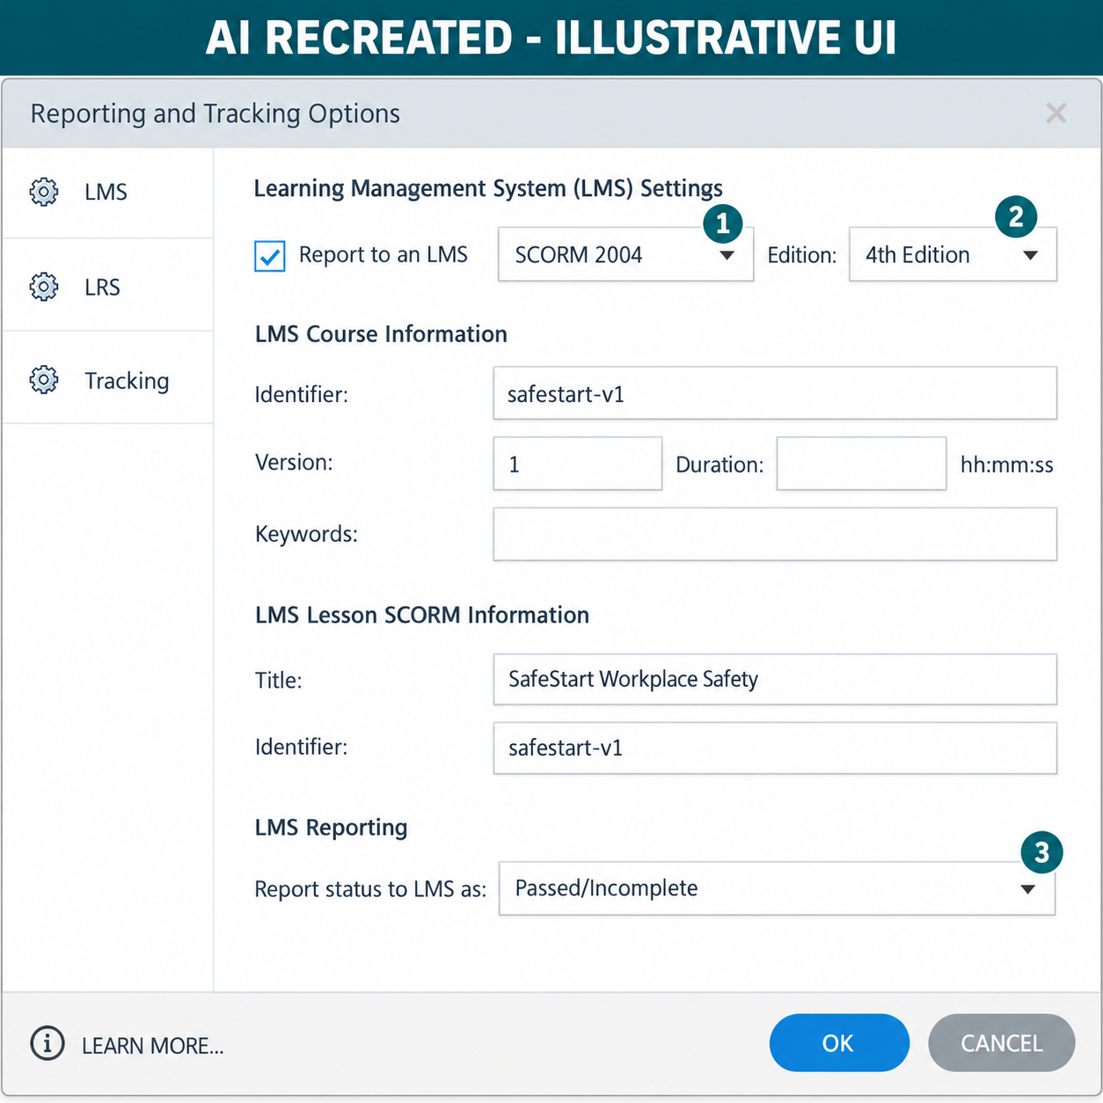
AUTHENTIC ARTICULATE UI
Activity 13 · Interface Reference
Locate
Use this authentic interface capture to find the named…
Set
Select `xAPI (Tin Can API)` and enter the approved stable…
Verify
No credential appears in the package.
Evidence
Capture one final-state screenshot for the task; this…
© 2026 Tertiary Infotech Academy Pte Ltd · Mastering Articulate Storyline 360 for e-Learning Content Creation · TGS-2024042308
Articulate official product guidance
414

Slide 415
EDITABLE TECHNICAL MODEL
Activity 13 · Artifact Model
Artifact
Purpose
HarbourLink-WSH-Checkpoint-13-YourName.story
Prepare an xAPI package without embedded secrets and complete regression evidence.
Scenario input
Required output
HarbourLink annual WSH refresher; picture-first content, narration, captions, keyboard access and five-question 80% practice quiz.
No credential appears in the package.
Control point
Readback
Activity identifier is stable and recorded.
Retain the named .story checkpoint, the completed self-check table and one screenshot for each task showing the final state or setting that proves the acceptance criteria.
© 2026 Tertiary Infotech Academy Pte Ltd · Mastering Articulate Storyline 360 for e-Learning Content Creation · TGS-2024042308
415

Slide 416
EDITABLE TECHNICAL MODEL
Activity 13 · Runtime State Trace
Initial state
Input
Open with declared defaults and no prior test residue.
Use the named WSA asset, learner decision or publish setting.
Control
Stored state
No credential appears in the package.
Activity identifier is stable and recorded.
Runtime output
Boundary
Statement evidence or honest blocker is retained.
Release package is reproducible.
© 2026 Tertiary Infotech Academy Pte Ltd · Mastering Articulate Storyline 360 for e-Learning Content Creation · TGS-2024042308
416

Slide 417
EDITABLE TECHNICAL MODEL
Activity 13 · Worked Failure Case
Expected
Incomplete
No credential appears in the package.
Fail when: Activity identifier is stable and recorded. is not demonstrated.
Repeat
Access
Repeat/revisit must preserve: Statement evidence or honest blocker is retained.
Release package is reproducible.
Recovery
Log
Correct the named setting in the next checkpoint, then rerun the same case.
Record expected, actual, pass/fail and corrected version.
© 2026 Tertiary Infotech Academy Pte Ltd · Mastering Articulate Storyline 360 for e-Learning Content Creation · TGS-2024042308
417

Slide 418
EDITABLE TECHNICAL MODEL
Activity 13 · Evidence Record
Source
Evidence rule
HarbourLink-WSH-Checkpoint-13-YourName.story
One decisive learner screenshot per task.
Setting evidence
Runtime evidence
No credential appears in the package.
Activity identifier is stable and recorded.
Regression evidence
Retention
Release package is reproducible.
Retain the named .story checkpoint, the completed self-check table and one screenshot for each task showing the final state or setting that proves the acceptance criteria.
© 2026 Tertiary Infotech Academy Pte Ltd · Mastering Articulate Storyline 360 for e-Learning Content Creation · TGS-2024042308
418

Slide 419
AUTHENTIC ARTICULATE UI
Activity 13 · Verify the Panel
Named setting
Track the quiz Results slide and record the selected…
Expected output
No credential appears in the package.
Boundary
Release package is reproducible.
Own evidence
Show the learner-created checkpoint and final setting, not…
© 2026 Tertiary Infotech Academy Pte Ltd · Mastering Articulate Storyline 360 for e-Learning Content Creation · TGS-2024042308
Articulate official product guidance
419

Slide 420
EXPECTED VERSUS ACTUAL
Activity 13 · Test Matrix
Case 1
Case 2
No credential appears in the package.
Activity identifier is stable and recorded.
Case 3
Case 4
Statement evidence or honest blocker is retained.
Release package is reproducible.
Revisit
Record
Navigate away and back; compare actual state with the specified revisit rule.
Log expected, actual, pass/fail, defect owner and corrected checkpoint filename.
© 2026 Tertiary Infotech Academy Pte Ltd · Mastering Articulate Storyline 360 for e-Learning Content Creation · TGS-2024042308
420

Slide 421
HANDS-ON APPLICATION · TOPIC 4
Activity 14 · Independent Mini Capstone
Independently create a small original e-learning module from a new blank project and present verified evidence.
1
2
3
4
5
Analyse
Choose
Apply
Inspect
Evidence
EVIDENCE
Retain the named .story checkpoint, the completed self-check table and one screenshot for each task showing the final state or setting that proves the acceptance criteria.
Full click-by-click procedure · Learner Guide / Activity 14
© 2026 Tertiary Infotech Academy Pte Ltd · Mastering Articulate Storyline 360 for e-Learning Content Creation · TGS-2024042308
421

Slide 422
EDITABLE TECHNICAL MODEL
Activity 14 · Artifact Model
Artifact
Purpose
Capstone-YourName-v01.story
Independently create a small original e-learning module from a new blank project and present verified evidence.
Scenario input
Required output
Own learning topic; blank project; original narration, interaction, quiz and standards package.
Original blank project and brief are evident.
Control point
Readback
Required Storyline mechanisms work together.
Retain the named .story checkpoint, the completed self-check table and one screenshot for each task showing the final state or setting that proves the acceptance criteria.
© 2026 Tertiary Infotech Academy Pte Ltd · Mastering Articulate Storyline 360 for e-Learning Content Creation · TGS-2024042308
422

Slide 423
EDITABLE TECHNICAL MODEL
Activity 14 · Runtime State Trace
Initial state
Input
Open with declared defaults and no prior test residue.
Use the named WSA asset, learner decision or publish setting.
Control
Stored state
Original blank project and brief are evident.
Required Storyline mechanisms work together.
Runtime output
Boundary
Accessibility and test evidence are complete.
Capstone is labelled separately from formal PP.
© 2026 Tertiary Infotech Academy Pte Ltd · Mastering Articulate Storyline 360 for e-Learning Content Creation · TGS-2024042308
423

Slide 424
EDITABLE TECHNICAL MODEL
Activity 14 · Worked Failure Case
Expected
Incomplete
Original blank project and brief are evident.
Fail when: Required Storyline mechanisms work together. is not demonstrated.
Repeat
Access
Repeat/revisit must preserve: Accessibility and test evidence are complete.
Capstone is labelled separately from formal PP.
Recovery
Log
Correct the named setting in the next checkpoint, then rerun the same case.
Record expected, actual, pass/fail and corrected version.
© 2026 Tertiary Infotech Academy Pte Ltd · Mastering Articulate Storyline 360 for e-Learning Content Creation · TGS-2024042308
424

Slide 425
EDITABLE TECHNICAL MODEL
Activity 14 · Evidence Record
Source
Evidence rule
Capstone-YourName-v01.story
One decisive learner screenshot per task.
Setting evidence
Runtime evidence
Original blank project and brief are evident.
Required Storyline mechanisms work together.
Regression evidence
Retention
Capstone is labelled separately from formal PP.
Retain the named .story checkpoint, the completed self-check table and one screenshot for each task showing the final state or setting that proves the acceptance criteria.
© 2026 Tertiary Infotech Academy Pte Ltd · Mastering Articulate Storyline 360 for e-Learning Content Creation · TGS-2024042308
425

Slide 426
EXPECTED VERSUS ACTUAL
Activity 14 · Test Matrix
Case 1
Case 2
Original blank project and brief are evident.
Required Storyline mechanisms work together.
Case 3
Case 4
Accessibility and test evidence are complete.
Publishing choice matches the target.
Case 5
Revisit
Capstone is labelled separately from formal PP.
Navigate away and back; compare actual state with the specified revisit rule.
Record
Log expected, actual, pass/fail, defect owner and corrected checkpoint filename.
© 2026 Tertiary Infotech Academy Pte Ltd · Mastering Articulate Storyline 360 for e-Learning Content Creation · TGS-2024042308
426

Slide 427
WSA ACCEPTANCE MODEL
Topic 4 Checkpoint
Source
SCORM
xAPI
HarbourLink-WSH-Checkpoint-13-YourName.story
1.2 and supported 2004 edition; manifest at ZIP root
Actor/endpoint/auth supplied at launch
Cadence
Release
Evidence
Day0, Day3/7, Day10; stop on completion
Source + settings + checksum + sandbox log
Score/status/resume or honest blocked-test record
© 2026 Tertiary Infotech Academy Pte Ltd · Mastering Articulate Storyline 360 for e-Learning Content Creation · TGS-2024042308
427

Slide 428
COURSE SYNTHESIS
HarbourLink WSH Release Record
Source
Tracking
Package
HarbourLink-WSH-Checkpoint-13-YourName.story
Quiz Result only; classroom quiz 5 questions, 80%
SCORM/xAPI ZIP checksum recorded
Runtime
Cadence
Review
Fail, pass, bookmark, resume and session-time log
Day0 launch; Days3/7 reminders; Day10 escalation
180-day owner review event
© 2026 Tertiary Infotech Academy Pte Ltd · Mastering Articulate Storyline 360 for e-Learning Content Creation · TGS-2024042308
428

Slide 429
CONTENT GOVERNANCE
HarbourLink WSH Media Attribution
Register
Fields
Generated row
activities/source/media-attribution.json
file · kind · owner · source_page · accessed
warehouse-seven-hazards.png · AI-generated fictional scene
Official row
Use
Check
official-caption-editor.png · Articulate support source
Training orientation; official capture is not learner evidence
File hash and source URL retained with release
© 2026 Tertiary Infotech Academy Pte Ltd · Mastering Articulate Storyline 360 for e-Learning Content Creation · TGS-2024042308
v11 asset register
429

Slide 430
PROVENANCE
HarbourLink WSH Generated Asset Review
Asset
Purpose
Check
warehouse-seven-hazards.png
Fictional unsafe warehouse for seven-target inspection
Seven named hazards visible; no accidental text/logo
Access
Boundary
Record
Instructional alt text + numbered keyboard controls
No compliance or real-site claim
Prompt/provenance entry retained in asset register
© 2026 Tertiary Infotech Academy Pte Ltd · Mastering Articulate Storyline 360 for e-Learning Content Creation · TGS-2024042308
430

Slide 431
A7 · EXECUTION CONTROL
Review 360 Comment Record
Comment ID
Finding
Owner
R01
Caption covers Next at phone-width player
Storyline author
Due
Status
Acceptance
Before package regression
Open → corrected → resolved
Caption clear of control; keyboard path retested
© 2026 Tertiary Infotech Academy Pte Ltd · Mastering Articulate Storyline 360 for e-Learning Content Creation · TGS-2024042308
431

Slide 432
AFTER THE COURSE
Support
Email
Telephone
Portal
enquiry@tertiaryinfotech.com
+65 6100 0613
https://lms-tms.tertiaryinfotech.com/
Provider
Website
Privacy
Tertiary Infotech Academy Pte Ltd
www.tertiarycourses.com.sg
Do not send assessment content publicly.
© 2026 Tertiary Infotech Academy Pte Ltd · Mastering Articulate Storyline 360 for e-Learning Content Creation · TGS-2024042308
432

Slide 433
WA + PP
Final Assessment
1
2
3
4
5
Briefing
→
WA · 60 min
→
Transition
→
PP · 60 min
→
Submit
OUTCOME
Complete your own open-book evidence and upload the provided documents through LMS-TMS when instructed.
© 2026 Tertiary Infotech Academy Pte Ltd · Mastering Articulate Storyline 360 for e-Learning Content Creation · TGS-2024042308
433

Slide 434
COMPETENCY SIGN-OFF
Assessment Flow
1
2
3
4
5
TRAQOM
→
Assessment attendance
→
WA then PP
→
Submit LMS
→
Sign summary record
OUTCOME
Complete TRAQOM, digital assessment attendance, WA then PP, LMS submission and the Assessment Summary Record in this exact order.
© 2026 Tertiary Infotech Academy Pte Ltd · Mastering Articulate Storyline 360 for e-Learning Content Creation · TGS-2024042308
434

Slide 435
CLOSING ADMIN
Digital Attendance · Mandatory
Assessment event
Verification
Feedback
Complete the official assessment attendance.
Remain until the trainer verifies the record.
Use the official LMS-TMS/TRAQOM route after attendance.
© 2026 Tertiary Infotech Academy Pte Ltd · Mastering Articulate Storyline 360 for e-Learning Content Creation · TGS-2024042308
435

Slide 436
Thank You
Design with intent · build accessibly · verify every path
© 2026 Tertiary Infotech Academy Pte Ltd · Mastering Articulate Storyline 360 for e-Learning Content Creation · TGS-2024042308
436

